Slide 1

Ministri of defence of the republic of slovenija
Directorate for War Veterans and Military Heritage
Sector for War Graves and Gravesites

Slide 2
Directorate for War Veterans and Military Heritage
The Directorate was established on 1 May 2024. It took over all the tasks of the Administration of the Republic of Slovenia for Military Heritage, which had operated since June 2021 as a body within the Ministry of Defence. We assumed tasks in the field of military heritage.
The Directorate consists of:
Sector for War Graves and Gravesites
Sector for War Veterans, War Invalids and Victims of War Violence
Sector for the Implementation of Transfers to War Invalids, War Veterans and Victims of War Violence
Military Museum of the Slovenian Armed Forces in Maribor – Kadetnica (1850–1852)

Slide 3
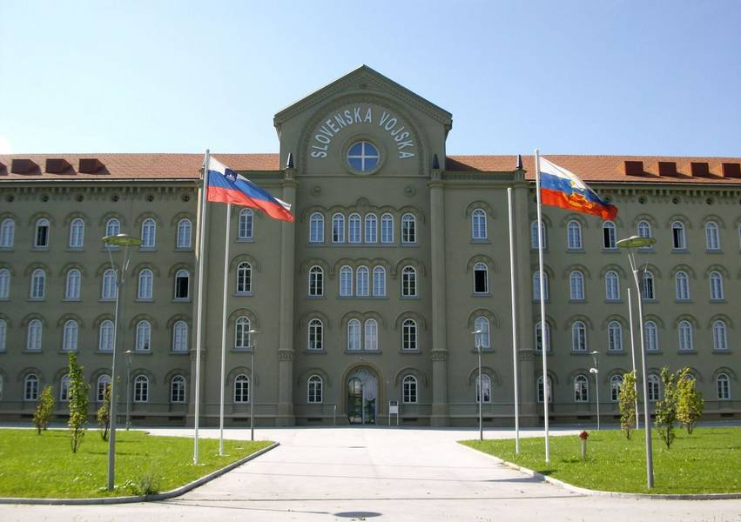

Slide 4
Sector for War Graves and Gravesites
Protection of War Graves
Carries out tasks of management and maintenance of war graves and concealed war graves.
Management = the long-term responsibility of the state, which implements legal and administrative measures and provides financial resources for the protection of war graves.
Maintenance = implementation of regular upkeep of war graves, emergency interventions, and major investment interventions.
Keeping the Register of War Graves and the Records of Concealed War Graves.
Updating the Information Database of War Graves – DEDIVOJ. This is a project obtained under the call for projects (RDI) – research, development, and innovation within NATO.

Slide 5
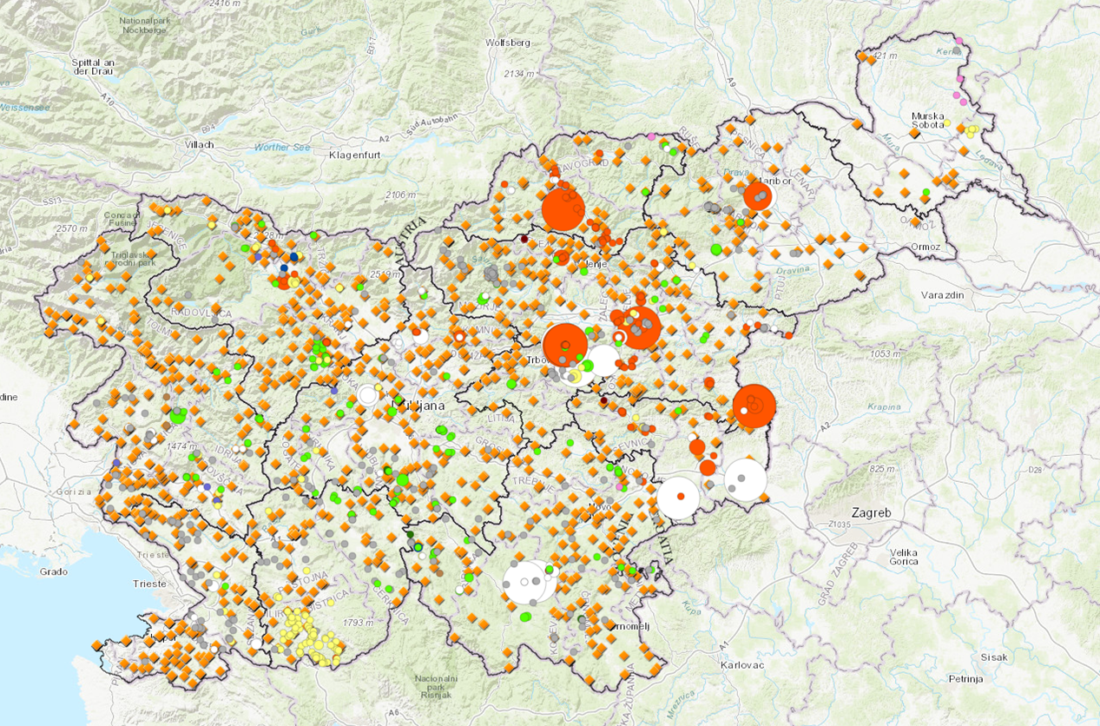

Slide 6
Support to the Commission of the Government of the Republic of Slovenia for resolving issues of concealed war graves.
Issuing permits for exhumations, explorations, and other interventions at war graves.
Participation in procedures for the adoption of spatial plans.
International cooperation.
Support and financial assistance to the Walks of Peace Foundation in the Soča Region, which preserves the cultural and historical heritage of the First World War.
Providing assistance to relatives of victims in their search for the remains of their loved ones.
(DNA analyses, transport of remains to cemeteries, erection of memorials).

Slide 7
Legal Basis for the Protection of War Graves
in the Republic of Slovenia and of war graves of Slovenian victims abroad are:
The War Graves Act, The Concealed War Graves and Burial of Victims Act, other special laws, The Geneva Conventions and International and bilateral agreements concluded with eight countries relating to the maintenance of war graves:
Italy, Croatia, Hungary, Germany, Czech Republic, Slovakia, Romania and the Russian Federation (currently the agreement is suspended).
All signatory states must respect Slovenian legislation and the protocol for handling human remains, and vice versa. Very important is the mutual exchange of information on the discovery and protection of human remains and the search for common solutions.

Slide 8
War Graves Act of 2003
= 1,300 gravesites from World War I and World War II
War graves
are by law the gravesites of soldiers, prisoners of war, victims of wars, and gravesites of persons executed after the war (after May 15, 1945).
They may be arranged as cemeteries, burial fields, tombs, ossuaries, and as individual graves.

Slide 9
Act on Concealed War Graves and the Burial of Victims of 2015
= almost 800 gravesites of victims of wartime and post-war executions of World War II
(after May 15, 1945)
Concealed war graves
These are intentionally concealed gravesites, which began to be intensively uncovered after 1991.
Most are located in hard-to-reach areas or in karst caves and abyss.

Slide 10
Financing
Regular budget financing
Permanent budget funds of the Republic of Slovenia are allocated to the Ministry of Defence and amount to about EUR 2 million under both budget items:
1. war graves
2. concealed war graves

Slide 11
Funds are allocated for:
maintenance of existing war graves and gravesites: regular and emergency maintenance
thorough, comprehensive renovations of war graves and gravesites
research and documentation of concealed gravesites
arrangement, marking, and erection of memorials
professional research (historical, archaeological, forensic)
cooperation with local communities and non-governmental organizations

Slide 12
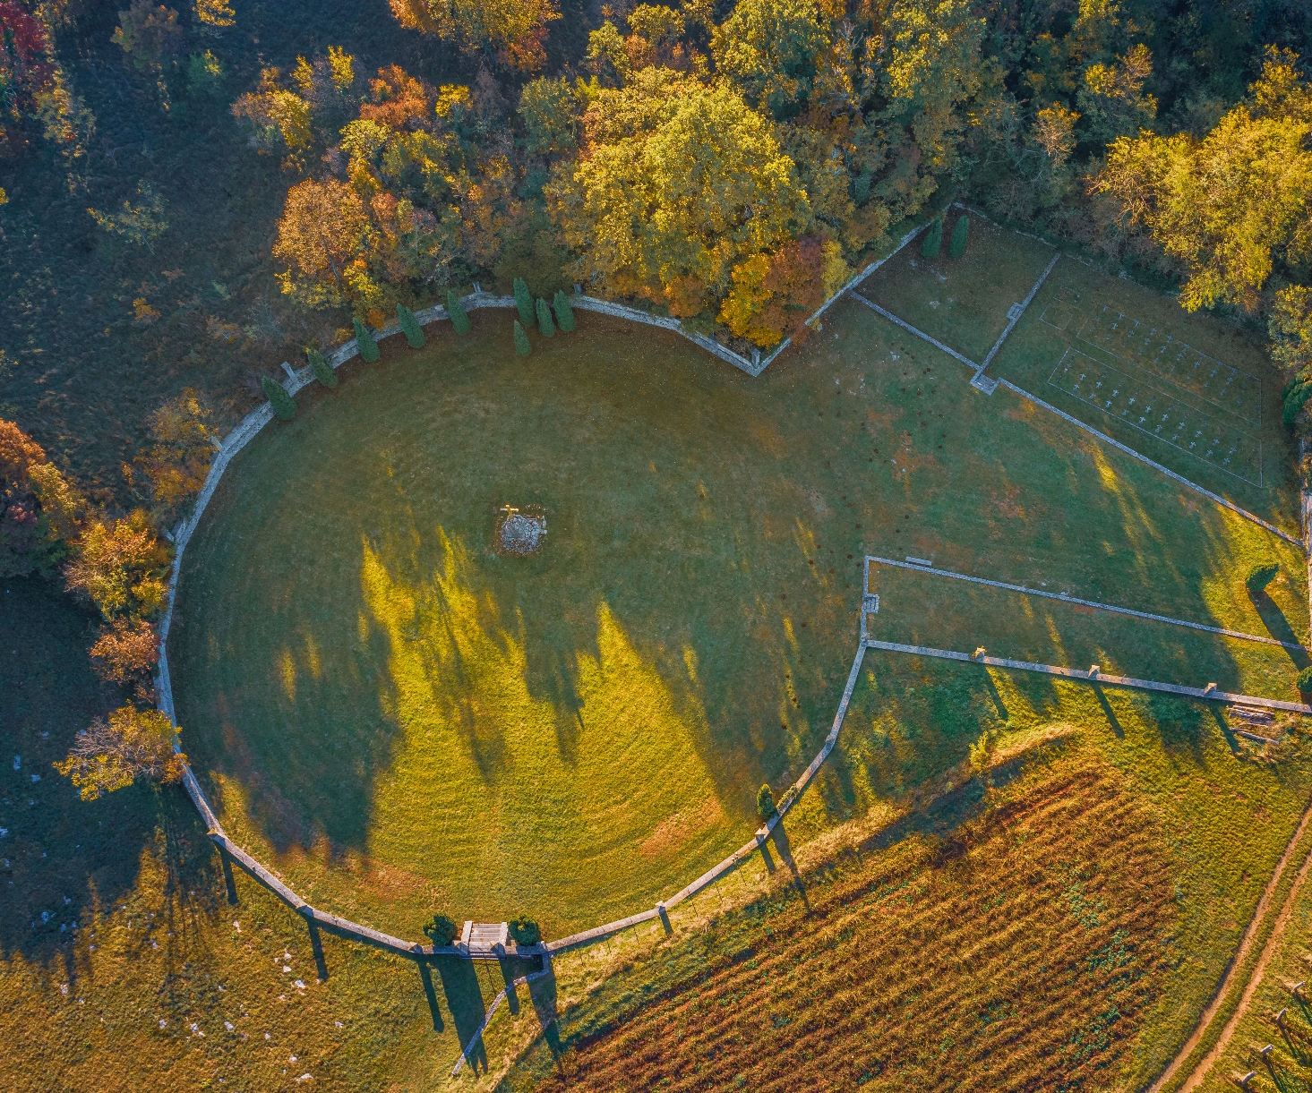

Slide 13
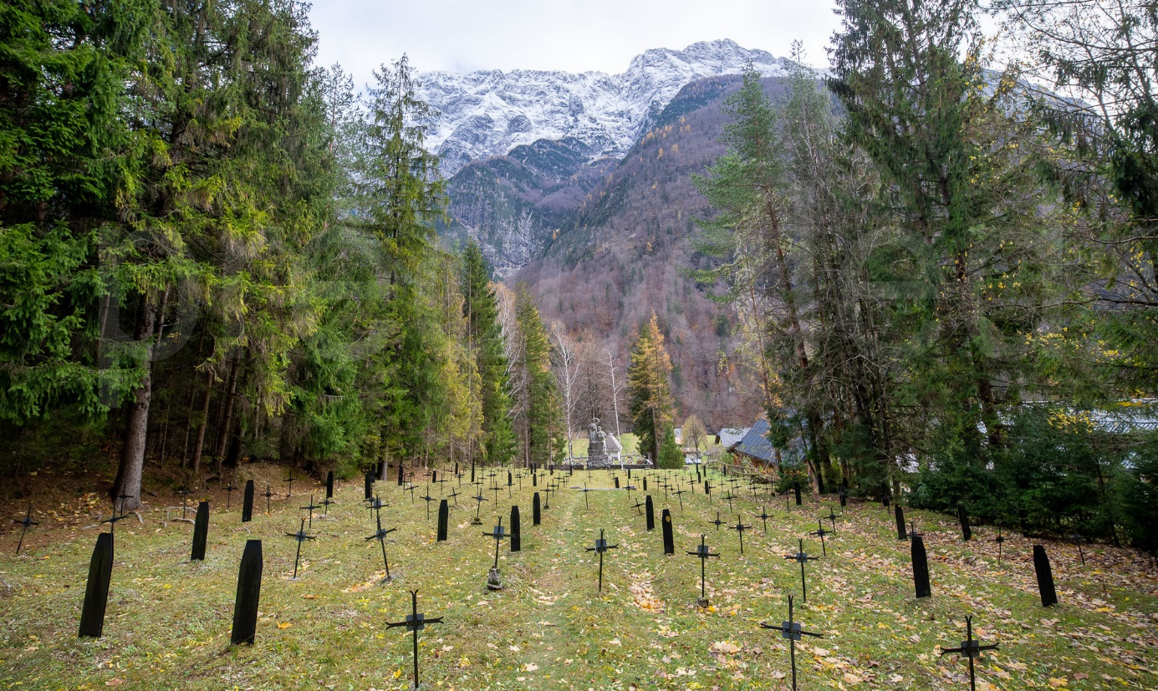
Log pod Mangrtom, Grobišče I. svetovne vojne

Slide 14
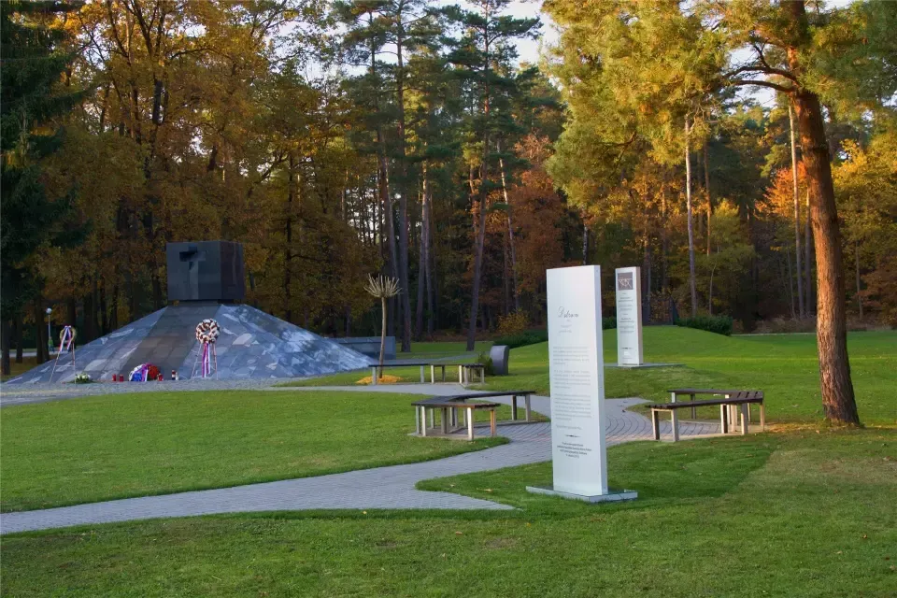
.

Slide 15
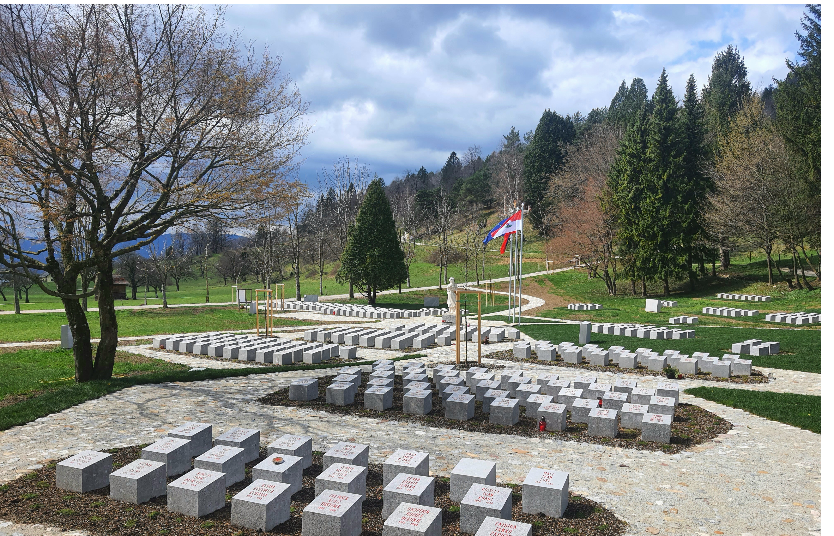

Slide 16
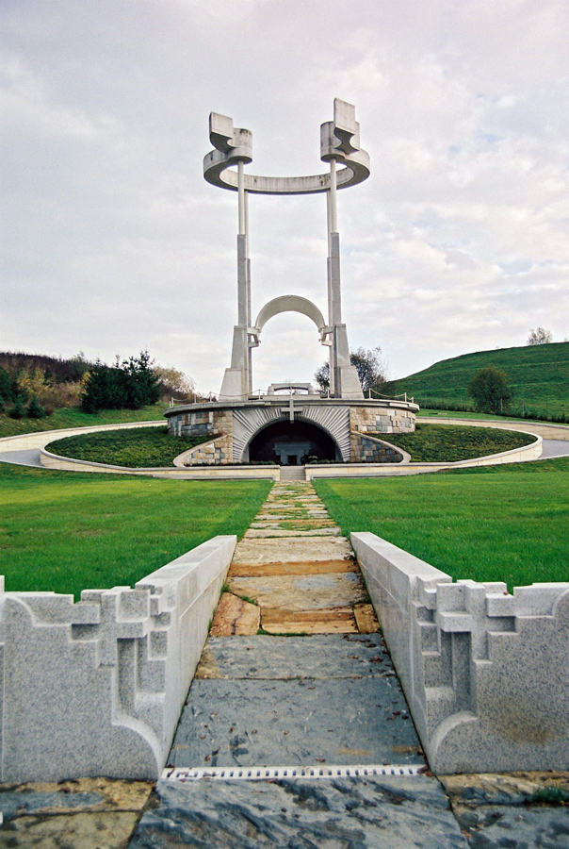
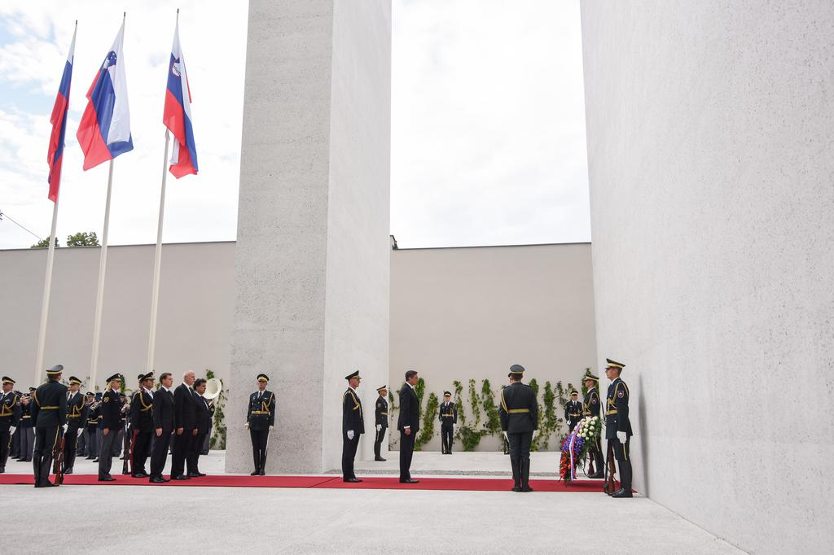

Slide 17
Completed projects and plans for the future

Slide 18
Concealed war grave of post-war executions
Cave under Macesnova gorica – Kočevski Rog
Monument of cultural significance (2008)
Report: 3,450 victims were exhumed, men, most older than 23 years; there were no children under 15 among the victims.
Today, this is an arranged memorial site where the relatives of the victims can pay their respects, pray, and light candles for the deceased.

Slide 19
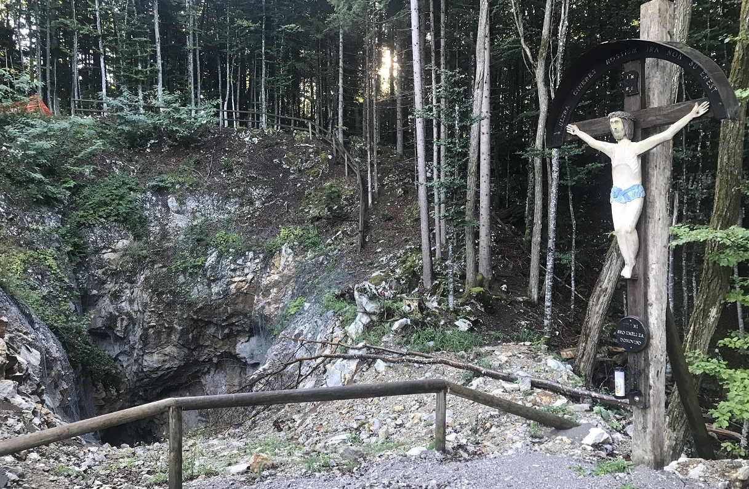
Jama pod Macesnovo gorico

Slide 20
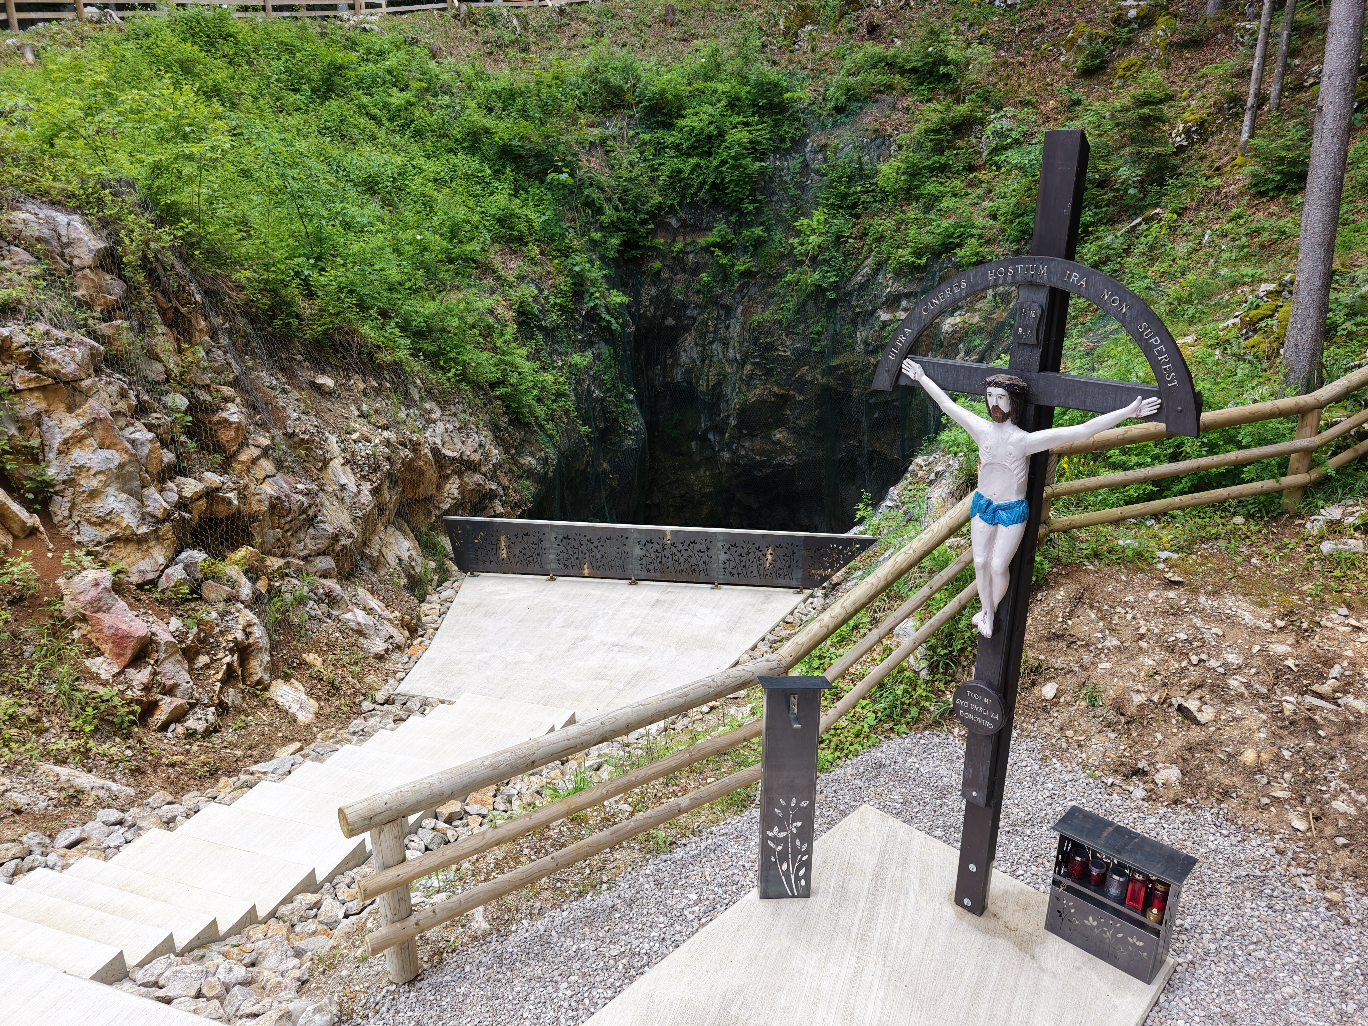

Slide 21
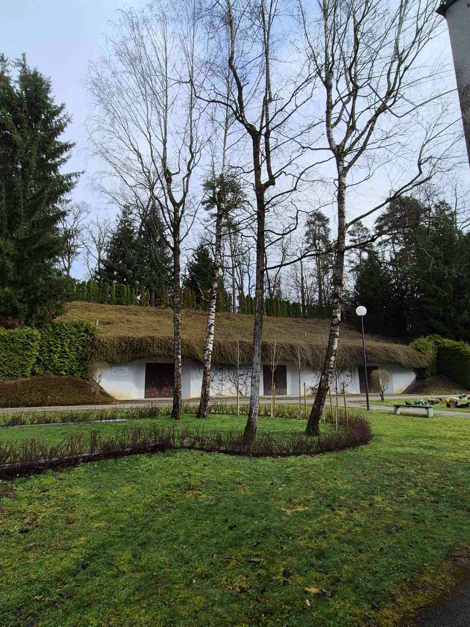
April 2025 – Transfer of the remains of victims from the Cave under Macesnova Gorica in Kočevje to the Škofja Loka Ossuary for temporary storage until their final burial.

Slide 22
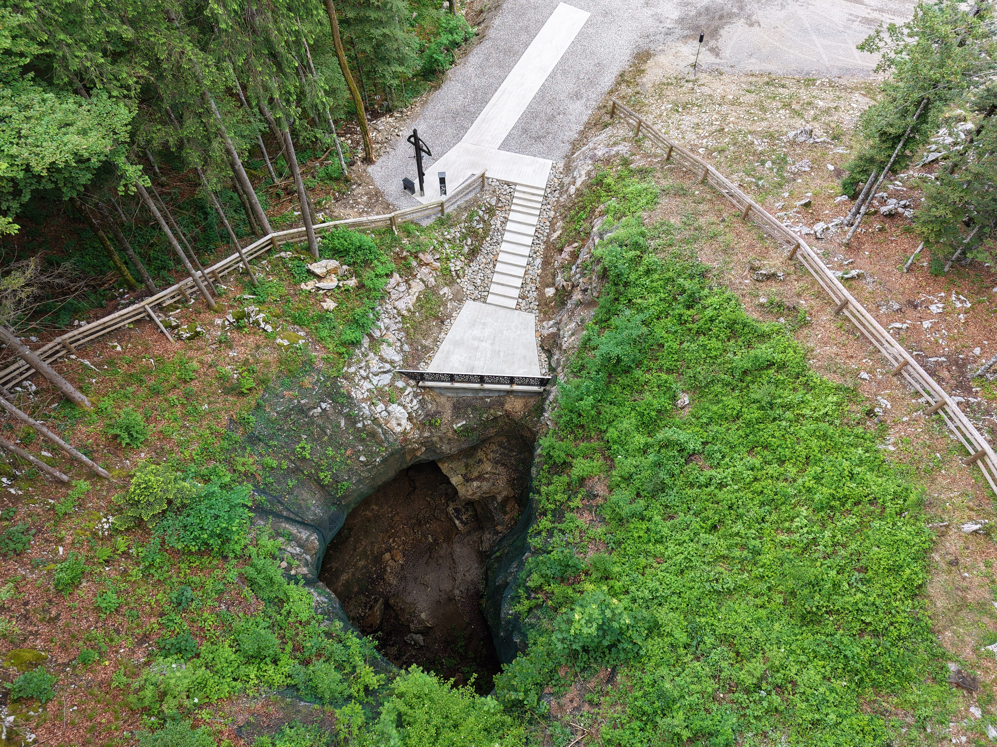

Slide 23
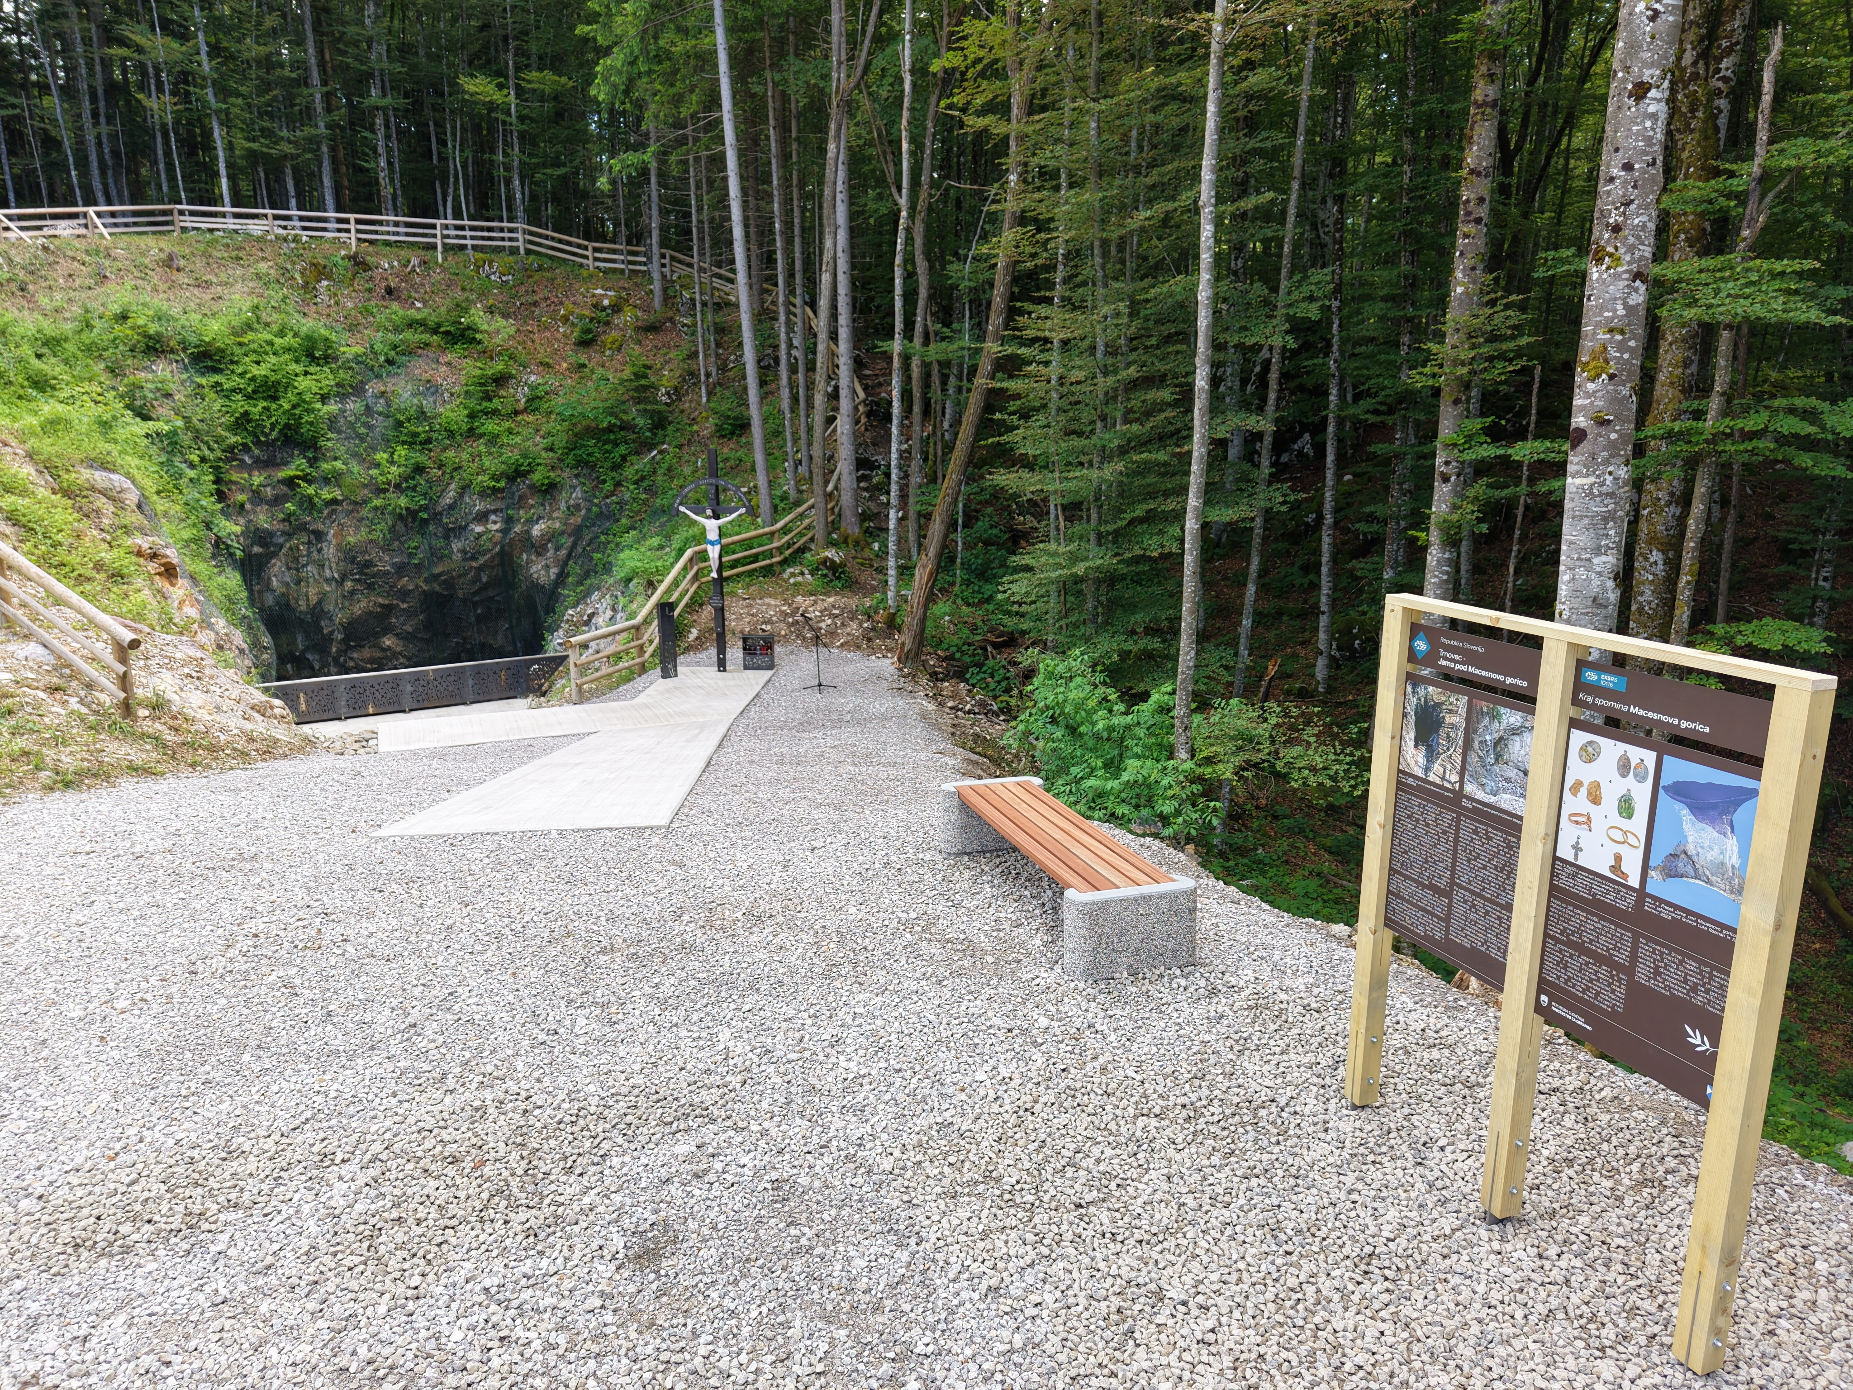

Slide 24
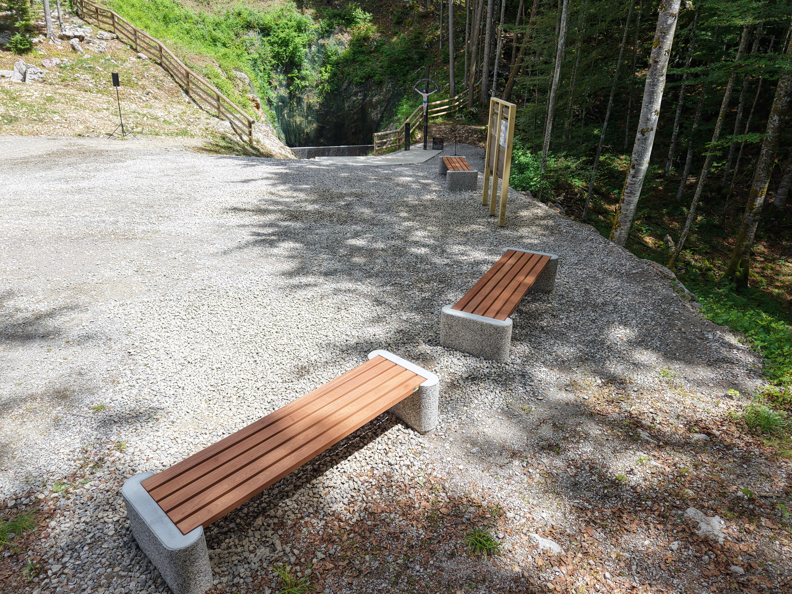

Slide 25
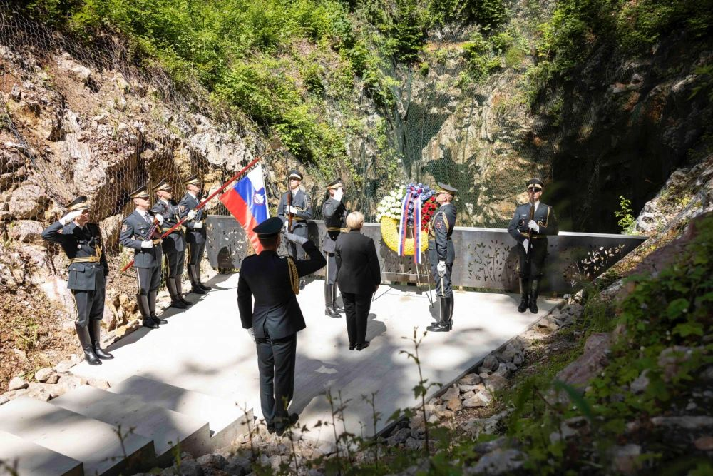

Slide 26
Other major projects in 2025, completed or in the final phase of comprehensive renovation:
Memorial Park and War Cemetery Kampor on the Croatian island of Rab, the site of an Italian camp during World War II.
Renovation of the 3 largest and several smaller Partisan gravesites across Slovenia.

Slide 27
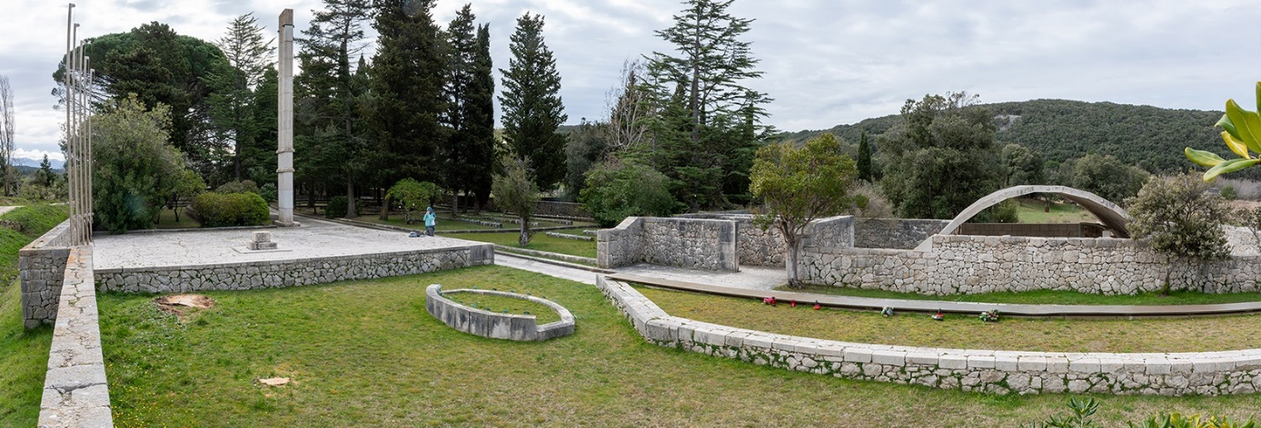
Konec leta 2024 zaključujemo z obnovitveno - restavratorskimi deli na vojnem grobišču in spominskem parku Kampor na Rabu.

Slide 28
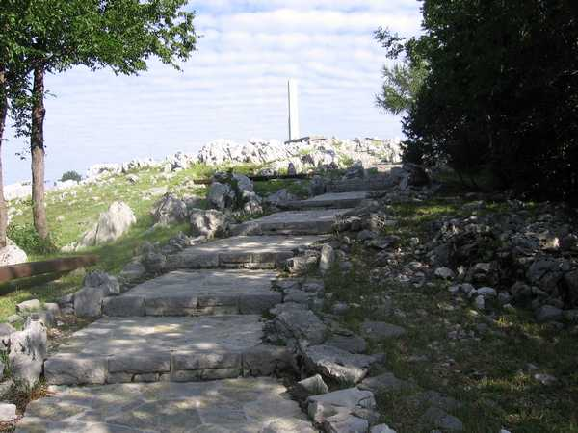
Obnova partizanskega grobišča Trnovo nad Novo Gorico v letu 2025

Slide 29
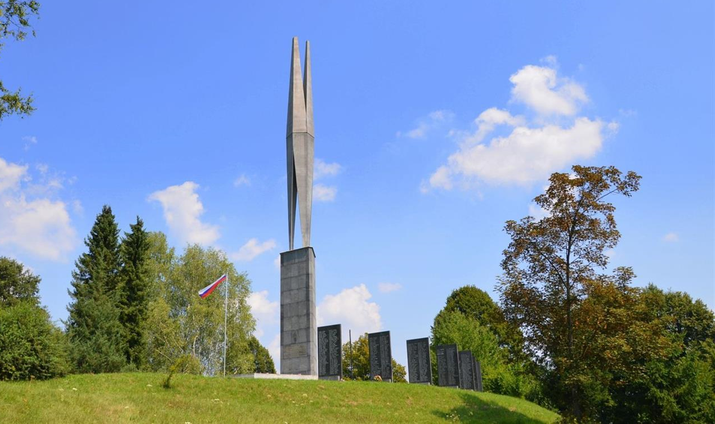
Obnova partizanskega grobišča Cvibelj, Žužemberk v letu 2025

Slide 31
The largest planned multi-year project:
Ossuary of World War I at the central cemetery in Ljubljana
The remains of 5,258 victims of the First World War were transferred to the ossuary from various locations. The ossuary contains 35 officers and 4,701 soldiers of the Austro-Hungarian army, 342 Russian prisoners of war, 80 Romanian, and 79 Serbian prisoners of war. A comprehensive renovation will be carried out according to the guidelines of the Slovenian Institute for the Protection of Cultural Heritage. From a financial perspective, this will be a very expensive but absolutely necessary investment.

Slide 32
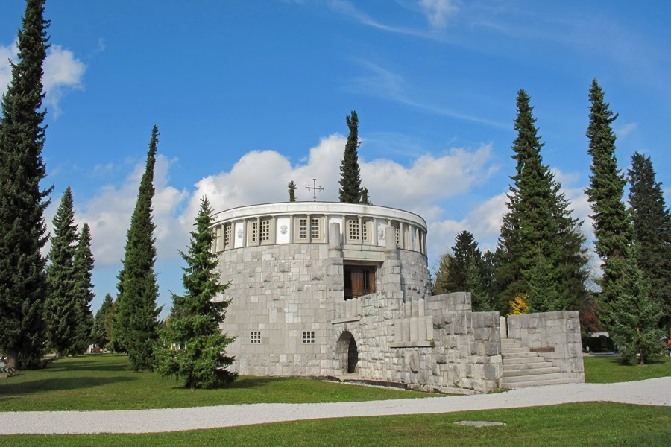
Začetek obnove kostnice I. svetovne vojne na Žalah v letu 2025

