Slide 1


WAR GRAVES
SLOVAKIA
Mgr. Martin Drobňák

Slide 2

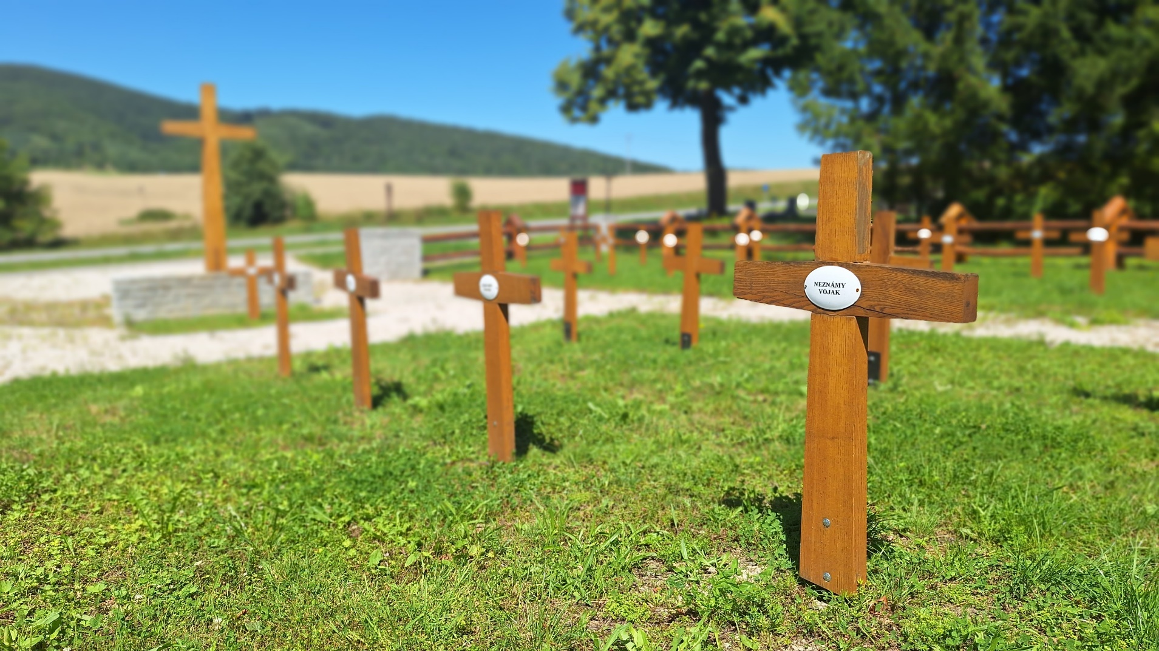
Main goals
care for war graves and memorials
evidence

Slide 3
Until 2001, the Slovak Republic did not have a law defining what a war grave is and what the term “care of a war grave” means. The first such law was passed in 2001. We are currently governed by Act No. 130 of 2005.
This law defines what a war grave is: it refers not only to a grave, but also to a memorial site for war (e.g., a memorial).

Slide 4
The care of war graves in Slovakia is provided by municipalities and towns. The state gives them money for this activity. In 2025, this amounted to approximately €23 per war grave. In total, we allocated almost half a million euros to municipalities and towns.
In addition, we allocated approximately €70,000 to projects involving the repair of war graves and cemeteries.

Slide 5

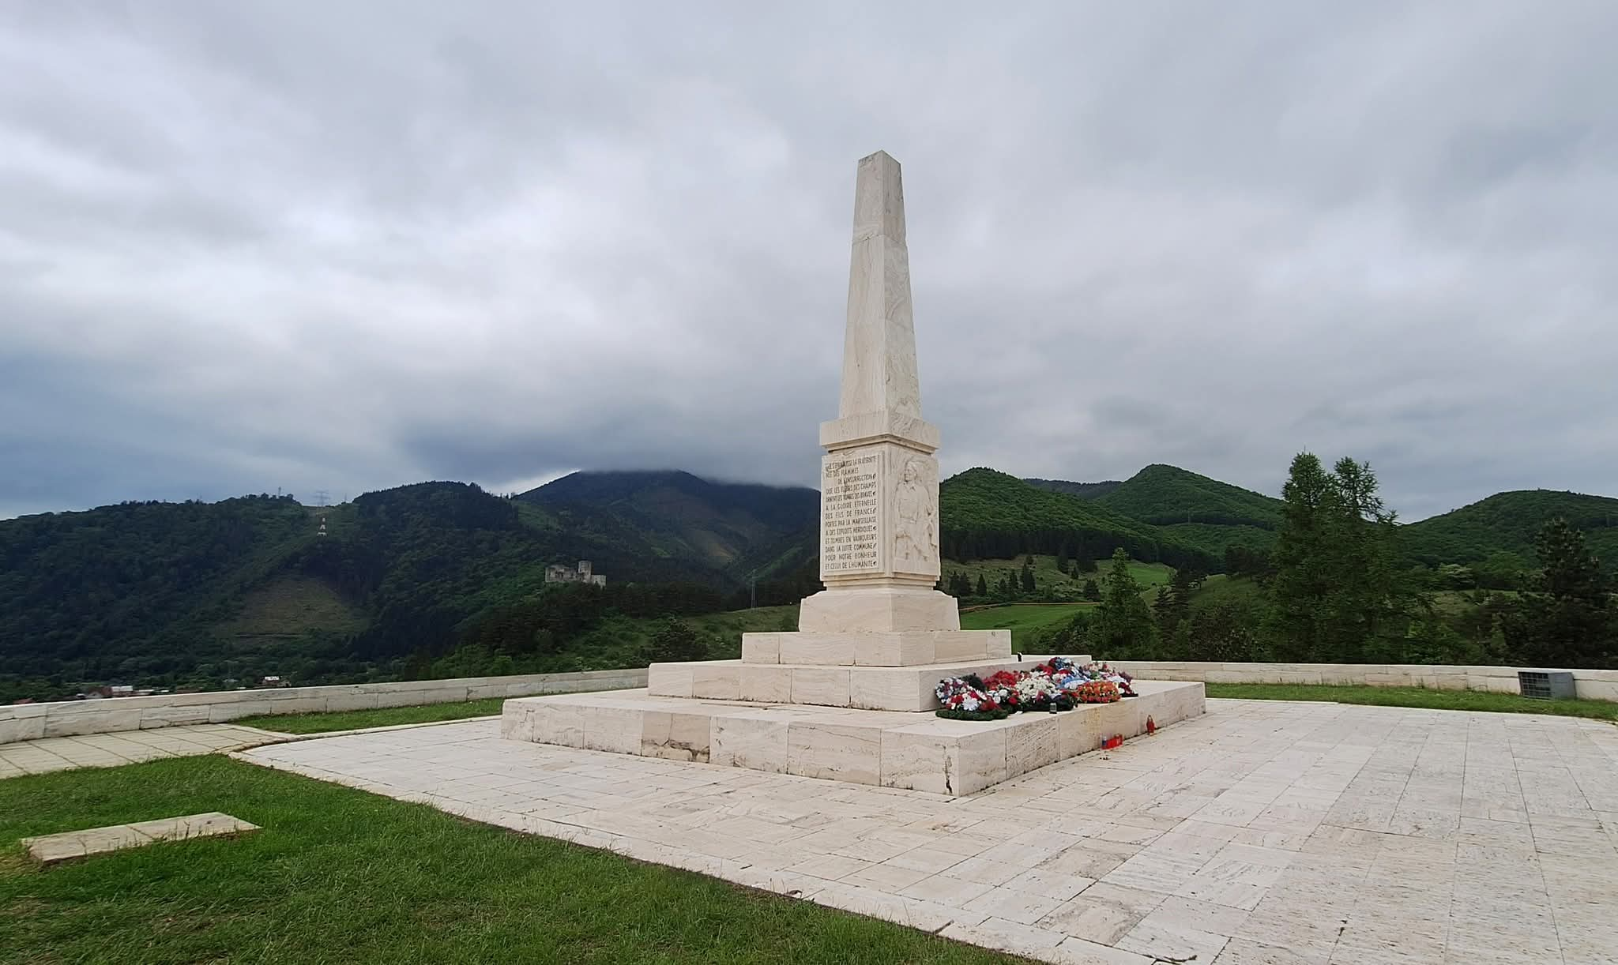
POSKYTOVANIE PROSTRIEDKOV PODĽA ODSEKU 1
2025
23,45 €
487 666,20 €

Slide 6
Our ministry also keeps records of fallen soldiers. Currently, there are more than 36,000 entries in the register. However, this register has many shortcomings. Our big task is to fill the register with new data. According to our estimates, we should have more than 200,000 records in the database. I am talking about those who fell in World War I and II and are buried in Slovakia. But also about Slovak soldiers in many countries. This is a challenge for the near future.

Slide 7
EVIDENCIA VOJNOVÝCH HROBOV
60 000
SLOVENSKO
70 000
Slováci na bojiskách
1914-198
WW1
60 000 ČA
1 700
1. ČSAZ
WW2
Tisíce civilných obetí
1 300 Vojakov Slovenskej armády na východnom fronte
11 000
Rumunská kráľovská armáda
15 000
Nemecká armáda
1 500
Padlých počas SNP
Domáci a zahraničných odboj

Slide 8

250 000
ÚEVH
$$more than$$
30 000
ÚEVH
𝑚𝑜𝑟𝑒 𝑡ℎ𝑎𝑛
30 000
research and identification of fallen soldiers

Slide 9
Mgr. Martin Drobňák
martin.drobnak@minv.sk

