Slide 1
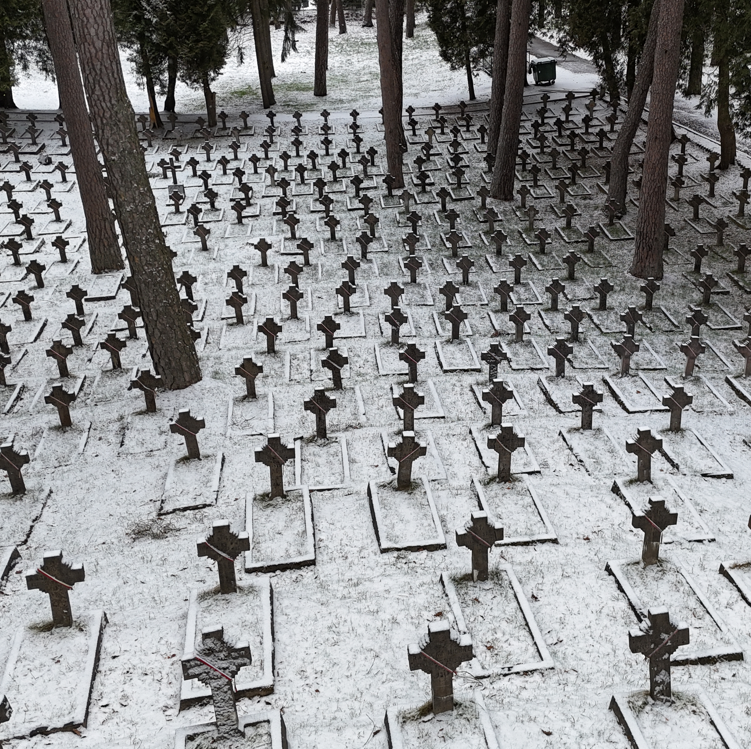

WAR GRAVES
OUR WORK
OUR MISSION
Notes:
I would like to remind you that the Polish Ministry of Culture and National Heritage took over responsibility for the care of war graves after the Council for the Protection of Memory of Combat and Martyrdom was dissolved in 2016. Certain tasks (duties) related to exhumation works are carried out by the Polish Institute of National Remembrance (IPN), as our host is well aware. Due to time limits, I will present only a few projects that we have completed so far. I will briefly discuss the opportunities and challenges ahead, as well as our plans for the future and the need for cooperation. I will start with projects completed in Poland.

Slide 2
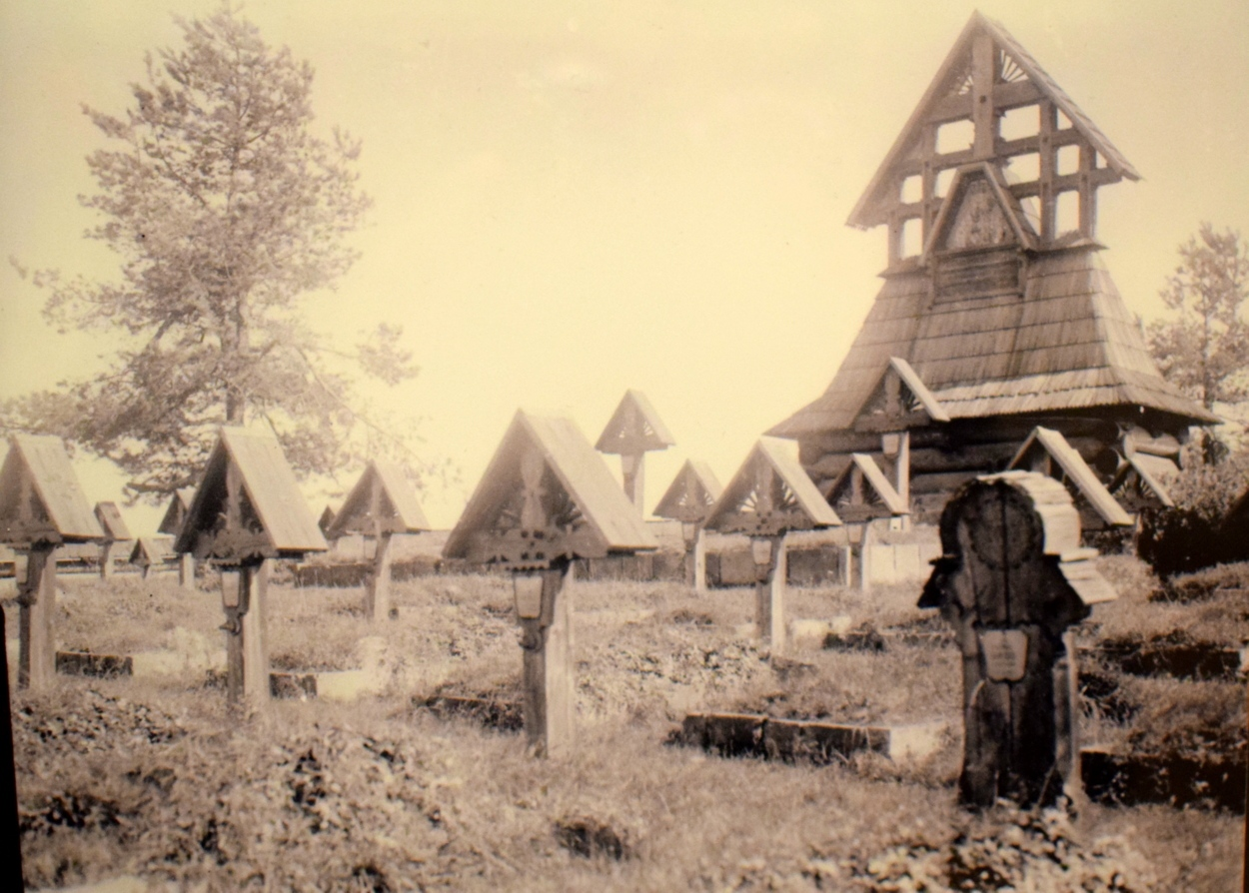
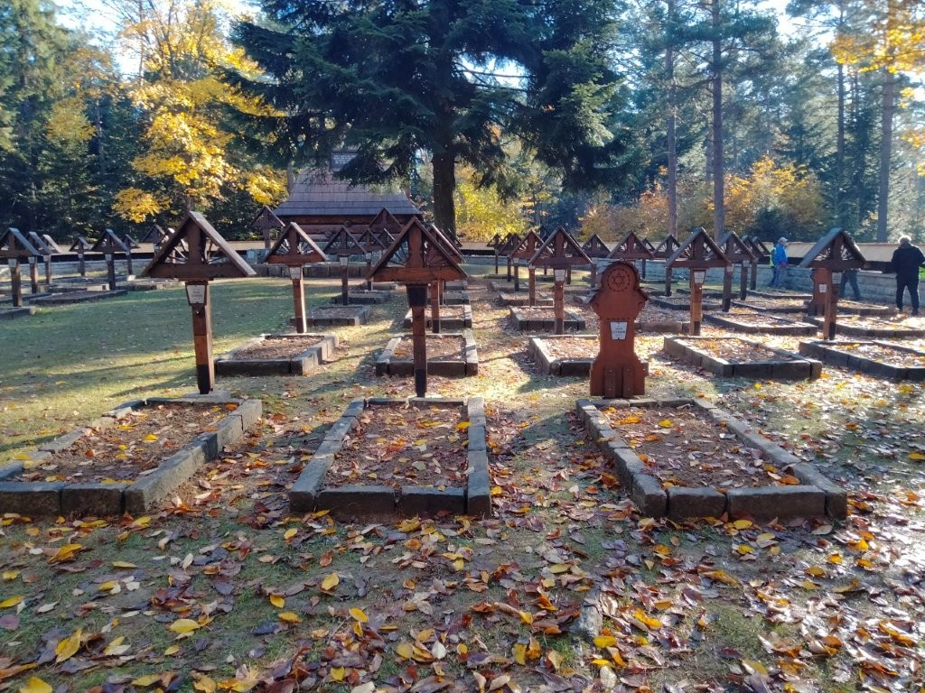
Conservation and reconstruction works in Poland
Austro-Hungarian War Cemetery No. 60 at the Małastowska Pass
Notes:
Our main goal was to restore the cemetery to its original condition and protect this historical monument from destruction. In accordance with the recommendations of the Provincial Conservator of Monuments, conservation work was also carried out on the wooden chapel, which is the focal point of the cemetery.

Slide 3
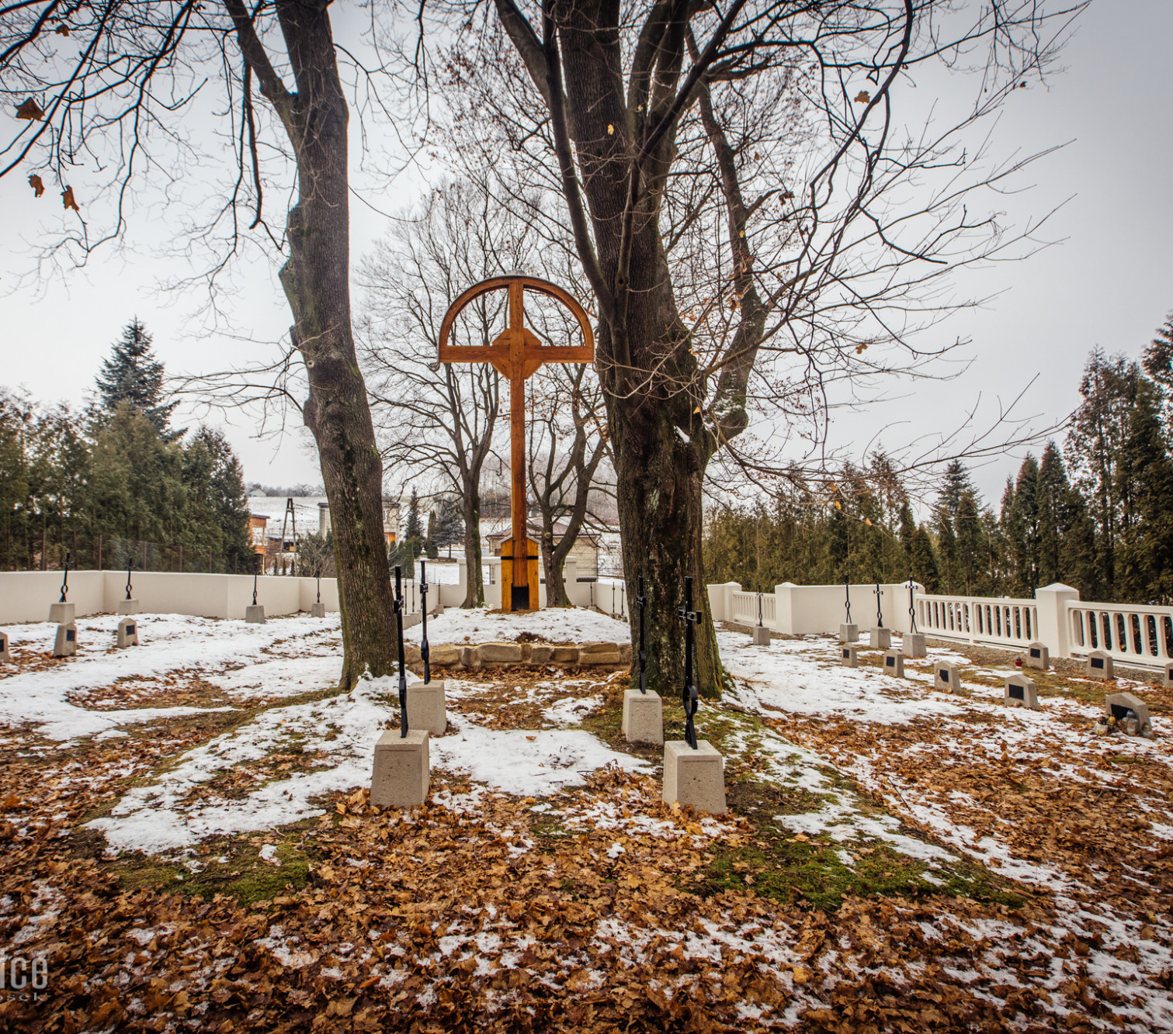
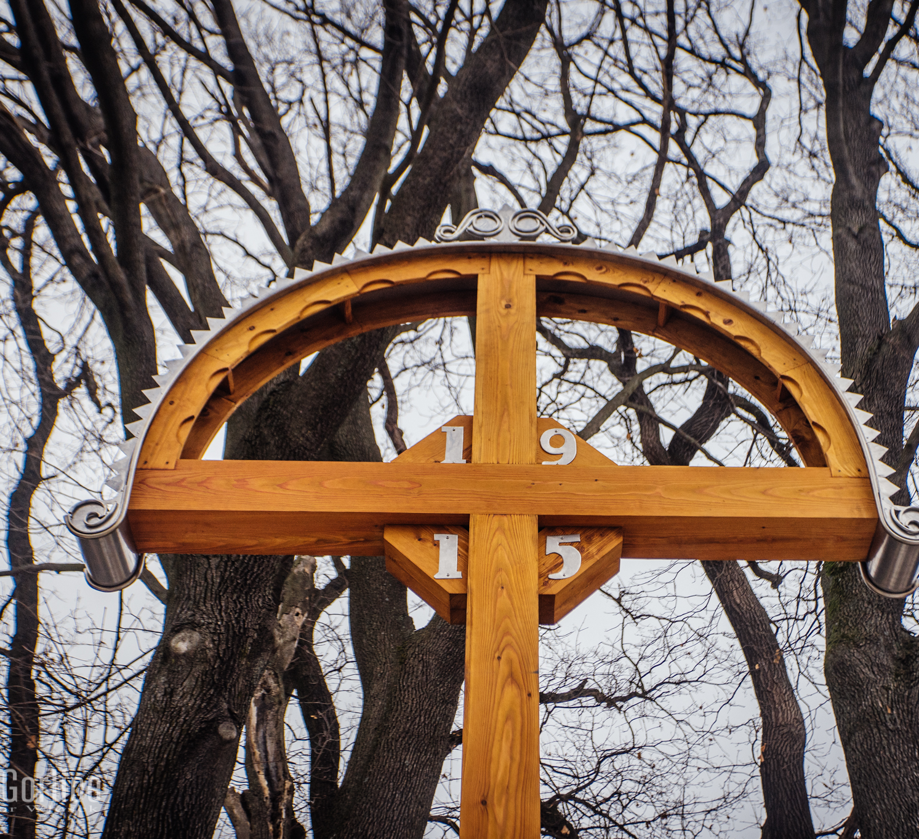
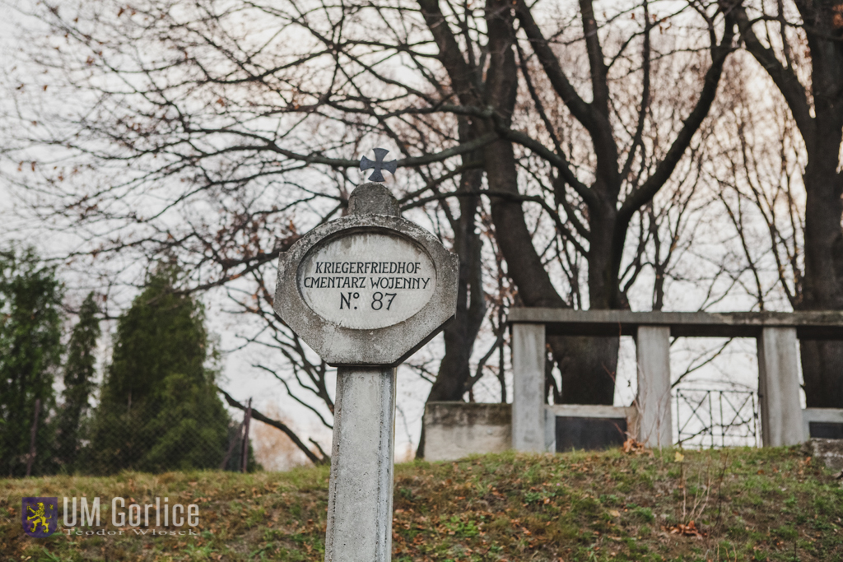
Conservation and reconstruction works
War Cemetery No. 87 located in Gorlice, the First World War
Notes:
War Cemetery No. 87 from World War I is located in Gorlice. It was built in 1915 according to a design by Austrian architect. A total of 204 soldiers from various armies (Austrian, Prussian and Russian) who fought in the Gorlice County during World War I were buried in mass and individual graves in the cemetery. The conservation and reconstruction work took three consecutive years.

Slide 4
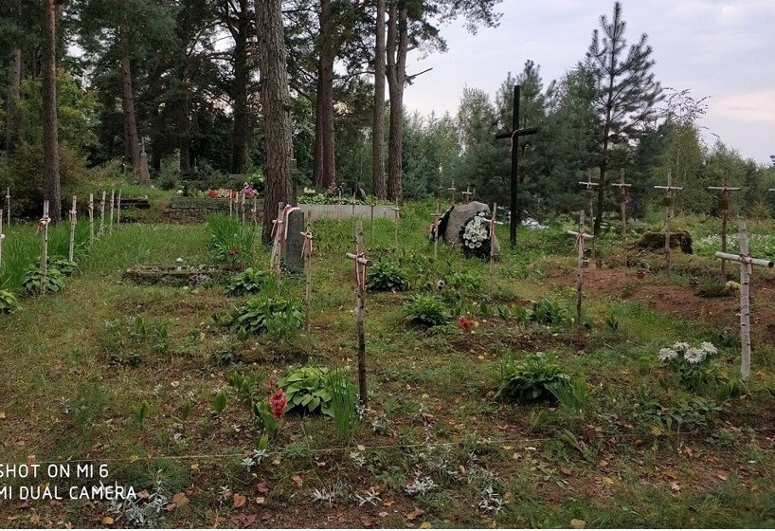
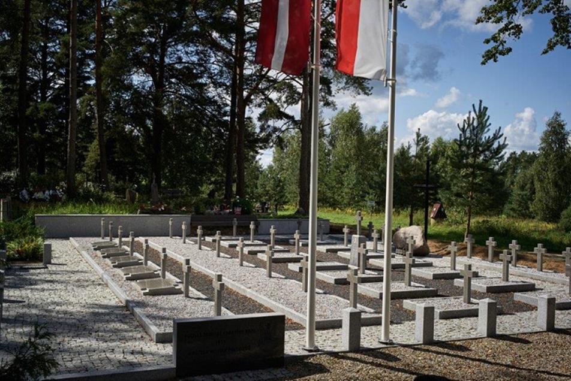
Renovation and reconstruction works on Polish War Cemeteries in Belarus, Ukraine, Lithuania, Latvia
(Polish-Soviet War 1919-1921)
Notes:
The largest renovation project carried out between 2017 and 2022 outside Poland involved works at over 60 sites (in Ukraine, Belarus, Lithuania and Latvia). The renovation work was preceded by a verification of the names of the fallen servicemen. It was a huge undertaking in difficult areas. Unfortunately, the project was interrupted in 2022 after the outbreak of the Ukrainian-Russian war. You will see why on the next slide.

Slide 5
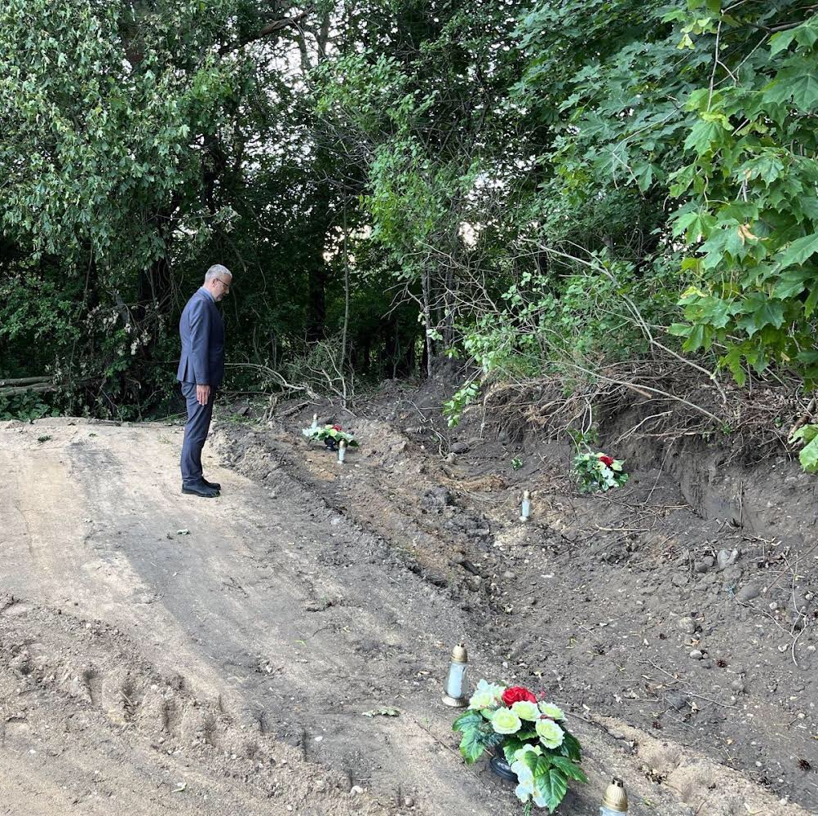
Polish war cemetery in Belarus after the visit of unknown perpetrators in July 2022

Slide 6
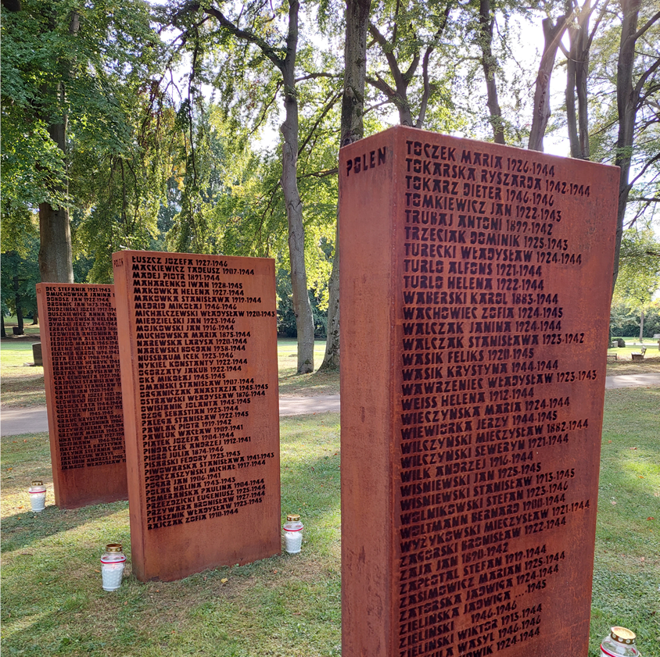
Commemorations of Polish citizens – victims of nazi regime in Germany
Münich, Perlacher Forst cemetery (2021) – victims of Dachau concentration camp;
Hamburg, Ohlsdorf cemetery (2022)
Groß Fullen - Meppen (2022) – mostly DPs
Stuttgart (2023) – mostly forced labourers and DPs
Ulm (2024) – mostly forced labourers and DPs
Hafkrug near Lübeck (2025) – mostly victims of AEL Nordmark
Güterfelde near Berlin (2025) – victims of Sachsenhausen concentration camp and forced labourers
Notes:
Here is another demanding project. Commemorating the victims of the Nazi regime is most often possible by placing plaques with the names of the victims in the places where their remains or ashes were laid to rest. The main challenge here remains historical research and verification of names. Here you can see plaques at the Stuttgart cemetery, on which over 200 names have been engraved. At the Perlacher Forst cemetery over 2,000 names were engraved on stone slabs

Slide 7
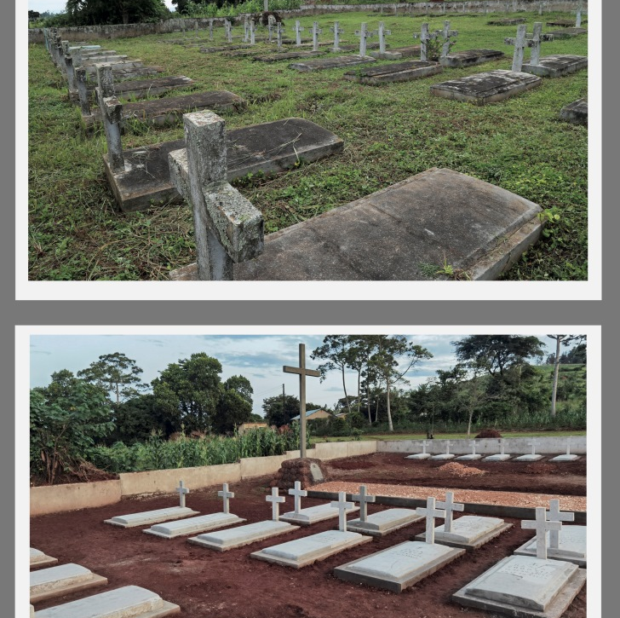
Renovation works at Polish WW2 refugee cemeteries in East Africa
cemetery in Kidugala, Tanzania (2021)
cemetery in Nyabeya, Uganda (2022)
cemetery in Kondoa, Tanzania (2024)
Notes:
We also take care of the graves of Polish refugees who died during World War II. After their evacuation from the Soviet Union, they also found themselves in East Africa. The weather conditions and location of these sites make them extremely difficult to maintain and, unfortunately, vulnerable to damage.

Slide 8
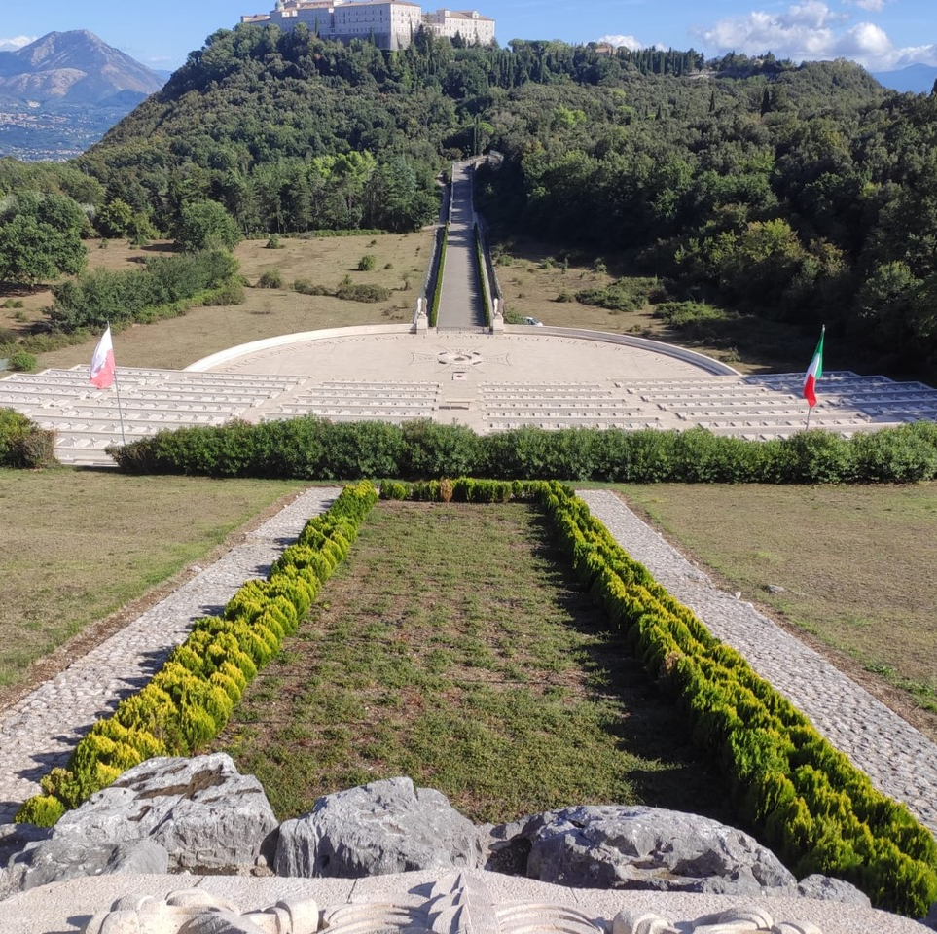
Most important upcoming projects
RENOVATION WORKS:
MONTE CASSINO WAR CEMETERY, ITALY
LORETO WAR CEMETERY, ITALY
SEARCHING FOR POLISH WAR GRAVES IN STALAG XI A ALTENGRABOW, GERMANY
SEARCHING FOR POLISH WAR GRAVES IN CENTRAL ASIA
Notes:
The beautifully situated Polish war cemeteries in Monte Cassino and Loreto face very serious structural problems, partly due to their location. Very challenging works are coming.
After the Second World War, the site of the former Stalag XI A Altengrabow became a military training ground for the Soviet Army. Over 100 Polish war graves disappeared. It would be wonderful to find the remains of the soldiers and bring them home (in order to give them a proper burial)
Historical research based on previously unknown sources gives us hope of finding Polish war graves from World War II located in Central Asia.

Slide 9
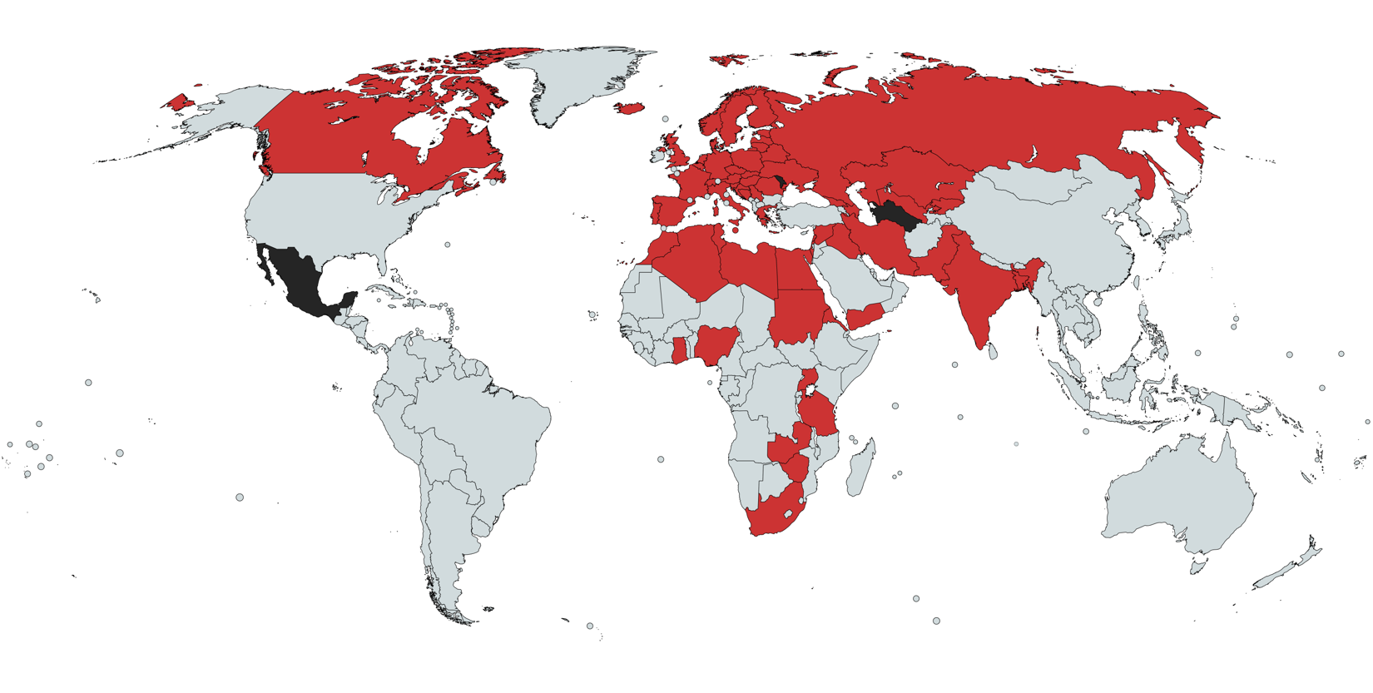
Challenges
Polish war graves are located in 60 countries
Notes:
This generates many problems.
we currently do not have access to some of sites because of the political or safety reasons -
It is quite a difficult task to supervise war graves located outside Poland, especially in Asia and Africa.
Selecting contractors and supervising work carried out in remote locations is quite a difficult (daunting) task.
Formalities, in particular public procurement law, do not help either.

Slide 10
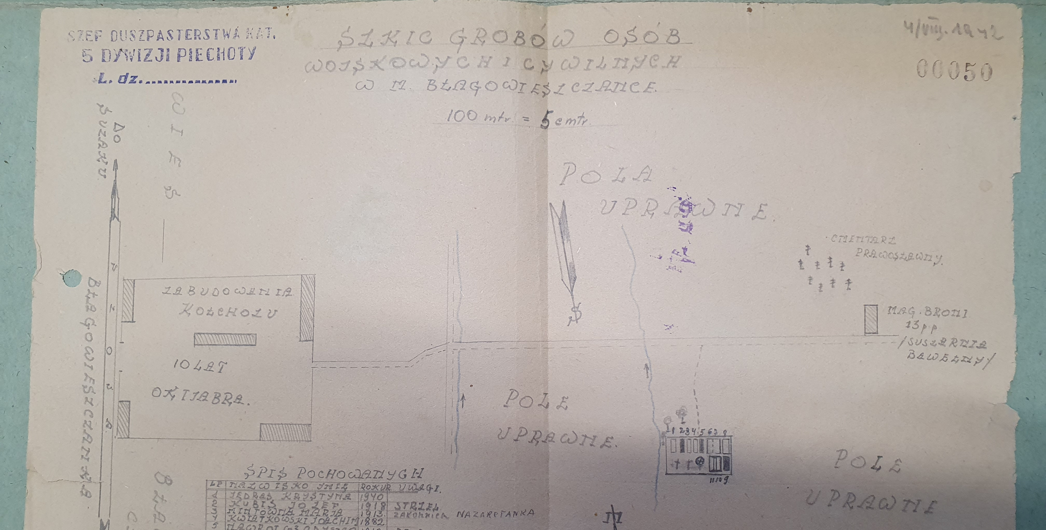
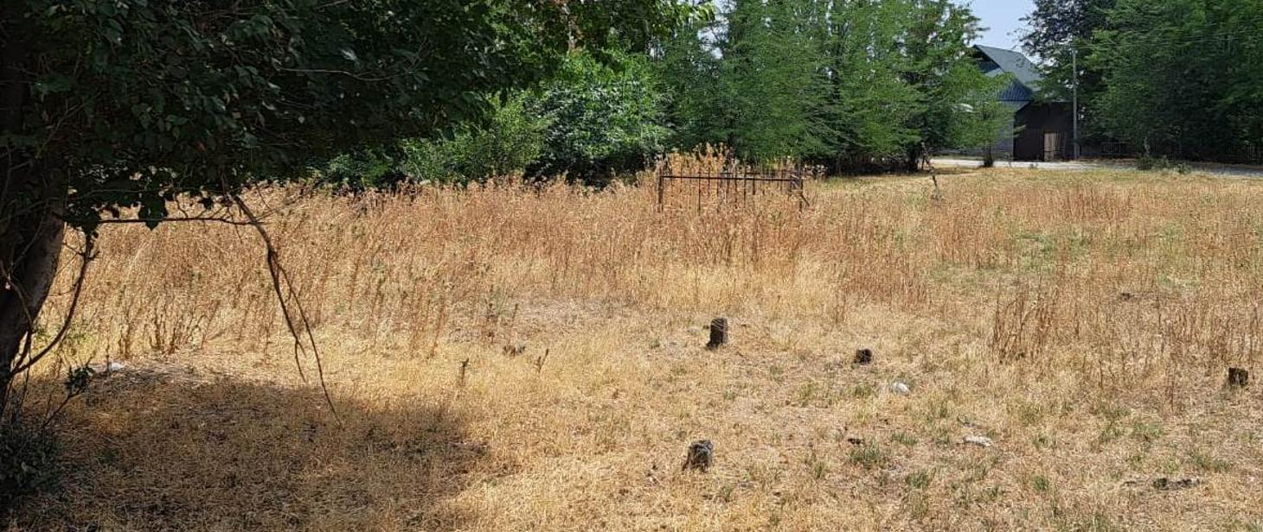
Opportunities
Historical research based on previously unknown sources enabling the identification of the names of non-commemorated victims of the Second World War and the location of war graves
Notes:
The biggest and most positive change is the increasing availability of historical sources. This opens up many opportunities for us. It turns out that the archives of Polish Catholic missions in England, France and Germany contain invaluable sources concerning Polish war graves. During my first, very brief visit to one of the church archives, I received archival materials hidden in 1946, which no one had seen since. You can only imagine how I felt when I opened the folder. I felt as if I had found myself in the Library of Alexandria or in the library from Umberto Eco's novel ‘The Name of the Rose’. The slide shows a sketch of the location of Polish war graves in Błagowieszczanka, Kyrgyzstan. In the spring of this year, we found these graves, or rather what was left of them. We intend to rebuild them.

Slide 11
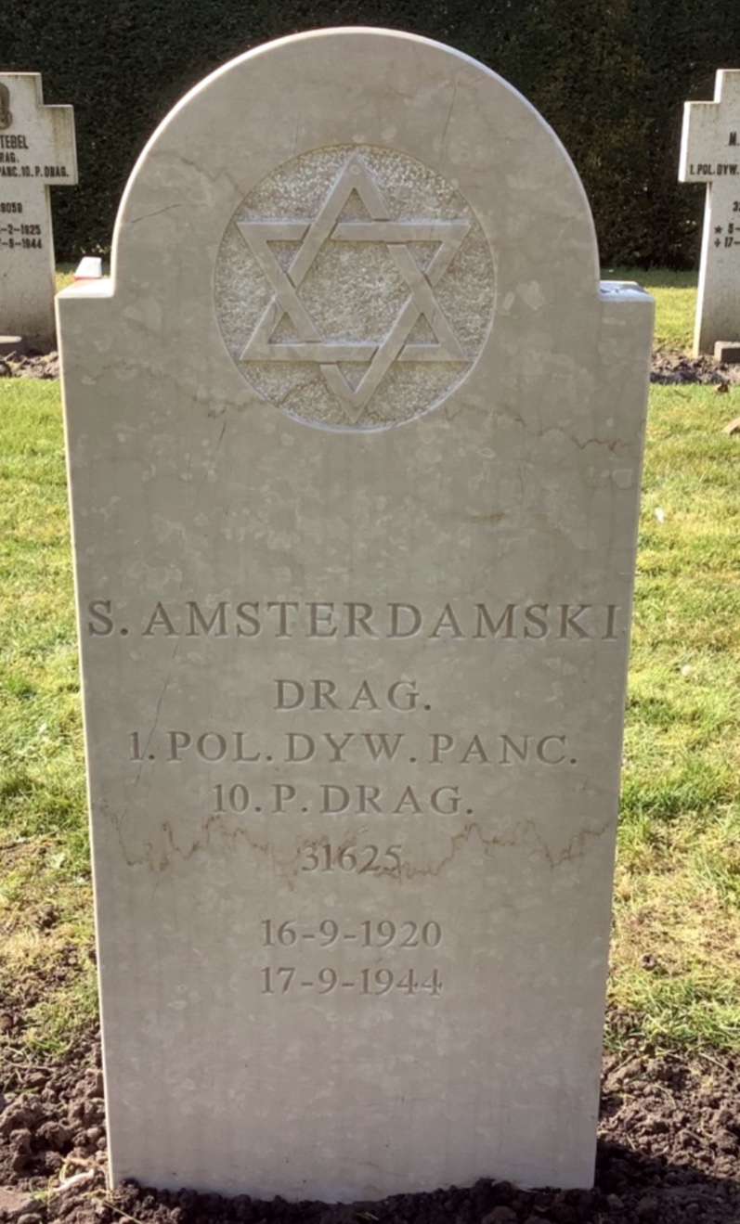
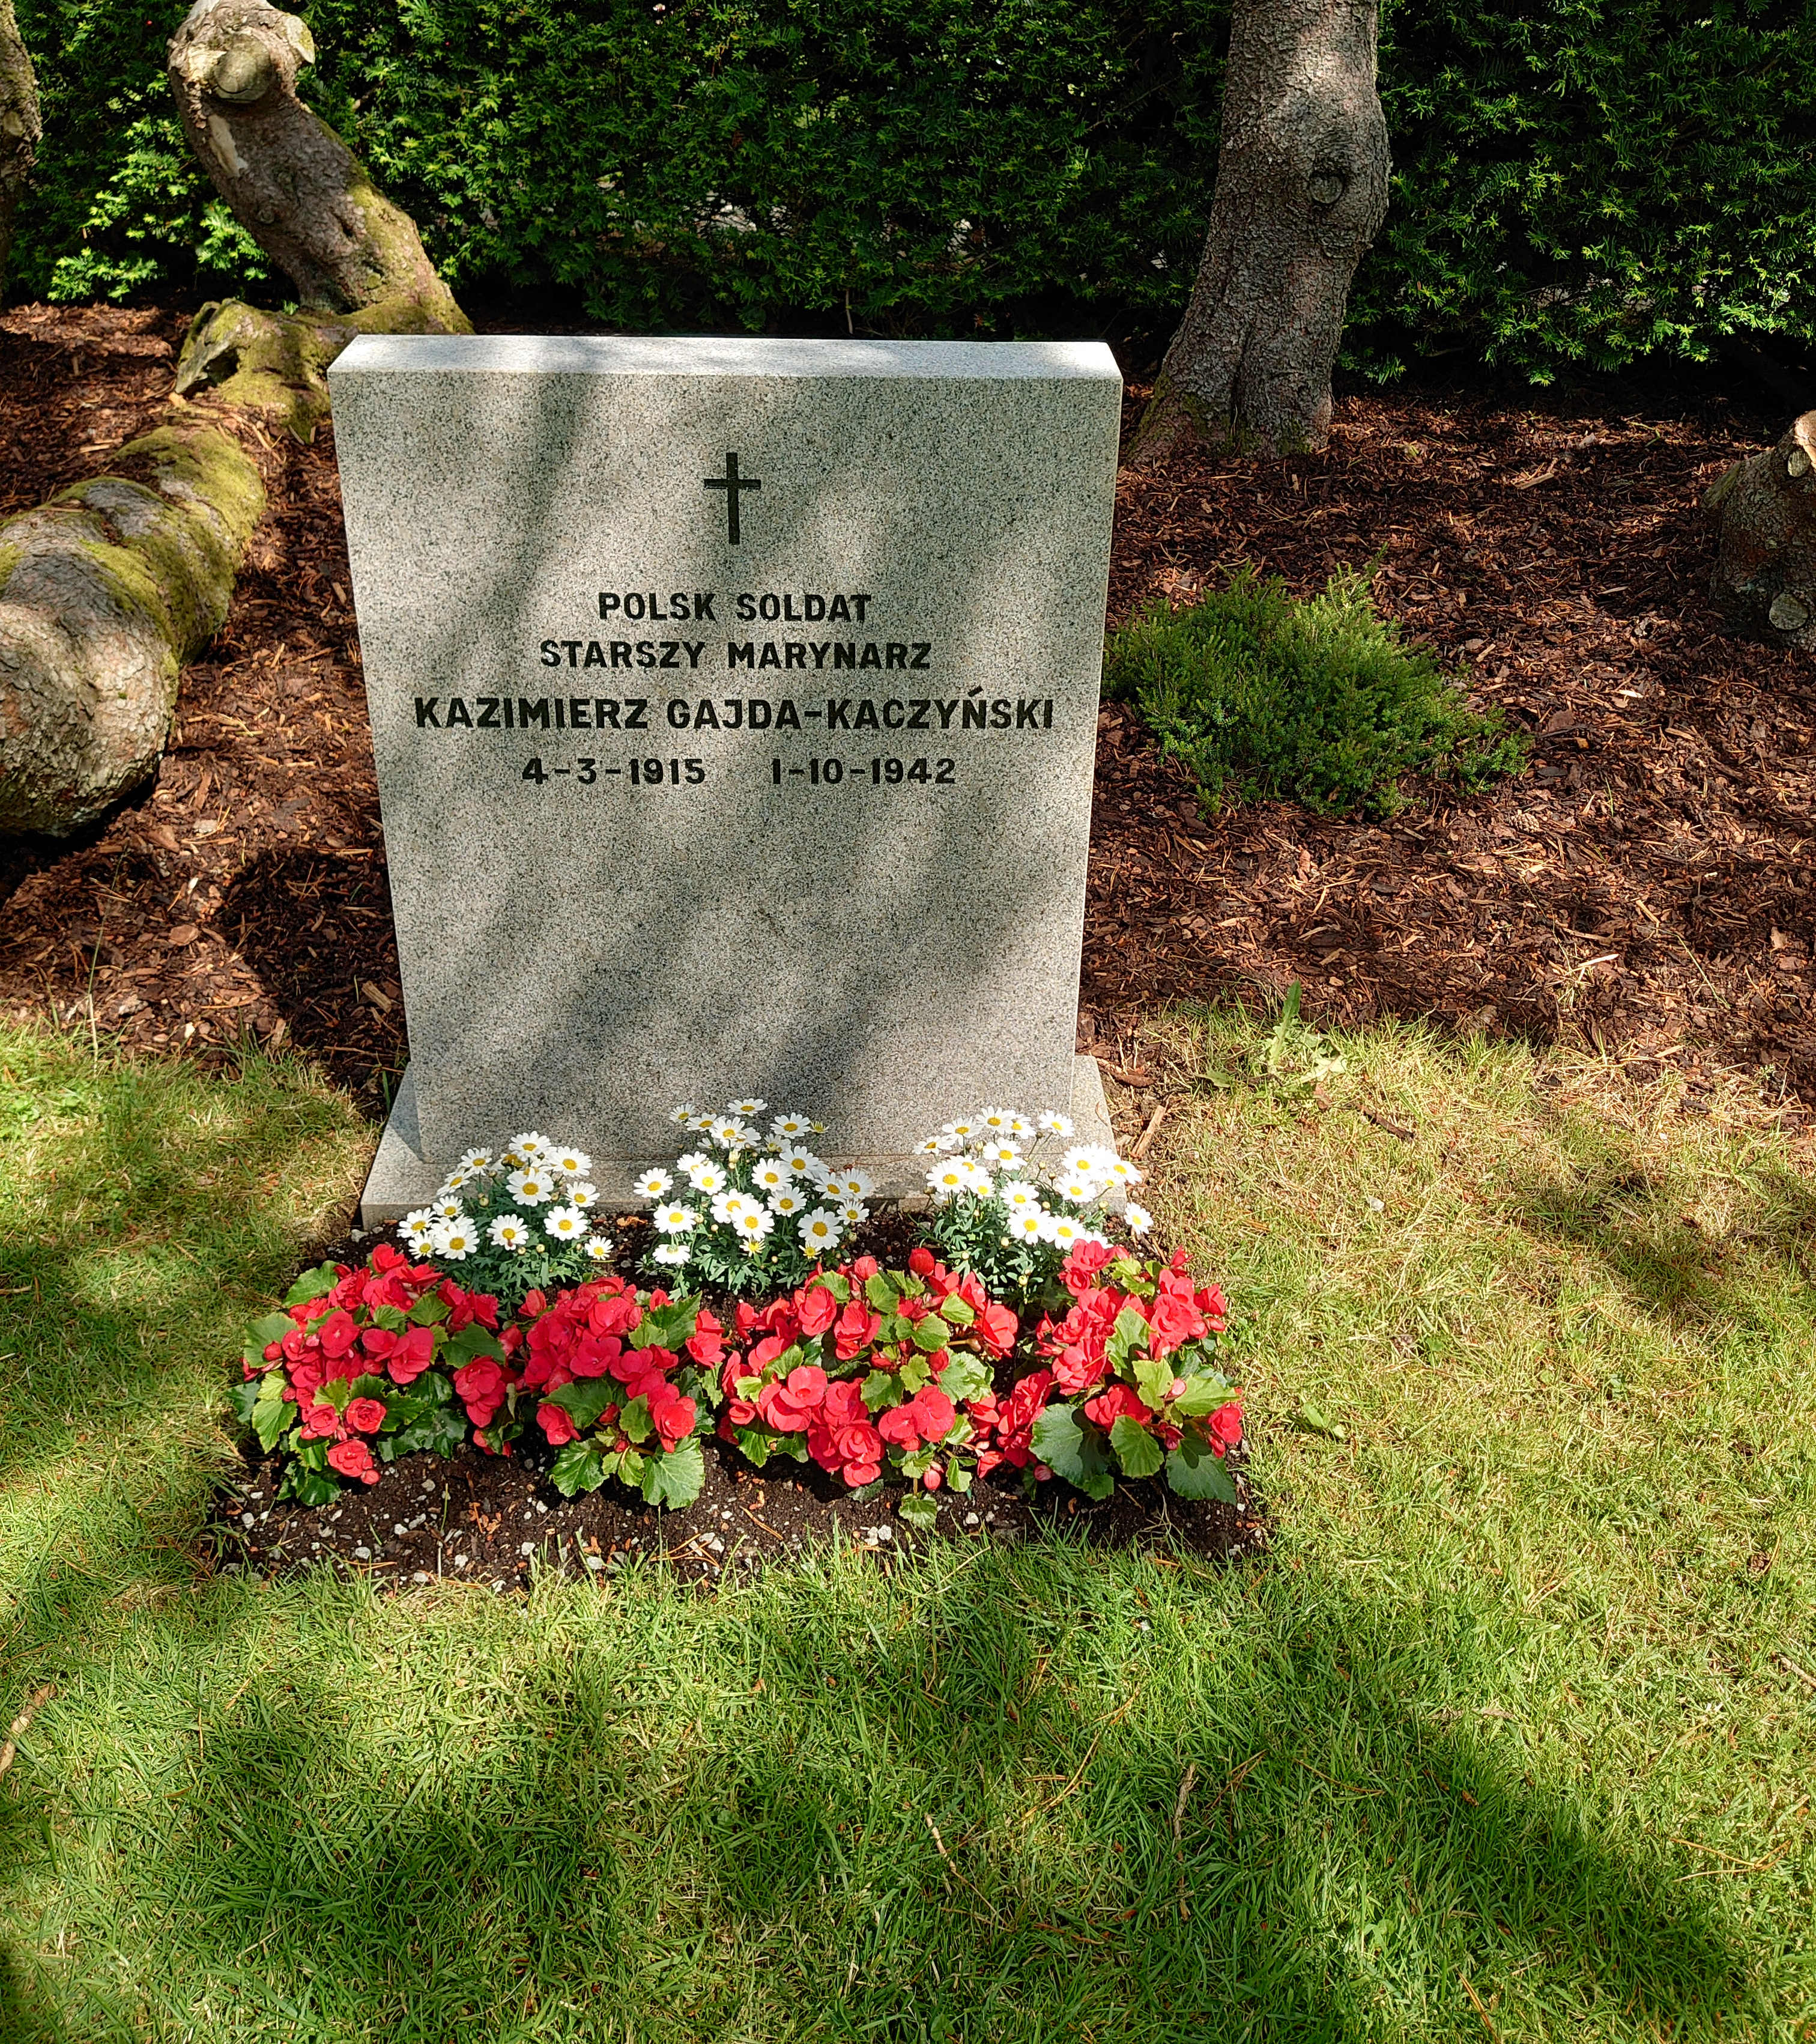
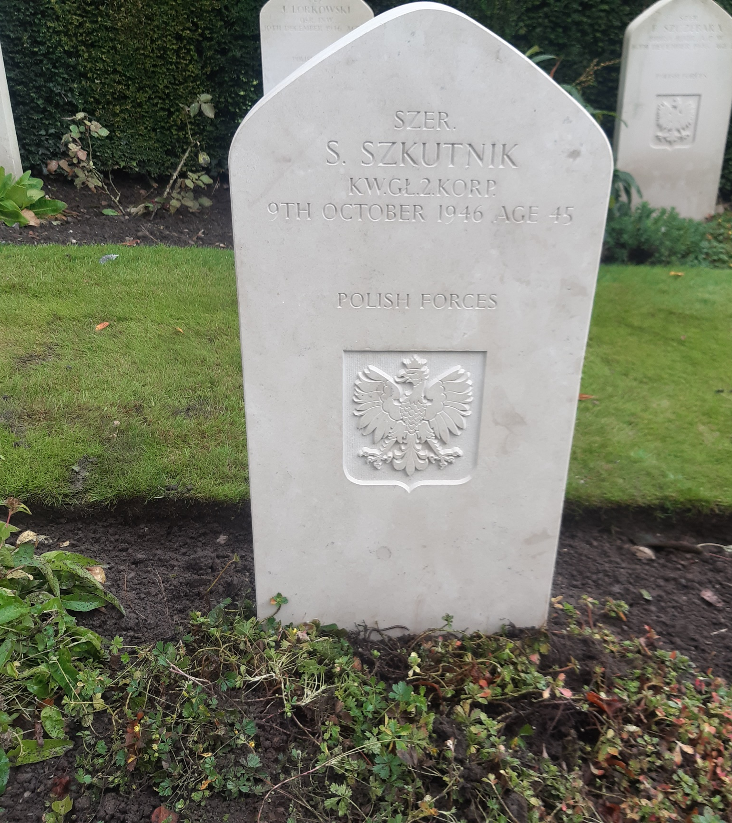
The need for cooperation
Notes:
The slide presents three examples of cooperation that perfectly capture the gist of our work.
Saul Amsterdamski was a soldier who served with the Polish 1st Armoured Division. Until recently, there was a cross on his grave. When historical research revealed that he was of the Jewish faith, our colleagues from the Netherlands erected (installed) a matzeva.
Due to an error in the death certificate, there was a mistake on Stanisław Szkutnik's grave, which prevented his daughter from finding her father. At our request, colleagues from the CWGC replaced the headstone. Thanks that the family visited their relative's grave for the first time.
Historical research conducted by our Norwegian colleagues revealed that a Polish prisoner of war was buried as a Soviet soldier. Thanks to this discovery, they installed a headstone bearing his name and correct details, including his nationality.
It goes without saying that most of the organisations present here have helped us.

Slide 12
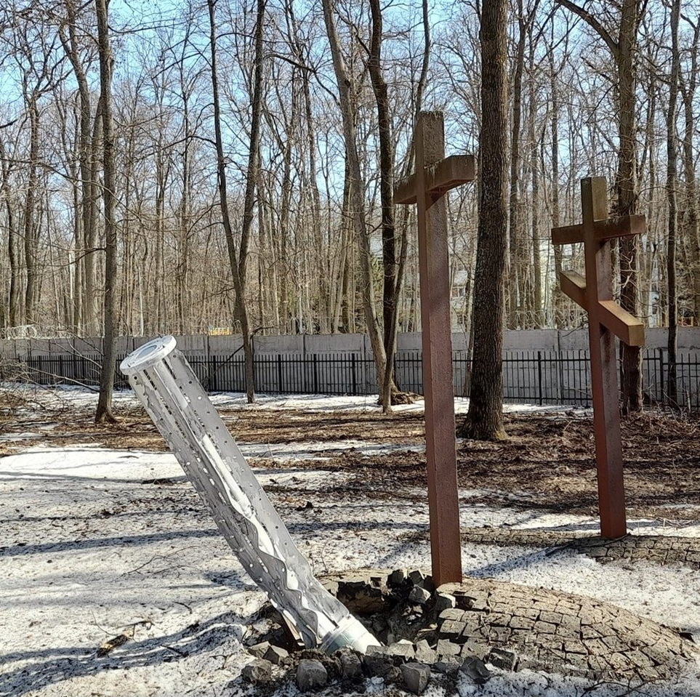
Thank you for your attention
Jan Ambroziak, Department of Cultural Heritage Abroad and Memorial Sites
jambroziak@kultura.gov.pl
Notes:
I would like to end my presentation with a very symbolic photograph of a Russian rocket that hit the Polish War Cemetery in Kiev, where Polish officers – prisoners of war murdered in 1940 on Stalin's order – are buried.

