Slide 1
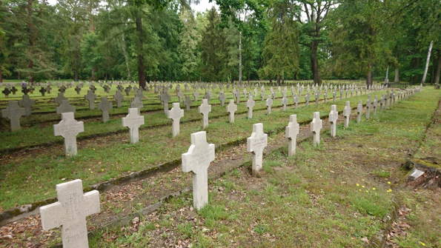

National Memorial Sites
Abroad
Department of Cultural Heritage Abroad and Memorial Sites
Care of war graves in Poland

Slide 2
Act on War Graves and Cemeteries of 28th March 1933
War graves = places of rest:
1) people killed during their fight for independence and unification of the State of Poland;
2) people of the army, killed or died as a result of war actions - regardless of their nationality;
3) sisters of mercy and all people killed or died as a result of war actions while performing their duties - at any military formation;
4) prisoners of war and internees;
5) refugees of 1915;
6) people of the army and civilians - regardless of their nationality who lost their lives as a result of suppression of the German or Soviet invaders from 1 September 1939;
7) victims of German and Soviet camps;
8) people who lost their lives as a result of a fight against the imposed totalitarian system or as a result of totalitarian suppression or ethnic cleansing from 8 November 1917 to 31 July 1990.

Slide 3
Competences of the Ministry of Culture and National Heritage
Act on Government Administration Units of 4 September 1997
Section: Culture and Protection of National Heritage comprises:
issues of development and custody over tangible and intangible national heritage,
issues of cultural activity, including the State patronage over this activity, in particular with respect to the following: national memorial sites, war graves and cemeteries, monuments of extermination.
[state supervision]
Act on War Graves and Cemeteries of 28 March 1933
War graves and cemeteries will remain in the custody of the State.
The minister responsible for culture and national heritage exercises supervision over them, which consists checking and controlling actions of subordinate units in terms of legitimacy and taking administrative decisions.
[outsourcing]
Act on War Graves and Cemeteries of 28 March 1933
- The minister responsible for culture and the safeguarding of national heritage may outsource the obligation to maintain war graves and cemeteries to foundations, associations and social establishments, upon their consent; however, according to Article 6(4a), the supervision over the performance of the tasks by those units will be exercised by a provincial governor.

Slide 4
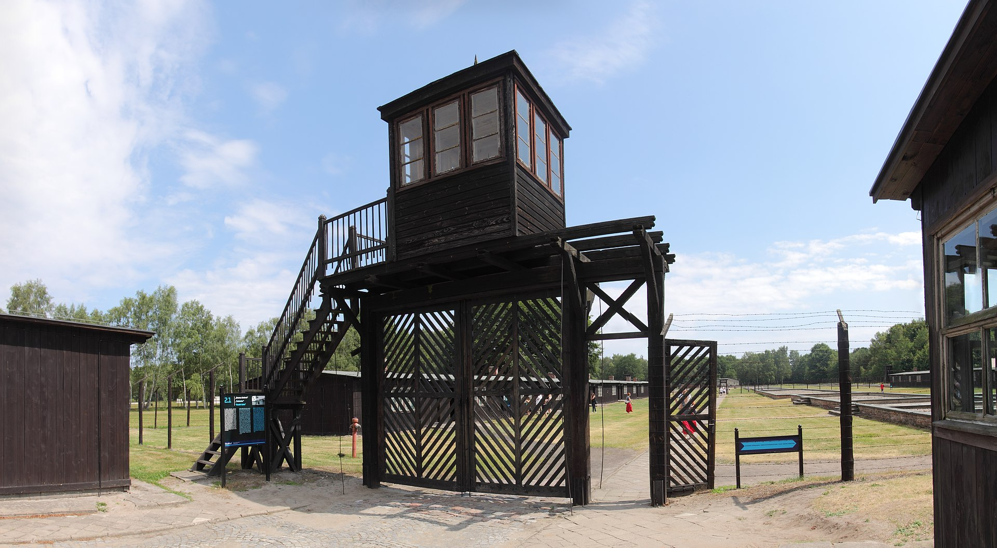
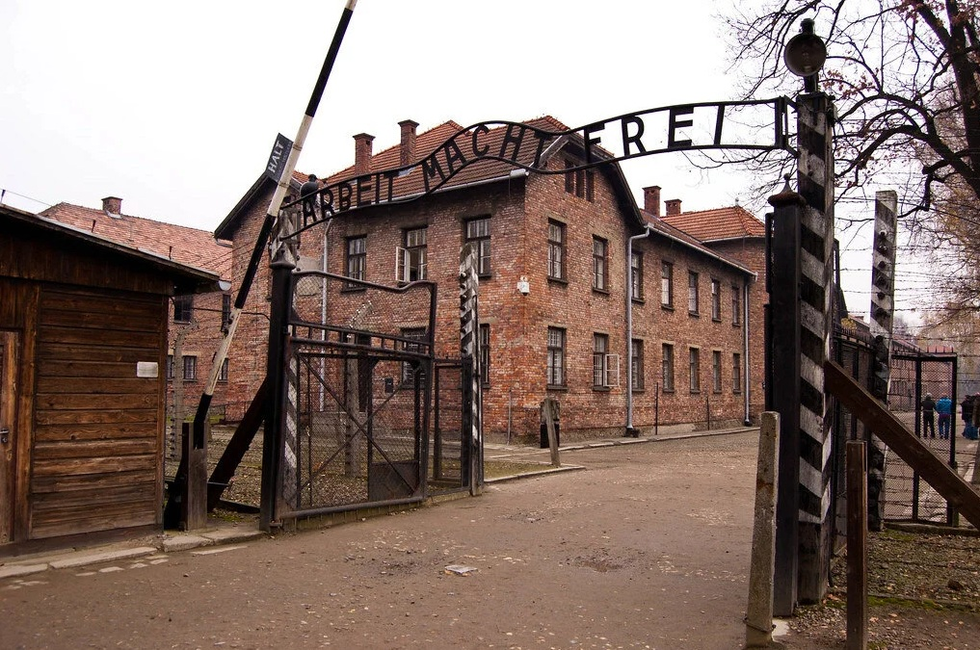
State martyrdom museums in Poland
Auschwitz-Birkenau. German Nazi concentration and extermination camp (1940–1945)
State Museum at Majdanek. German Nazi concentration and extermination camp (1941–1944) along with the following divisions:
  Museum and Memorial Site in Bełżec. German Nazi extermination camp (1942-1943).
  Museum and Memorial Site in Sobibór. German Nazi extermination camp (1942-1943).
Stutthof Museum in Sztutowo. German Nazi concentration and extermination camp (1939–1945)
Warsaw Ghetto Museum (in organisation)
Museum of Polish Children - Victims of Totalitarianism. German Nazi camp for Polish children in Łódź (1942-1945) (in organisation)

Slide 5
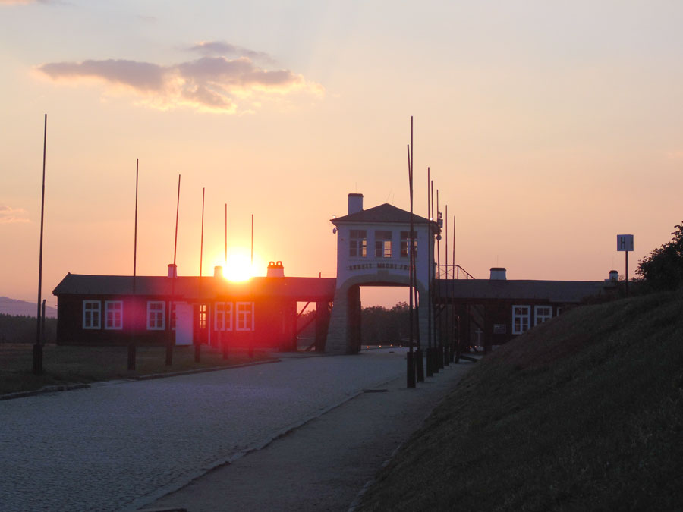
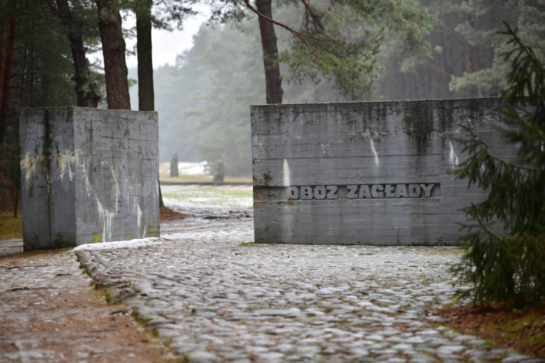
Museums run jointly with local government authorities
Central Museum of Prisoners-of-War – Łambinowice/Opole
Treblinka Museum. German Nazi extermination and forced-labour camp (1941-1944)
Gross-Rosen Museum in Rogoźnica. German Nazi concentration and extermination camp (1940-1945)
Memorial Site Museum in Płaszów/Krakow. German Nazi forced-labour and concentration camp KL Plaszow (1942-1945) (in organisation)

Slide 6
Bilateral agreements on the protection of memorial sites and war graves/cemeteries
Uzbekistan 1995
Belarus 1997
Germany 2003
Hungary 2014
Romania 2018
Italy
2012
Russia 1994
Ukraine 1994
Kyrgyzstan 1993

Slide 7
Competences of provincial governors (wojewoda)
Act on War Graves and Cemeteries of 28 March 1933
[Article 5]
- Performance of ground works, erection of monuments and other installations at war cemeteries and graves will require a permit of a provincial governor.
[Article 5a]
- Approval of plans for war cemeteries and issues related to the overall management of war cemeteries, in particular the issues related to the registration, restoration and maintenance of war graves and cemeteries as well as issues related to the settlement of ownership of the lands taken for the purpose of war cemeteries, will be in the scope of activity of a provincial governor.
[Article 6.3 ]
- A provincial governor may outsource the obligation to maintain war graves and cemeteries, to a local government unit, along with the transfer of relevant funds if the local government unit has not accepted this obligation free of any charge.

Slide 8
Competence of municipalities
Article 7 of the Act on War Graves and Cemeteries of 28 March 1933
- Direct supervision over the condition of war graves and cemeteries will be exercised by municipalities unless the supervision activities have been outsourced to social associations and establishments as provided for in Article 6(4) (it will be supervised by the provincial governor).
Article 18 of the Act on Municipal Self-Government 8 March 1990
- The Municipality Council will be solely responsible for the adoption of resolutions on the municipality emblem, names of streets and squares being public roads or names of internal roads within the meaning of the Act on Public Roads of 21 March 1985 as well as for the erection of monuments.

Slide 9
MINISTER OF CULTURE AND NATIONAL HERITAGE
PROVINCIAL GOVERNOR
(WOJEWODA)
MUNICIPALITY
(GMINA)

Slide 10
Act on Museums of 21 November 1996
[Article 6a. 1]
The minister of culture and national heritage coordinates and implement the State policy on museums activity and on national memorial sites, including extermination monuments and war graves and cemeteries.
[Article 6a]
Institutions competent for making permanent signs of culture and facilities commemorating fight and martyrdom will issue a permit following an opinion of the Minister of Culture and National Heritage, however, to the authority of the President of the Institute of National Remembrance [referred to in Article 53l of the Act on the Institute of National Remembrance of 18 December 1998 ]

Slide 11
Act on the Protection of Monuments of 23 July 2003
Article 1 of the Act defines the subject, scope and forms of protection and care of historical monuments, principles of designing the national programme for the protection and care of historical monuments, funding conservation, restoration and construction works on historical monuments, and the organisation of monument protection authorities.

Slide 12
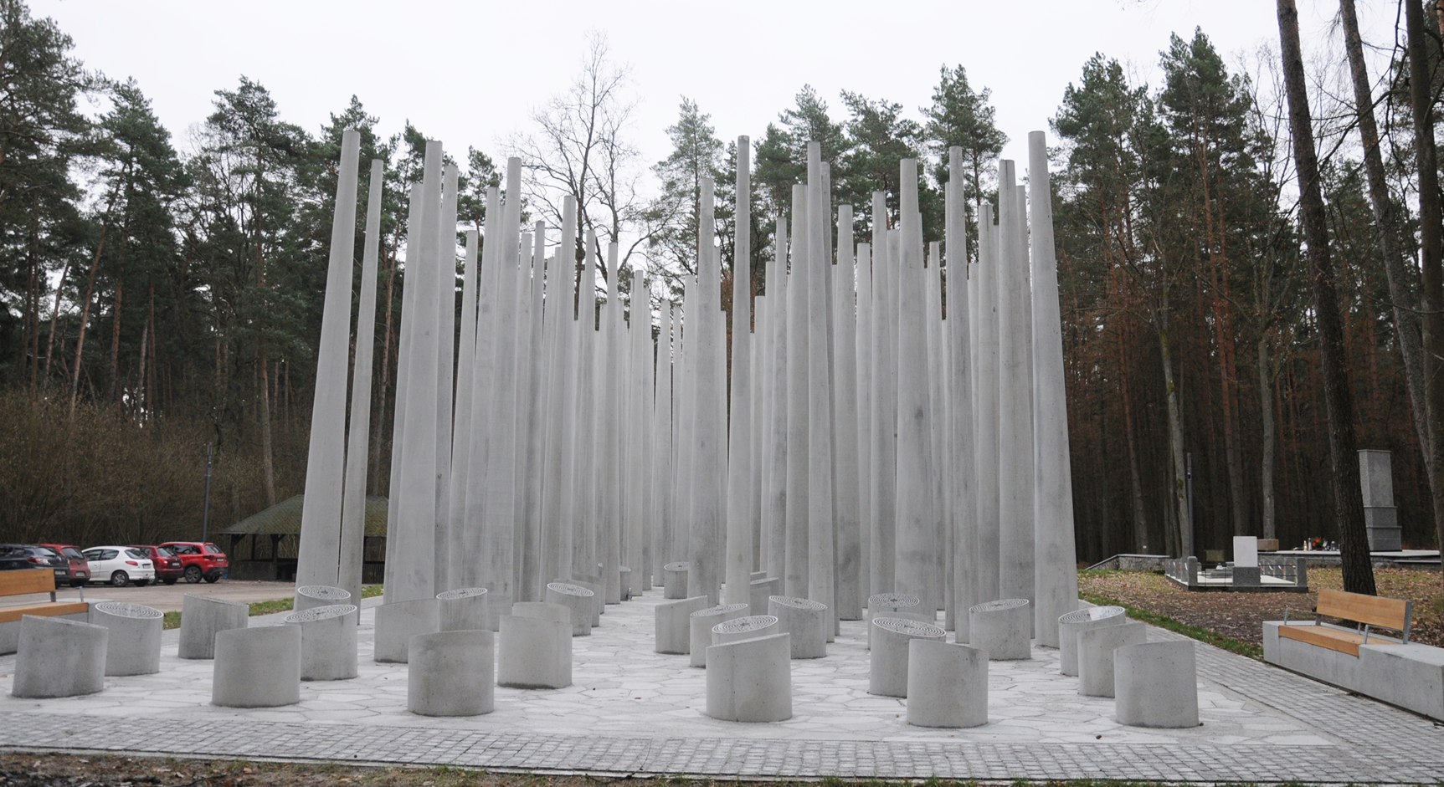
FINANCING

Slide 13
Subsidy grants of the Ministry of Culture and National Heritage
War graves and cemeteries in Poland, budget: PLN 6,000,000 (EUR 1,5 mln)
Memorial sites and commemorations in Poland, budget: PLN 6,000,000 (EUR 1,5 mln)
National Memorial Sites Abroad, budget: PLN 7,700,000 (EUR 1,8 mln)

Slide 14
Grant programme
War graves and cemeteries in Poland
conservation/restoration of a war grave/cemetery, technical documentation;
maintenance of a war grave/cemetery;
historical inquiries/ research;
archaeological research;
popularisation (arrangement of a temporary exhibition, seminar/conference, occasional/anniversary event);
exhumation;
construction works.
Who can apply: a Polish law-based entity (local government unit, foundations, state associations and local government institutions of culture, churches and religious organisations)

Slide 15
Grant programme
Memorial sites and commemorations in Poland
conservation/restoration/improvement of a memorial site, technical documentation;
maintenance of a memorial site;
historical inquiries/ research;
archaeological research;
popularisation (arrangement of a temporary exhibition, seminar/conference, occasional/anniversary event);
searching and research works;
construction works;
Who can apply: a Polish law-based entity (local government unit, foundations, state associations and local government institutions of culture, churches and religious organisations)

Slide 16
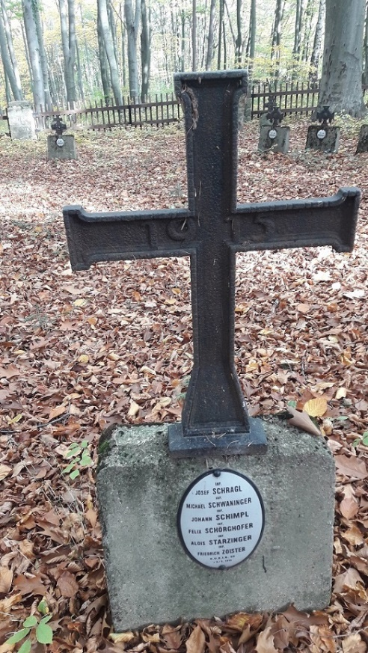
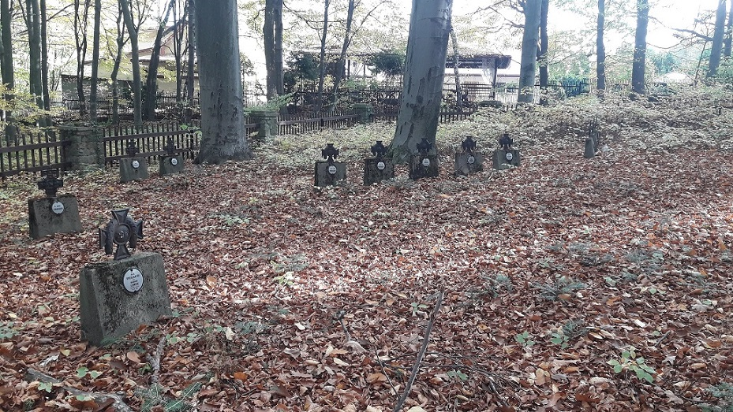
Tarnów Municipality
Restoration of the historic war cemetery no. 175 from
World War I in Poręba Radlna
before restoration

Slide 17
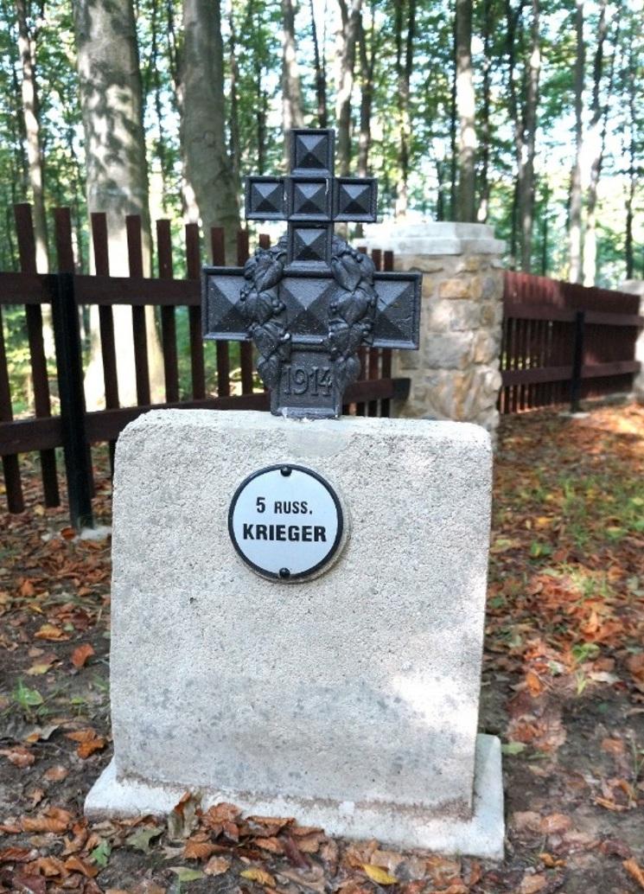
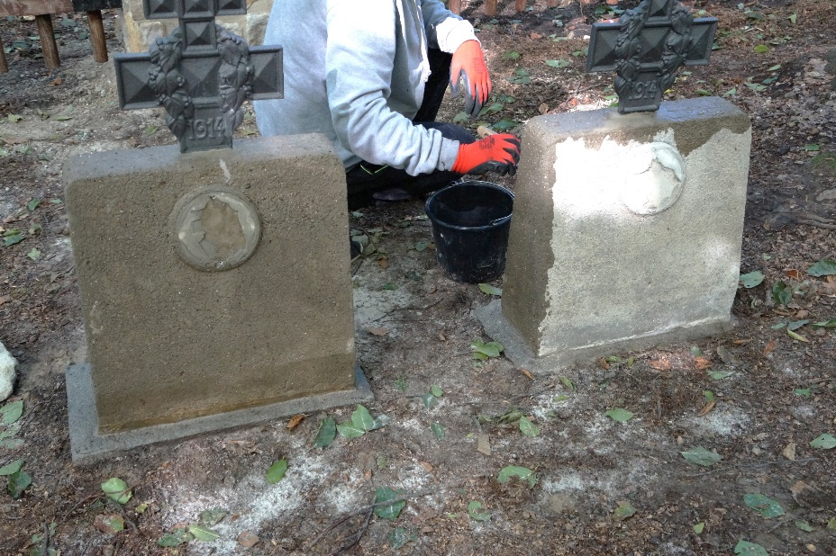
Tarnów Municipality
Restoration of the historic war cemetery no. 175 from World War I in Poręba Radlna

Slide 18
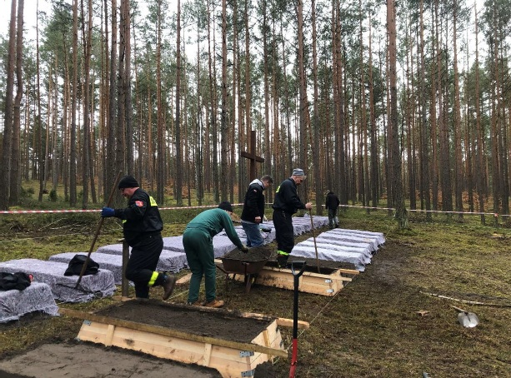
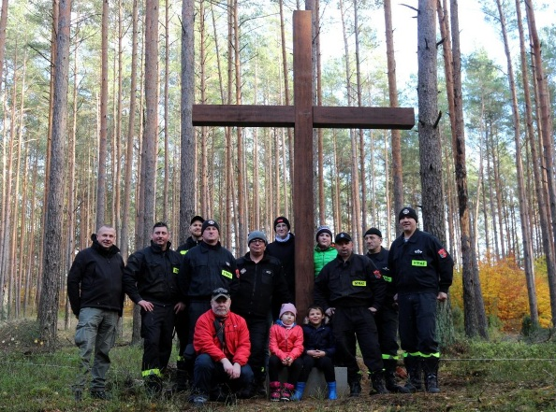
Restoration of the World War I cemetery „Zawady II” in Puszcza Kurpiowska

Slide 19
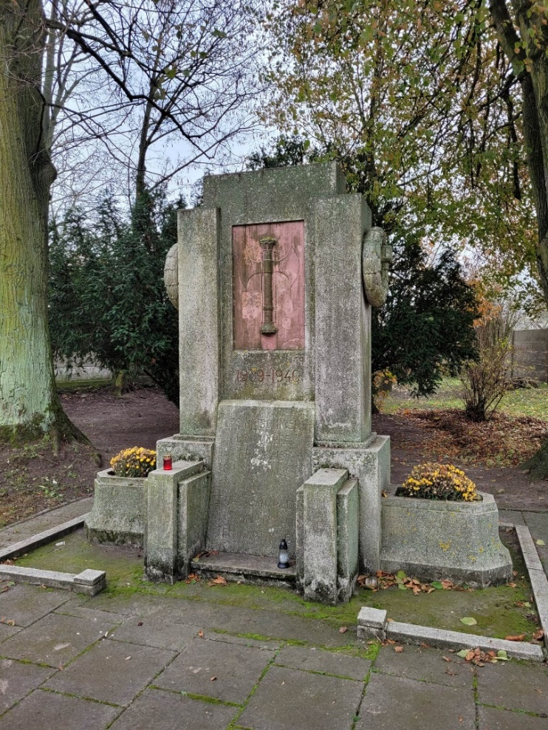
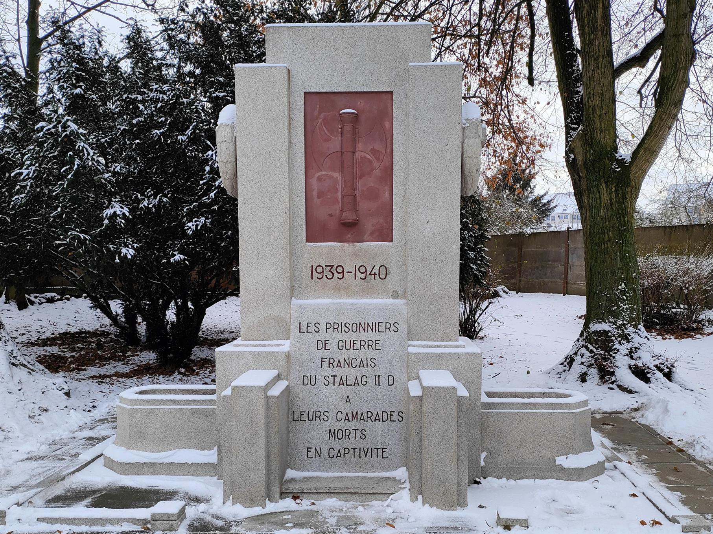
The Stargard City Municipality
Restoration works at the International Cemetery for Prisoners of War in Stargard
before
after

Slide 20
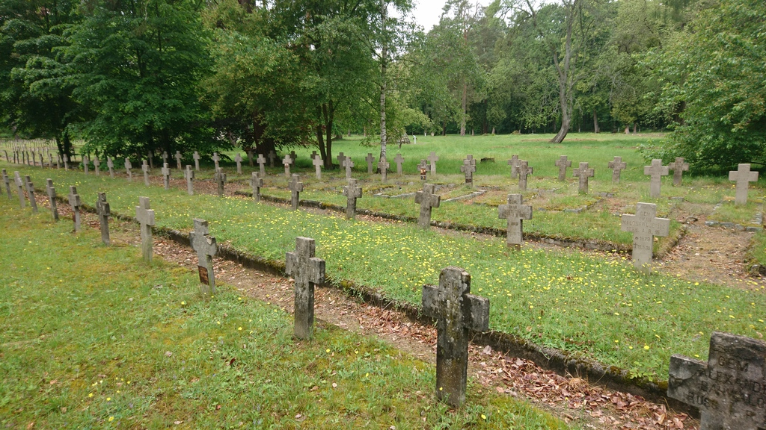
Łambinowice Municipality
Old Cemetery for Prisoners of War in Łambinowice
before
after

Slide 21
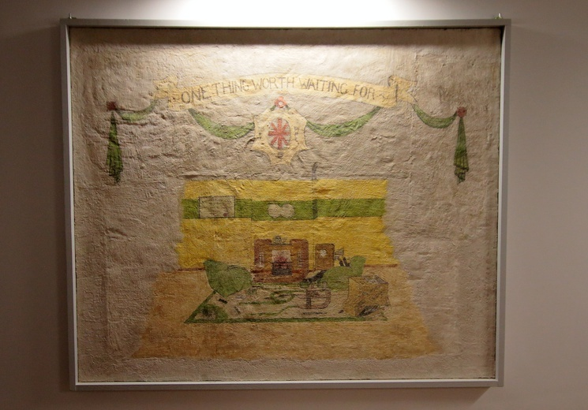
Wall painting from Stalag XXB
Malbork City Museum

Slide 22
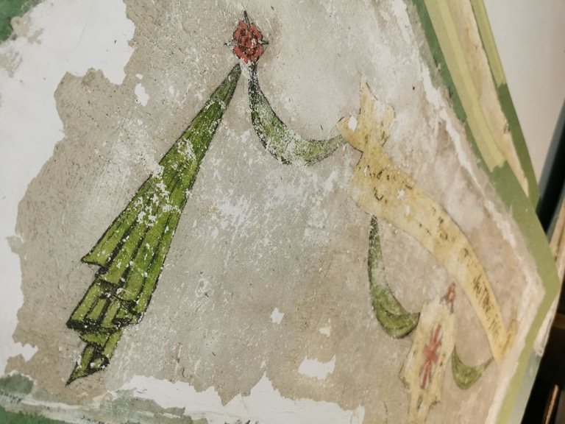
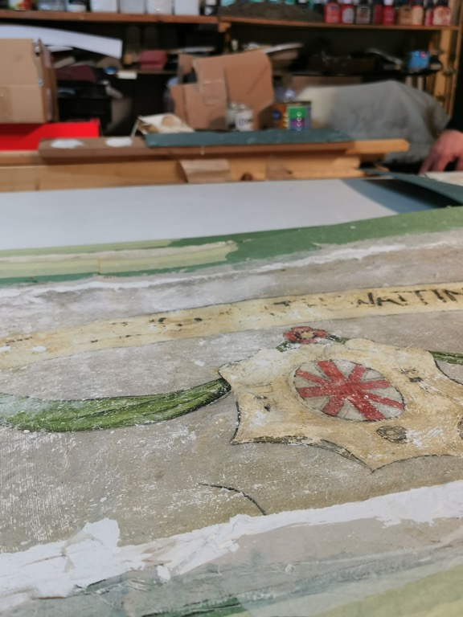
Wall painting from Stalag XXB
Malbork City Museum

Slide 23
Grant programme
National Memorial Sites Abroad
conservation/restoration of a war grave or cemetery, technical documentation;
maintenance of a war grave/cemetery;
historical inquiries/ research;
popularisation (arrangement of a temporary exhibition, seminar/conference, occasional/anniversary event);
exhumation.
Who can apply: a Polish law-based entity (foundations, state associations and local government institutions of culture, churches and religious organisations)

Slide 24
Projects completed (years 2019-2024)
“War graves and cemeteries in Poland”
359 completed projects for an aggregate amount of PLN 33 624 094 (EUR 8 005 736)
“Memorial sites and commemorations in Poland”
264 completed projects for an aggregate amount of PLN 27 233 712 (EUR 6 884 217)
“National Memorial Sites Abroad”
197 completed projects for an aggregate amount of PLN 41 038 732 (EUR 9 771126)

Slide 25
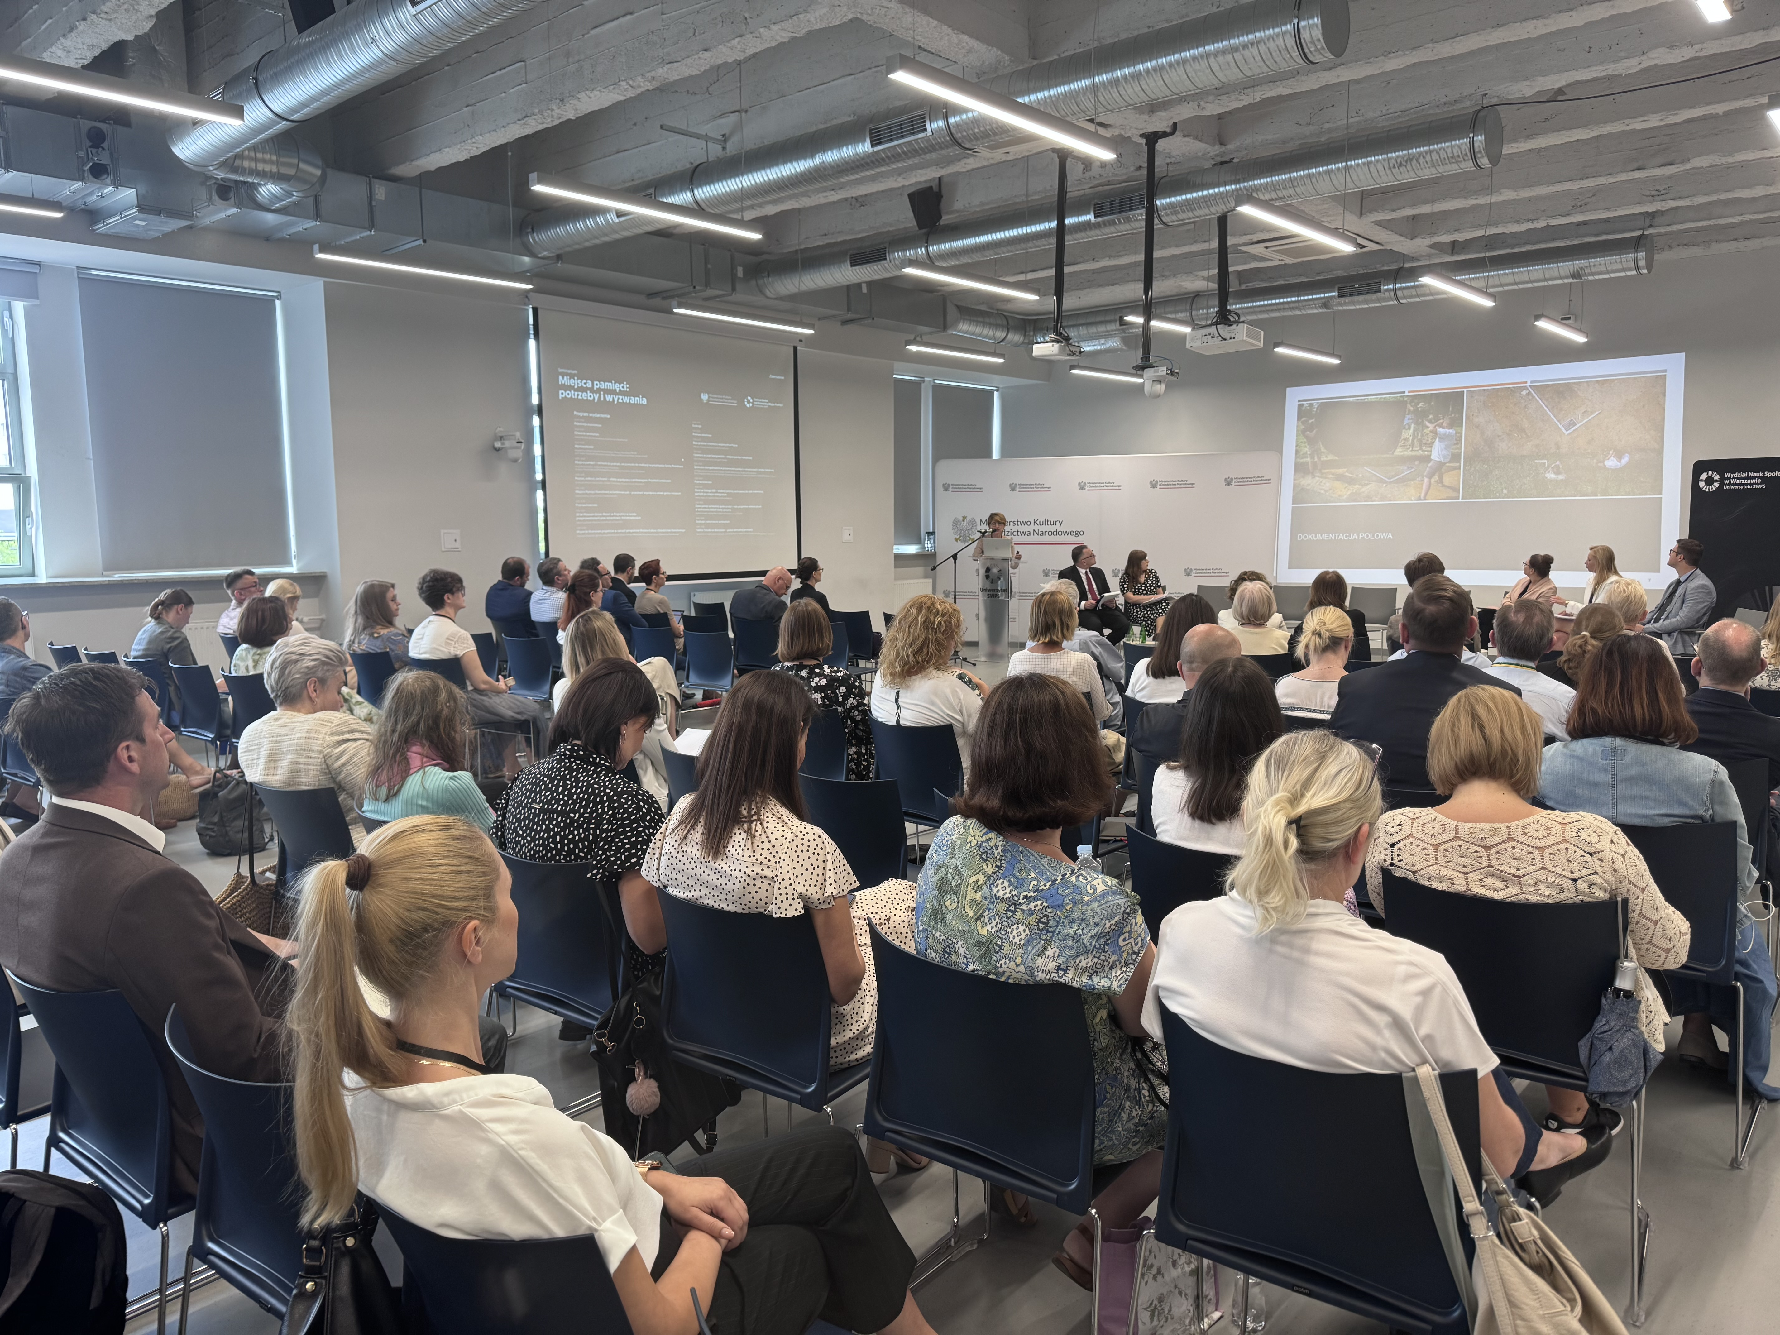
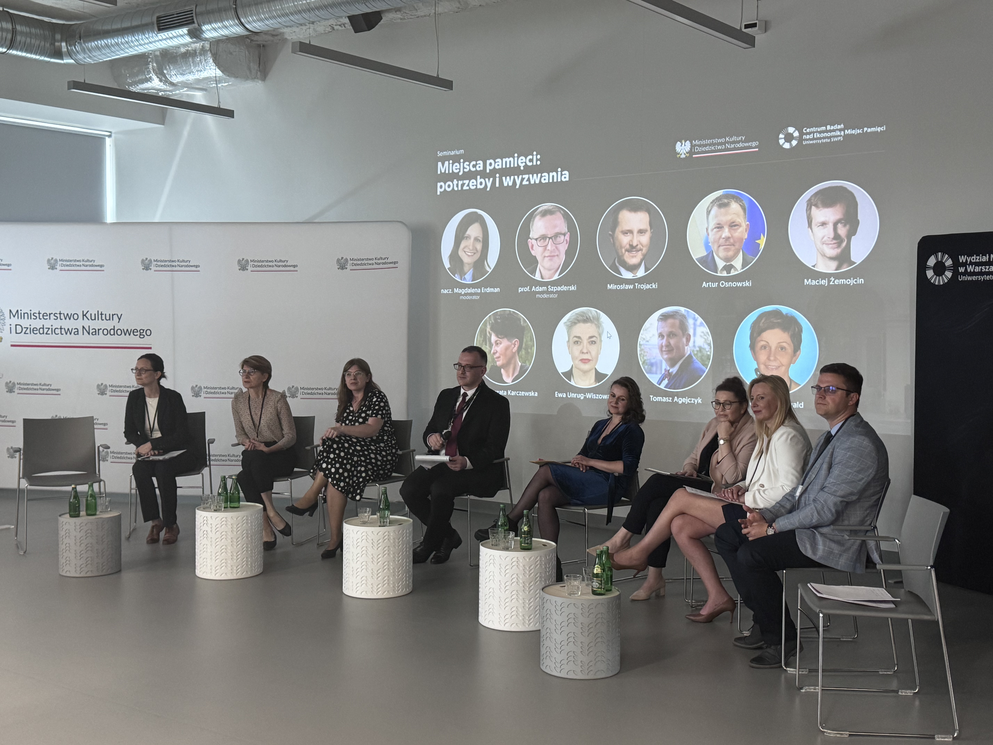
Memorial Sites Conference - since 2024

Slide 26
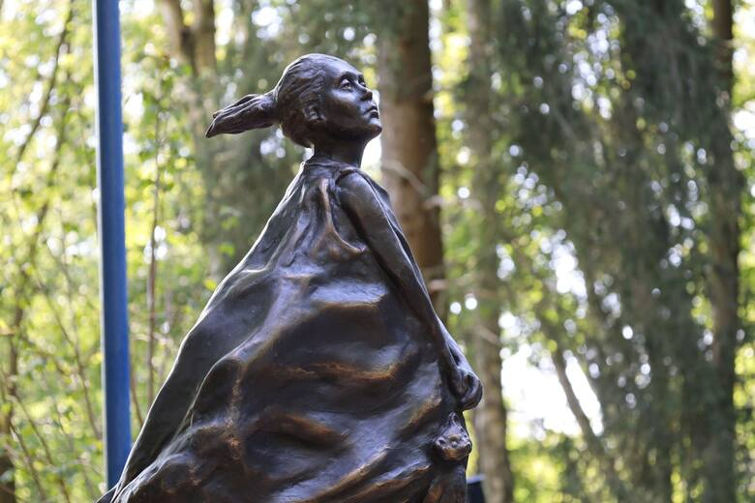
THANK YOU FOR YOUR ATTENTION
MAGDALENA ERDMAN
Department of Cultural Heritage Abroad and Memorial Sites
ddz@kultura.gov.pl

