Slide 1
What has been done in the past period and what is planned in the future?
Oorlogsgravenstichting
Prague, September 2025

Slide 2
New exhibition
Remembrance developments
Identifications
Excavations
Special projects

Slide 3
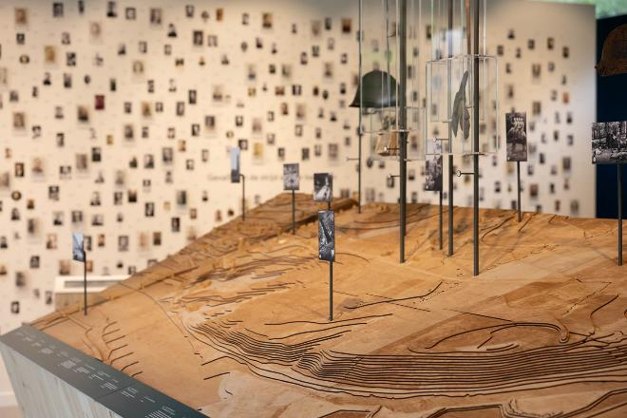
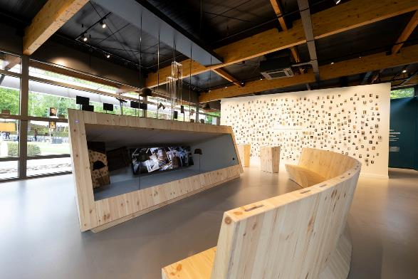
Mayday’s of 1940
Militair Ereveld Grebbeberg

Slide 4
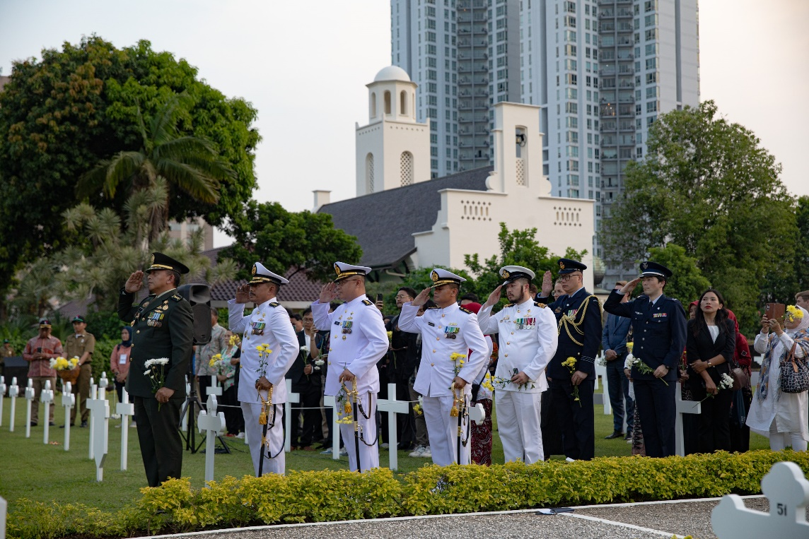
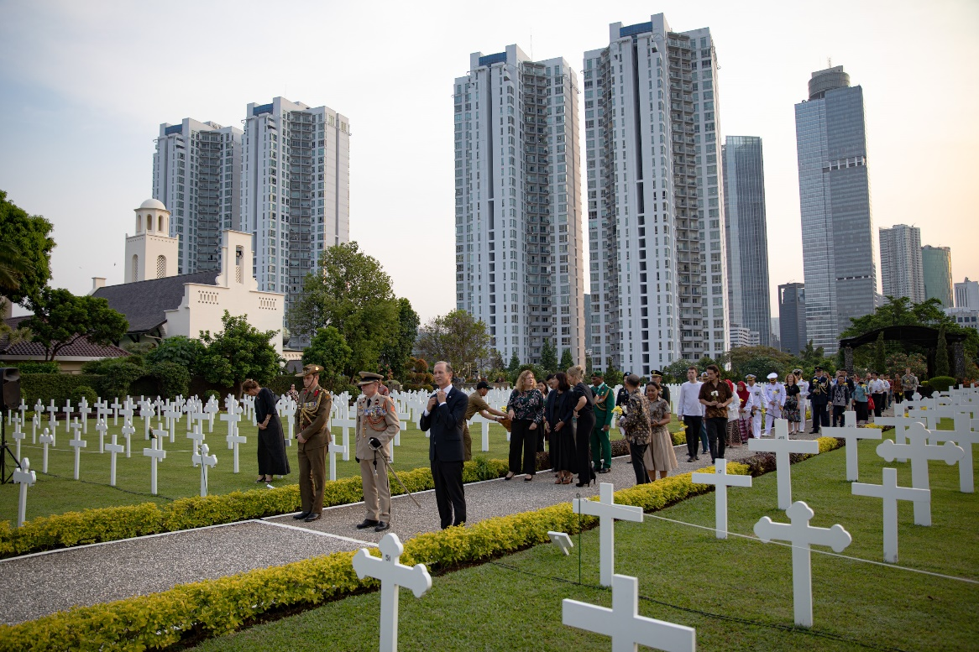
VJ-Day
VJ-Day, 15th of Aug 2025, Menteng Pulo Jakarta
Notes:
Streaming worldwide
Indonsian delagation
Remembrance cermonies at all
Presence of the Japanesd Defence Attache
Compilation of ceremony Mentung Pulo at national Dutch Remembrance ceremonie in The Hague

Slide 5
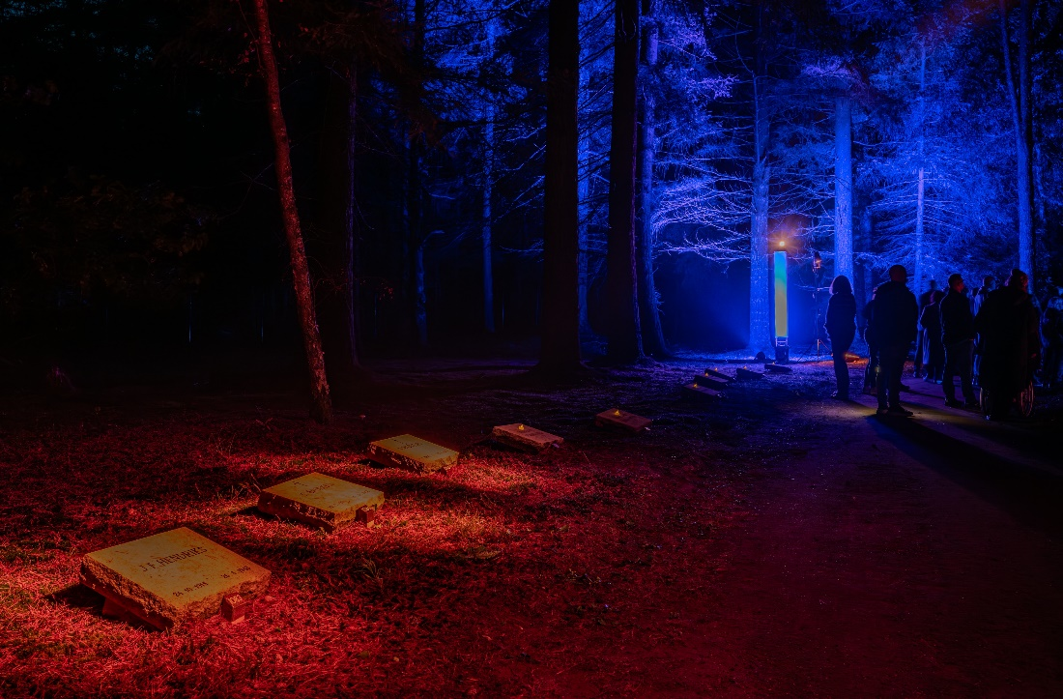
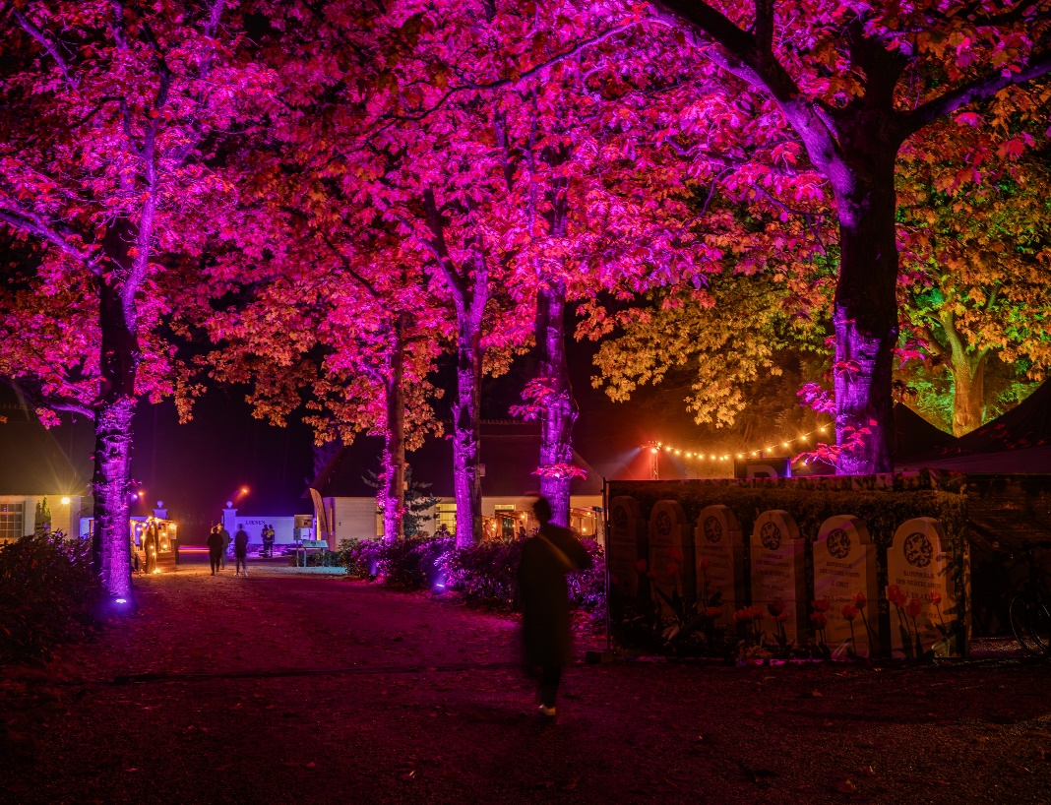
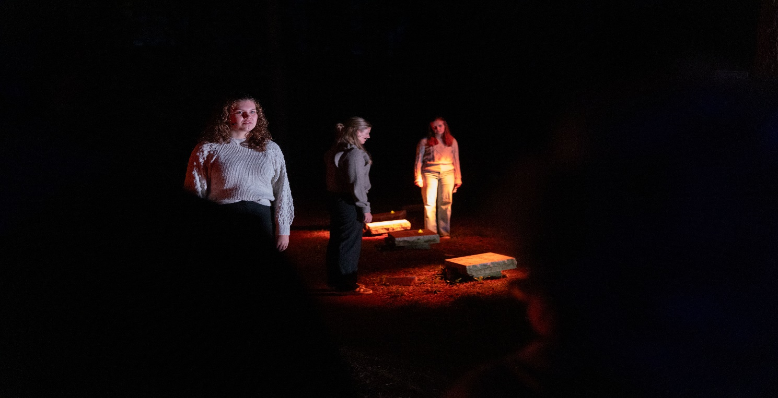
Walk of Light
75 years ereveld Loenen
National Ereveld Loenen, 2024
Notes:
Walk of Light 75Th Anniversary War Grave Foundation
4000?? Visitors

Slide 6
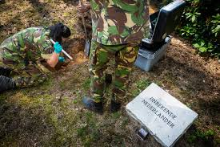
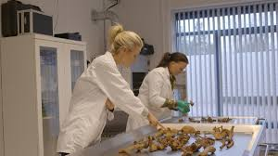
160 unknown victims of Loenen
Notes:
Identification of Unknown Dutch War Victims in Loenen
The Recovery and Identification Service of the Royal Netherlands Army (BIDKL), in collaboration with the Dutch War Graves Foundation, has begun exhuming the remains of unidentified individuals buried at the National Cemetery of Loenen in 2018
DNA samples are taken from each body, typically from the femur or dental elements.
Potential relatives are invited to come forward for DNA collection via cheek swabs.
The samples are compared using the Dutch Missing Persons DNA Database.
Archival research is also conducted, including records from the War Graves Foundation.
This initiative aims to restore identities and honor those who have remained nameless for decades.
Almost 50 victims haven been identified

Slide 7
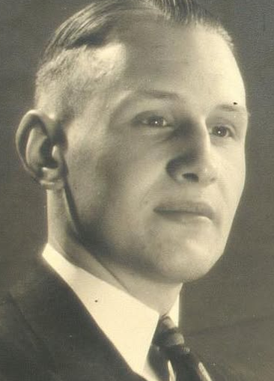
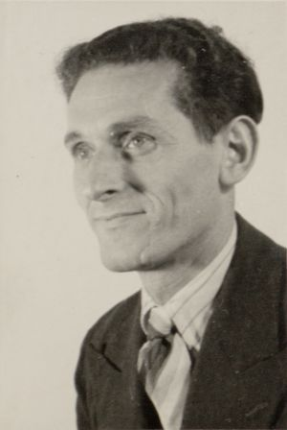
160 of Loenen
Notes:
Dirk de Veer 1922 Rotterdam – Mising since feb 2nd 1945 after being arrested at an attempt to crooss the rivers to reach the liberated south of the Netherlands.
July 2025 he was identified a stone with is name will be put on his grave in Loenen
Bernard Luza, identified in 2023 by DNA match through his nephew
Amsterdam, 10 december 1903 – Scheveningen, 15 februari 1943
Jewish Resistence Fighter
Nect week he will be exhumated and transferred to the jewish cementery in Diemen
Om Sunday 26th of his nephew, now living in Australia, wil unveal his grave monument at Diemen

Slide 8
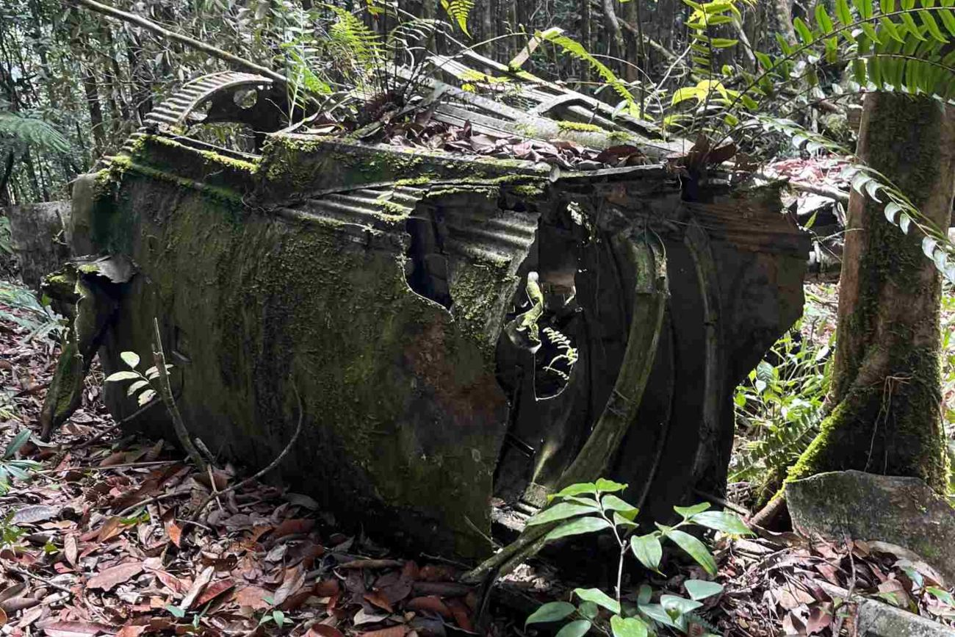
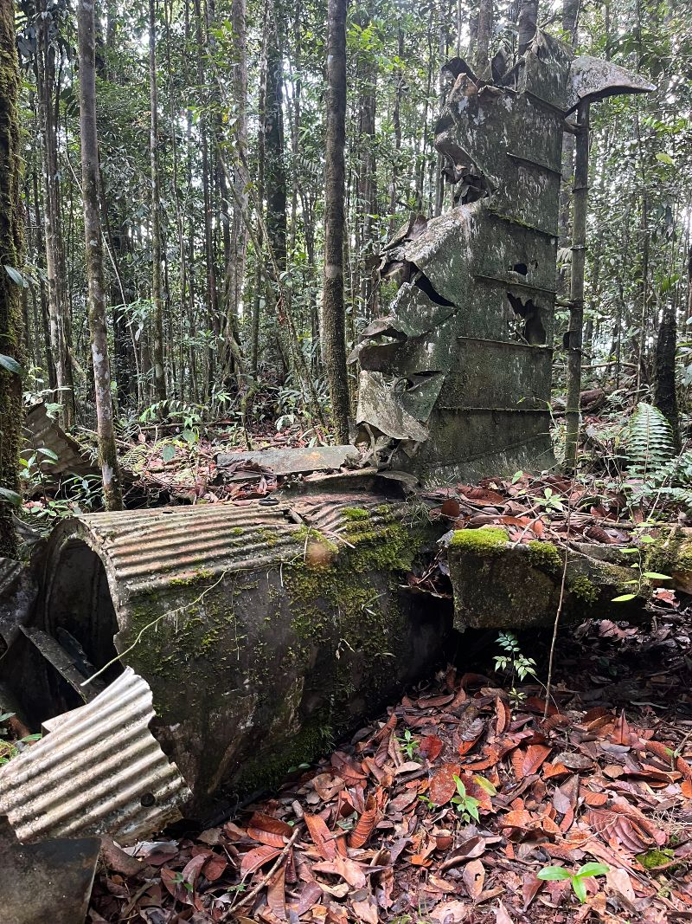
Kalimantan Project
Notes:
Six planes
Royal Ducth Indies Airforce
Recovery crews
Challenge: Jungle area and permits

Slide 9
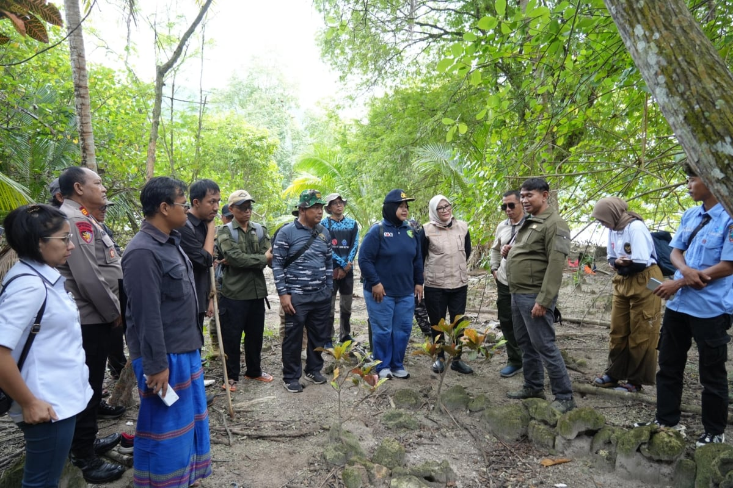
Sebuku Project

Slide 10
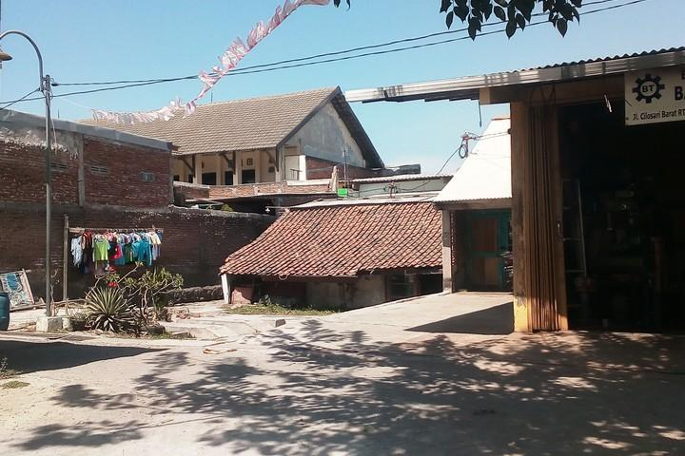
Semarang Project

Slide 11
Thank You

