Slide 1

Past and future
- Hungary
Notes:
Géza Kovács – MoD Institute and Museum of Military History, Hungary
Directorate of Wargravecare and Heroic Cult

Slide 2
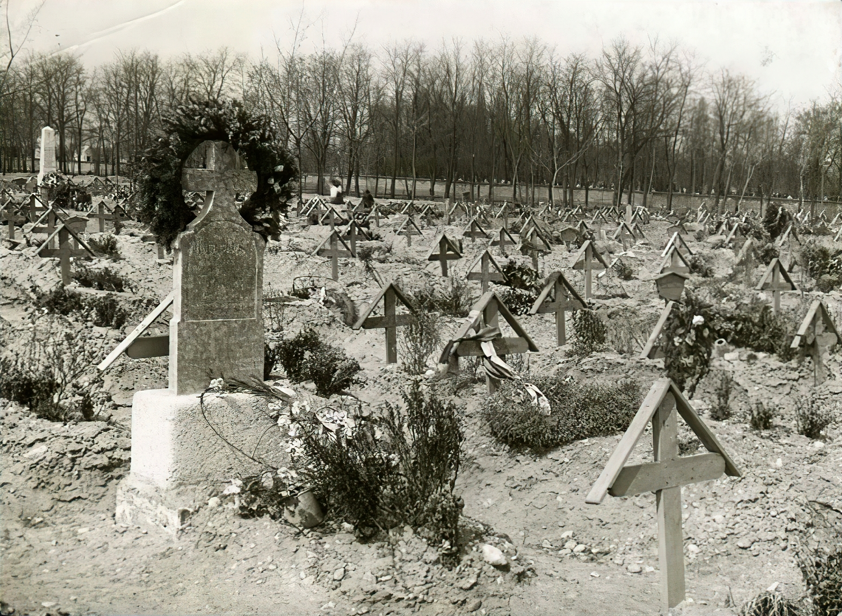
Background
Central origin of heroes’ commemoration
  WWI. 1917 – central regulation of war memorials
  1924 – memorial day of fallen heroes
WWII. – Hungarian Kingdom – frontline
  Incomplete KIA and MIA soldier's registry
Notes:
As in every country war grave care and the centralised rules of building memorials were founded during the WWI: 1917.
- Since 1924 we have the memorial day of fallen heroes
WWII: new situation – the country is on the front line since the late September of 1944.
The administration of the KIA and MIA soldiers became tragically complicated for the new year's eve of 1945.
The most registers and data were lost during the bombings and those facts are still missing
1990: regime change, democratic turning point
Last chance of talking with the war veterans, eyewitnesses of the funerals

Slide 3
Communist „legacy”
Forming the historical thinking
Forming and aiming the Hungarian self-awareness → communism still with us
We must defeat the consequences of a 40 years gap
Notes:
Communism started its attack on Hungarian life not just on the political podium but on the everyday life and that was the key to the everyday people → it steal our events, holidays, squares, street names, and of course our heroes. We had workers, communist „heroes” of the party or the communist nation. And slowly but surely our heroes' names, stories and everything in connection with their life and death was wiped out of the public consciousness.
Our soldiers had their graveyards, sections, they let civilians bury on their graves, or just left those without cleaning and reconstruction, without any chance to survive. There are many examples, one is on the picture: Bp. Új Köztemető – more than 10.000 graves were demolished. Even the written sources.
40 years of communism I don’t have to describe: systematic destruction of memorials and wargraves direct attack on the memorial places and persecution of the war veterans and their relatives, children, etc.
Since 1990 30 years was still not enough to pick every piece together in connection with our soldiers’ history, but we try.

Slide 4
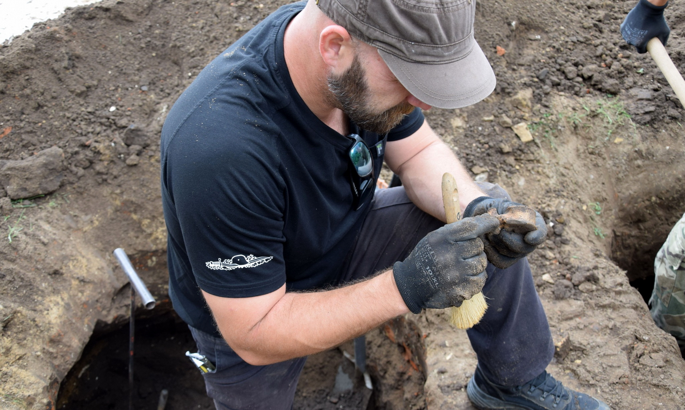
Mission
Consistent and step-by-step built remembrance policy
Bringing back our heroes and spread their story widely
Researching, publishing, encouraging the people visiting the graveyards
Main goal: discover the places of all KIA or MIA Hungarian soldiers and identify them and find their families
Notes:
We have to be there in the Hungarian peoples’, students’ everyday life so in the social media for instance – they are not necessarily reading studies in connection with the military history but they are clicking on a post showing a WWII military man from the past → we can have their attention during 30 second… but those are very important 30 seconds to us and for our duty
We have to plant a new kind of thinking about the cemeteries – our central military cemetery would like to represent that new flow: the cemetery is the place where you can widen your knowledge and where the visitors can physically find the hero of the stories: the Fiúmei Str. Graveyard is an ideal place for this
About the structure: From the 1990s the wargrave care working in the system of the Ministry of Defence within the Military History Institute and Museum moving in and out of it depends on the circumstances
Since 2010. the Hungarian wargravecare department, directorate or the legal predecessors has bright and clear focus on the strict professionalism on one purpose: find the graves of our soldiers and to identify them for their family members

Slide 5
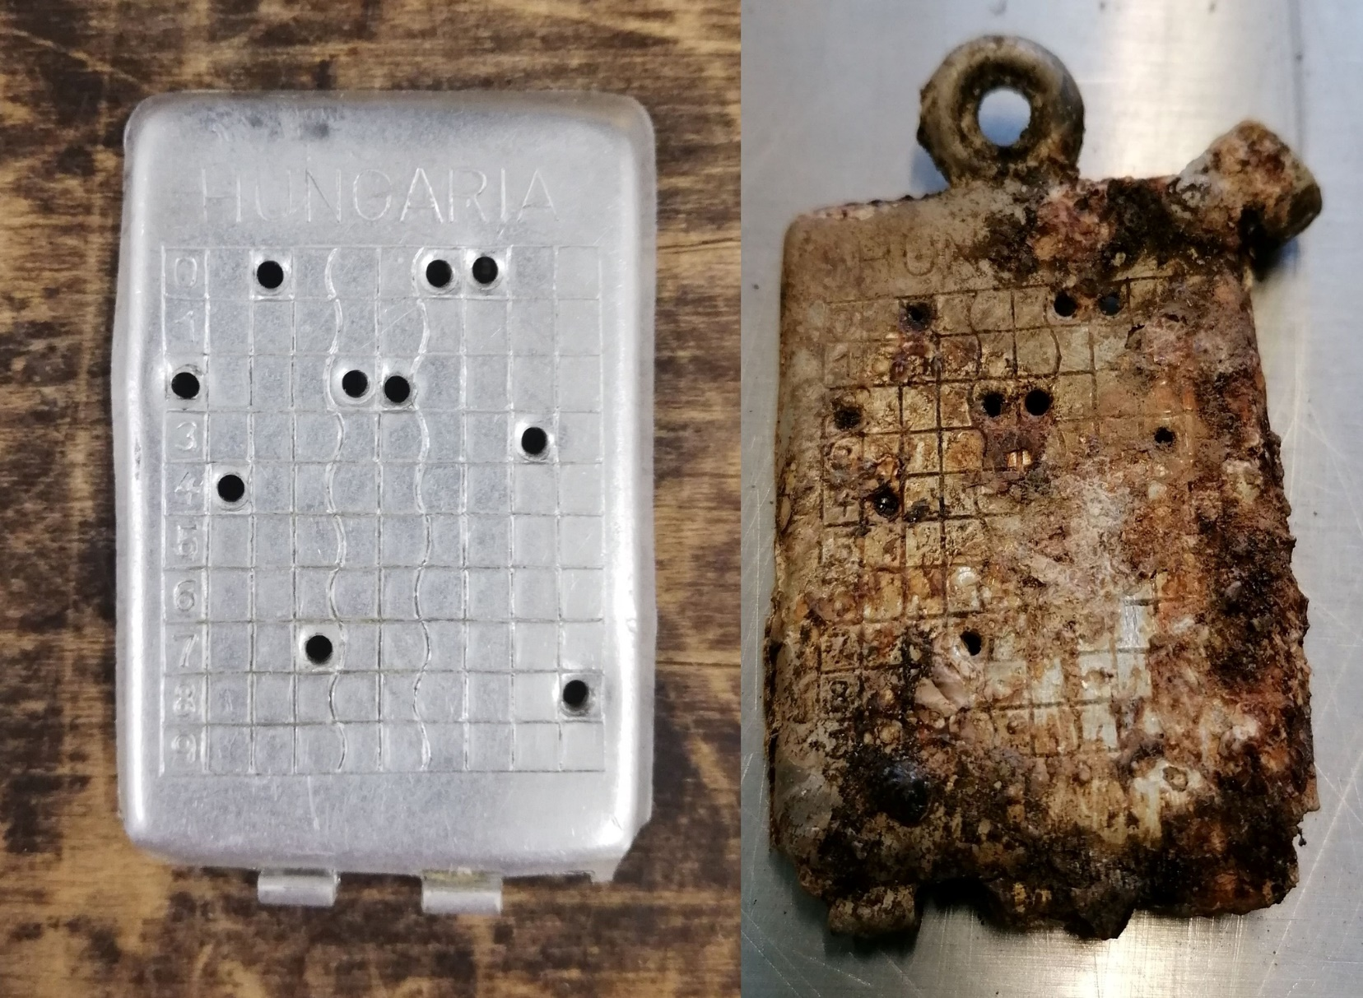
Role
Link between the past and the future
  Museum helps
  Databases
  Structure
  Research → Reburial
Notes:
Since 2010 the superiors or in the civil word so called managers wants to pair the capacity and the value to the structure now it works so I can tell that the ideal place of the wargravecare is in the Hungarian Military History Institute and Museum:
We have the research capacity with our researcher colleagues
We have the database – the archives can be found in one place – Military Archives and list of KIA, MIA, POW soldiers
We have the legal background – Hungarian MoD
We have the professionals – archaeologists, historians, traditionalists
We have the institutional background: logistical, financial background in one organisation
Our colleagues have the opportunity to start their searching work scrutinizing the Archive’s papers after they can have the matching vehicle to study the supposed to be burial scenes and after that build up the plan and organize the exhumations or the explorations for the following years. After that if they manage to find our soldiers and we can identify them, we can also burry them in the National Cemetery in the 52nd military section

Slide 6
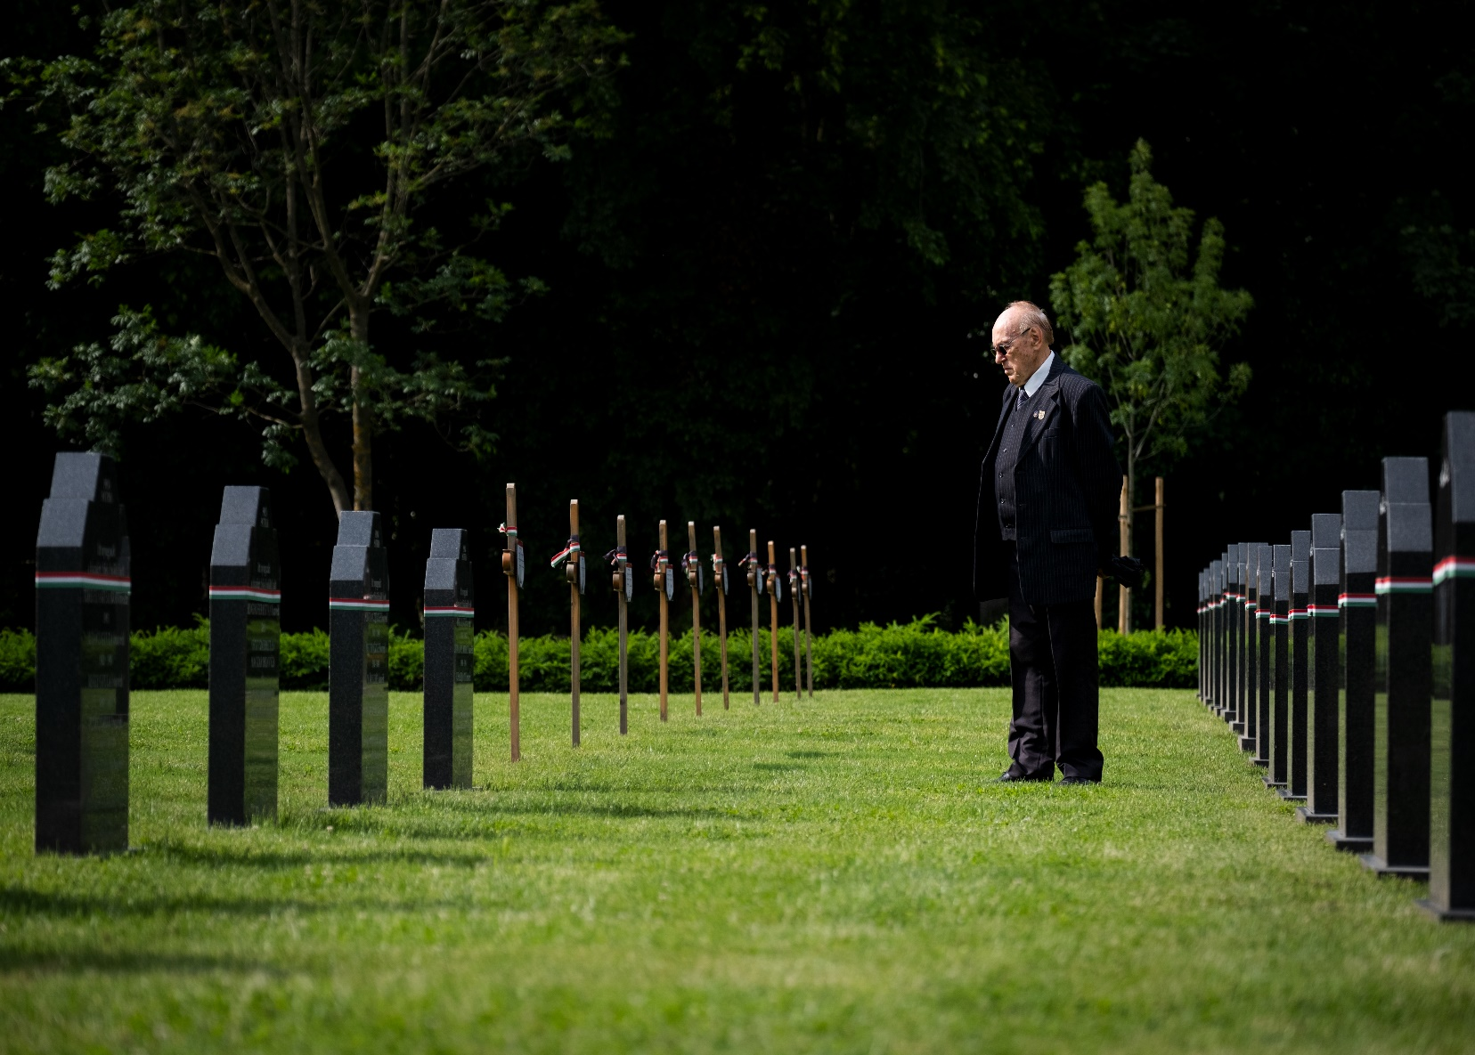
Role
Link between the past and the future
  Museum helps
  Databases
  Structure
  Research → Reburial
Notes:
Since 2010 the superiors or in the civil word so called managers wants to pair the capacity and the value to the structure now it works so I can tell that the ideal place of the wargravecare is in the Hungarian Military History Institute and Museum:
We have the research capacity with our researcher colleagues
We have the database – the archives can be found in one place – Military Archives and list of KIA, MIA, POW soldiers
We have the legal background – Hungarian MoD
We have the professionals – archaeologists, historians, traditionalists
We have the institutional background: logistical, financial background in one organisation
Our colleagues have the opportunity to start their searching work scrutinizing the Archive’s papers after they can have the matching vehicle to study the supposed to be burial scenes and after that build up the plan and organize the exhumations or the explorations for the following years. After that if they manage to find our soldiers and we can identify them, we can also burry them in the National Cemetery in the 52nd military section

Slide 7
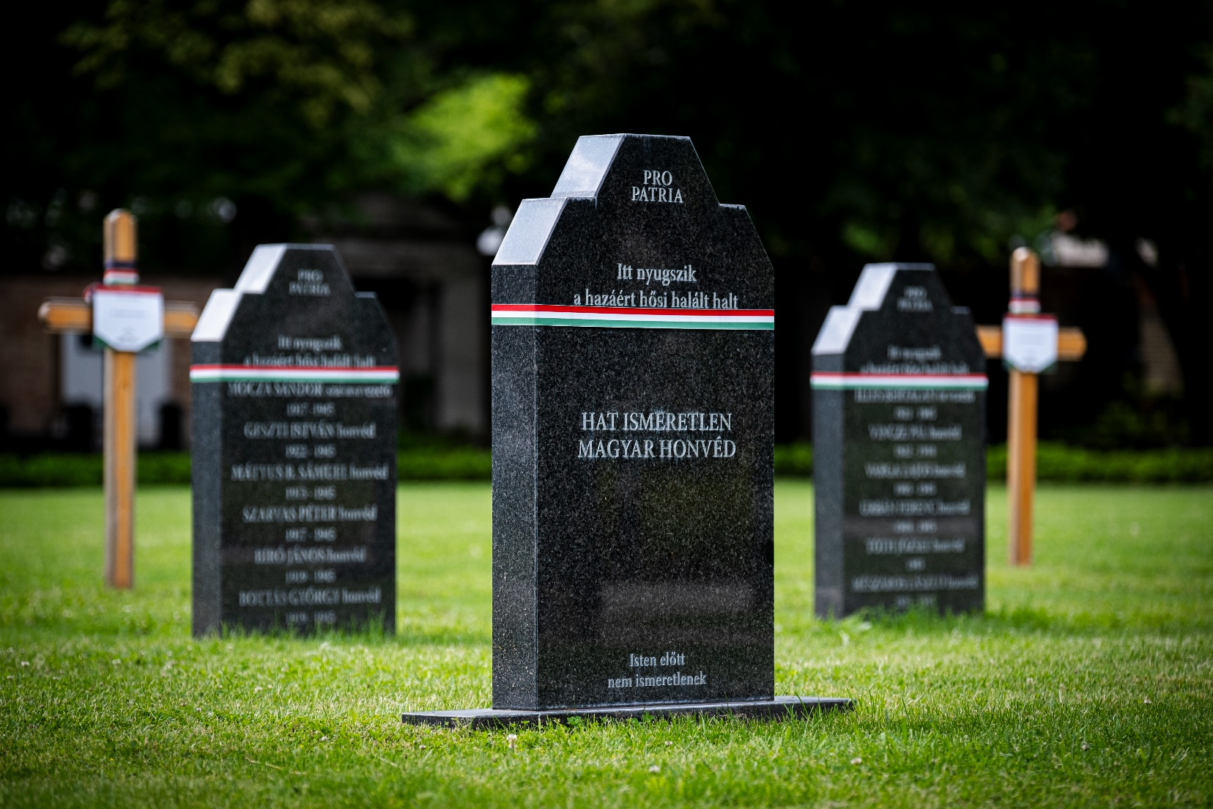
Tribute
Central cemetery and local memorial places
We should support the researchers and the local „historians”
Notes:
There is a need for the central cemetery – governmental memorials, central memorials
But there is a need for the local memorial places and those can be our heroes’ military sections in several cities or towns all over Hungary
We have to help the local researchers to find the stories of the local heroes, they have to tell the history of the broken families and the afterlife of the WWII standing next to the soldier’s grave.

Slide 8
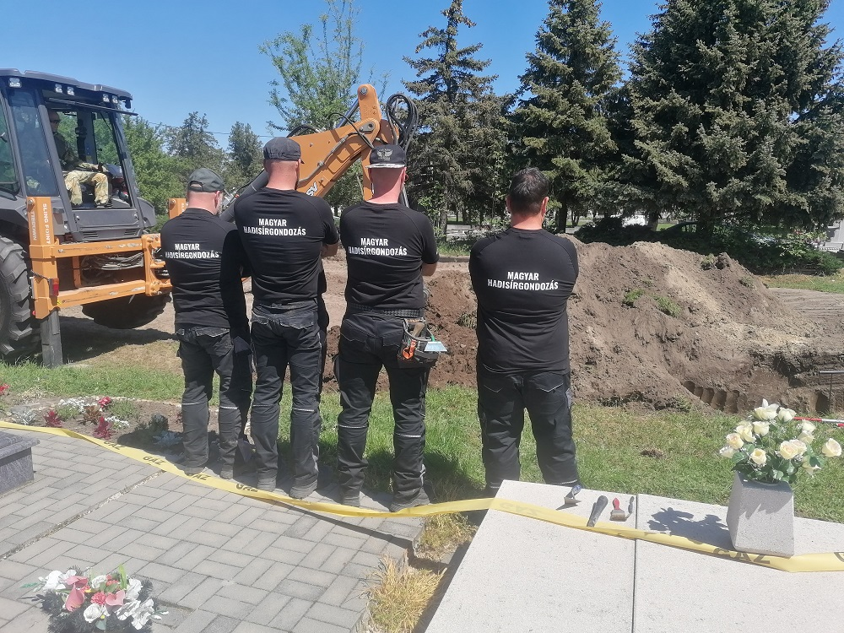
Future tasks
Focus on new policies
Help to improve effective research on the same or better quality
Notes:
We have to implement several new tools those we have right in front of us: AI is an effective tool, but we have to learn how to use it.
AI doesn’t have to kick the door in and using in every part of our job, but thoughtful and one step to the other it can be a very effective help
DNA policies – the biggest problem with it is its price and we have to be quiet and listen to the „older brothers” who have the working procedure and in Hungary we also have to work out the use of the DNA procedure on our field
More international dialogue, and exchange of experiences

Slide 9
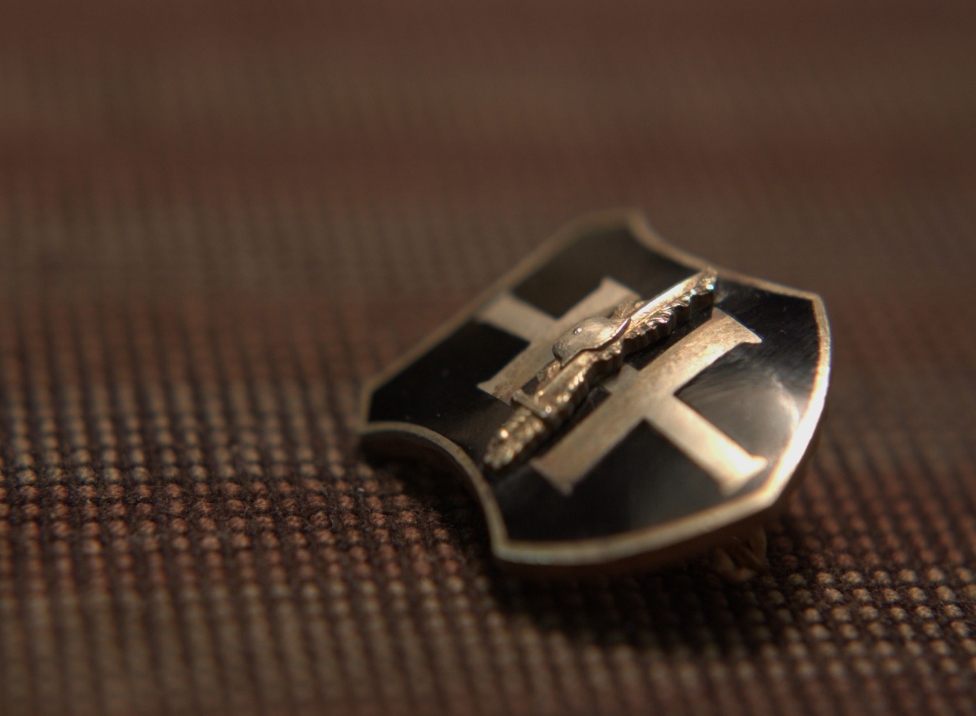
Contact
Address: 1087 Budapest Kerepesi út 29/B HUNGARY
E-mail: hadisir@hm.gov.hu
Facebook: https://www.facebook.com/hadisirgondozas/
Notes:
If anybody would like to keep in touch with us please don’t hesitate to write or call us!

