Slide 1

EWHG 2025
Prague
16-18 September 2025.
Legislation and financing of war grave care
Hungary
Lt Col Gyula Téglás
MoD Military History Institute and Museum
Directorate of War Graves and Heroic Cult

Slide 2
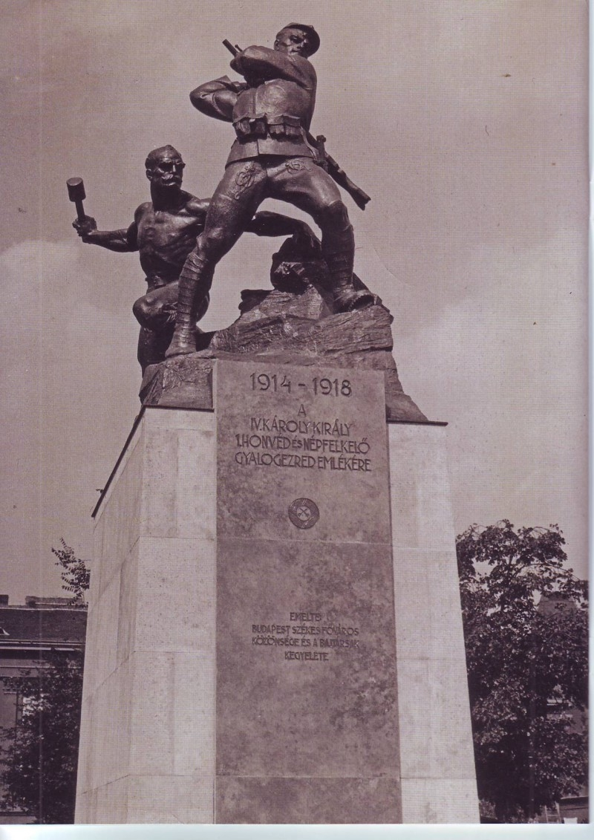
Historical background
Preservation of heroes memory – 1917
a worthy monument in every settlement
Celebration of heroes memory – 1924
Heroes' Memorial Day: the last Sunday in May every year
Renewal of heroes memorial day – 2001
Heroes' Memorial Day was abolished under the communist regime, it had to be renewed after that.

Slide 3
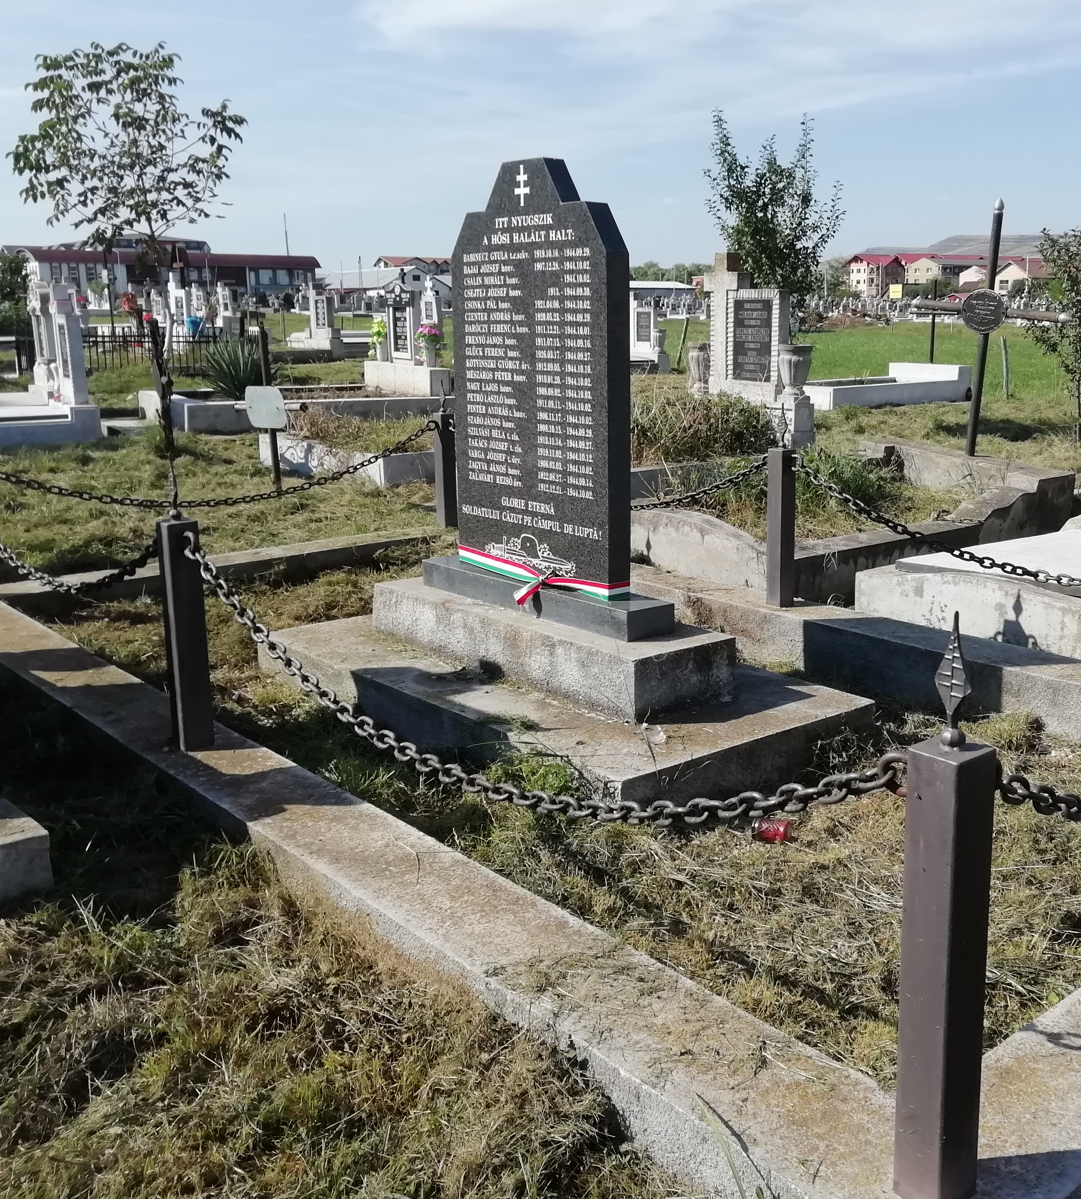
Current legislation
Law of cemeteries and funeral – 1999
Definition of heroes' cemetery and burial places:
- war-related death
Ministerial order of war grave care – 2021
Definition of war graves:
- heroes' cemetery and burial places
- burial places of important persons of the military history
- war monuments in cemeteries
- sites regulated in international law
Ministerial declaration of military funeral – 2013
Regulation of Heroes’ Cemetery:
- section nr. 52. in National Graveyard (Fiumei street, Budapest)
International law
- Geneva Conventions – 1949
- Gouvernmental Agreements (1993-2013, with 9 countries)

Slide 4
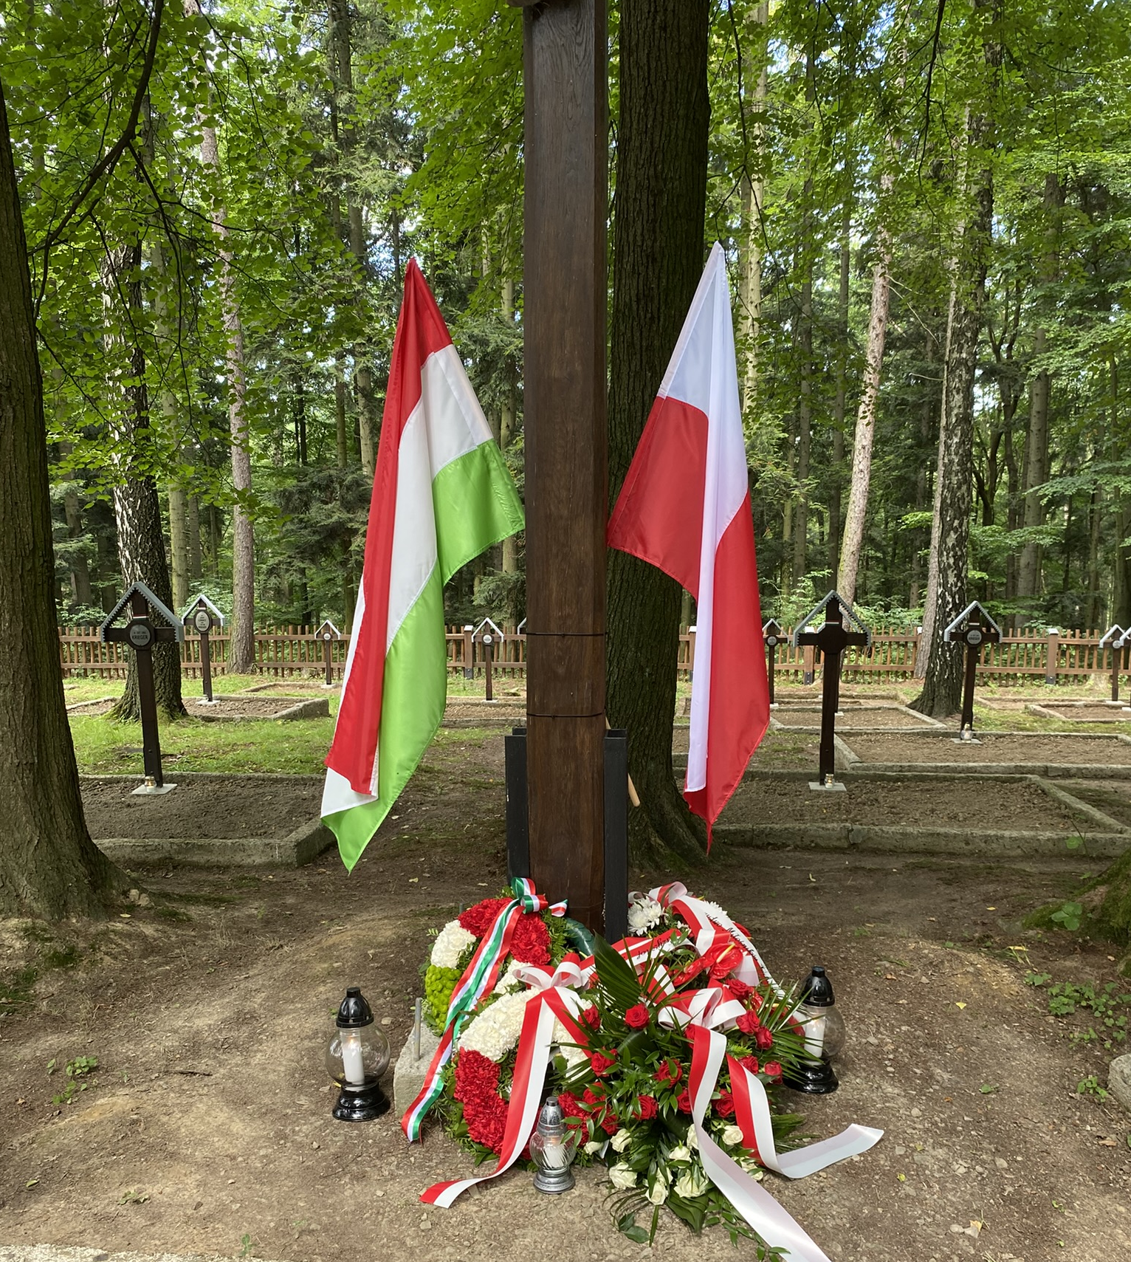
Financing
MoD Military History Institute and Museum
Background institution at Ministry of Defence:
- budget provided by the Ministry of Defence
Own execution of war grave care
- making a contract and the proof of fulfillment arranged by our institution
war grave care with the support of a civil organization
- approved plan
- money provided by our institution
- making a contract arranged by the civil organization
- proof of fulfillment arranged by our institution
Notes:
-

Slide 5

Thank you for your attention
  MoD Institute and Museum of Military History
  Directorate of War Graves and Heroic Cult
  Address: 1087 Budapest Kerepesi út 29/B - Hungary
  Facebook – Magyar Hadisírgondozás
  E-mail: hadisir@hm.gov.hu
  Website: https://katonahoseink.militaria.hu/

