Slide 2
EWHG Meeting | Prague, Sept. 17th 2025

Slide 3
Table of Contents
01 | Legislation and financing of war grave care
02 | What has been done in the past period and what is planned in the future?

Slide 4
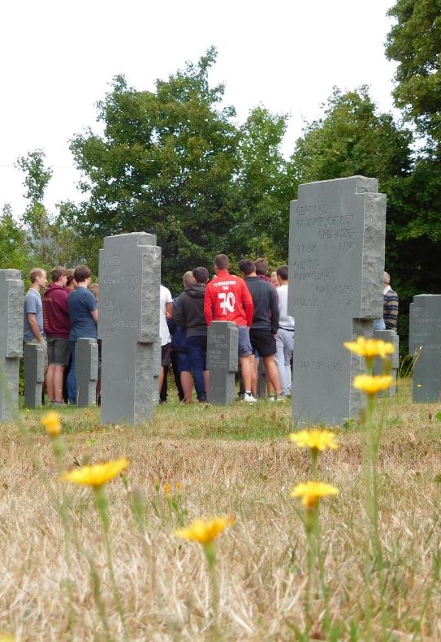
War dead are soldiers and…
Victims of forced labour
Victims of Nazi persecution
Victims of bombing raids
Victims of flight and expulsion
Victims of communism
“Victims [and perpetrators] of war and tyranny”
Graves Act, Article 74 of the German Constitution “...to commemorate the victims of war and tyranny in a special way and to keep alive the memory of the terrible consequences of war and tyranny for future generations.”
Notes:
Not all those buried in war cemeteries are soldiers. War cemeteries are also the final resting place for forced laborers, prisoners of war, children, women, civilians, and people from many different countries.
This raises questions such as: Were they war criminals or followers? How did they become involved in the machinery of war? How did they behave? What choices did they have? Could they have resisted?
These and many other questions open up a personal approach to the history of Nazism through the examination of biographies.
This also makes it possible to generate a deeper interest. The work at the cemetery, the discussion with peers, and the guided reflection on the biographies leave a lasting impression on the young people.

Slide 5
War Graves Commission in 60 seconds (1/2)
War grave maintenance is a federal responsibility (Article 74 of the German Constitution).
In Germany (1.8 million graves in around 12,000 cemeteries), responsibility is delegated to local authorities and municipalities under the Graves Act (over €40 million annually, “maintenance allowance”).
Volksbund in Germany: advice, education, remembrance
Abroad (2.8 million graves in over 830 cemeteries) regulated by bilateral war graves agreements, task performed by the Volksbund (project funding since 2003, since 2019 with €19.38 million annually (plus prisoner of war project plus PEACE LINE)
Responsibilities include: War graves 1870/71 (FRA), war graves 1914-1918, war graves 1939-1945, war graves 1945-19xx (e.g. prisoners of war)

Slide 6
War Graves Commission in 60 seconds (2/2)
Not responsible: e.g., colonial troops before 1914, World War I sites in Poland
Responsible, but still open: Serbia, Kosovo
Parameters:
  24 war gravesites World Heritage Sites
  Approx. 12,000 reburials/year
  Approx. 15,000 inquiries/year
  Approx. 35,000 young people (domestic/foreign) reached per year
  Approx. 66,000 members
Only non-governmental war graves service in Europe, over €900 million collected since the end of World War II

Slide 7
Financing of the work abroad

Slide 8
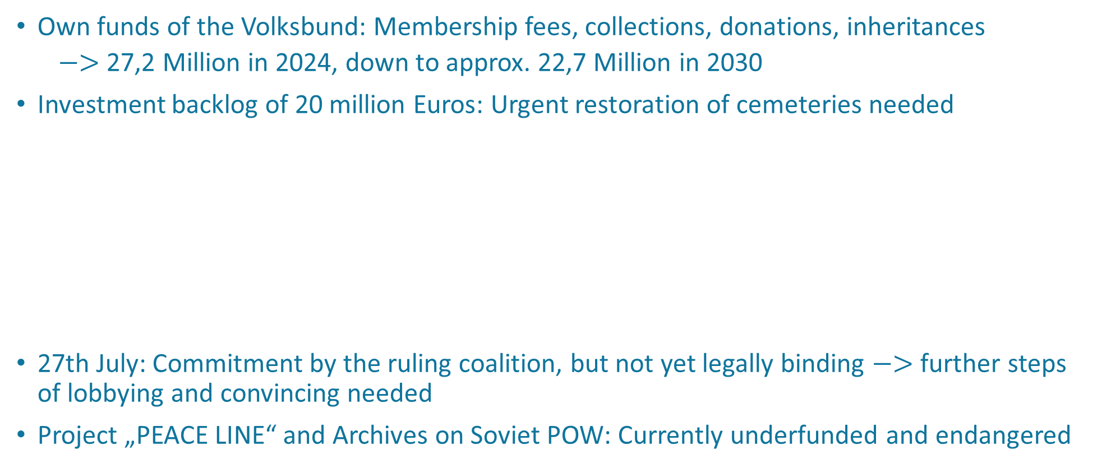
Need of further financing
Own funds of the Volksbund: Membership fees, collections, donations, inheritances
  $−>$ 27,2 Million in 2024, down to approx. 22,7 Million in 2030
Investment backlog of 20 million Euros: Urgent restoration of cemeteries needed
The Volksbund's work abroad is partly funded by the government, but its work in Germany has not been funded to date. Funding for work abroad has not been increased for many years, so the Volksbund has asked the Bundestag for support so that it can continue its work on behalf of the government.
27th July: Commitment by the ruling coalition, but not yet legally binding $−>$ further steps of lobbying and convincing needed
Project „PEACE LINE“ and Archives on Soviet POW: Currently underfunded and endangered

Slide 9
Table of Contents
01 | Legislation and financing of war grave care
02 | What has been done in the past period and what is planned in the future?

Slide 10
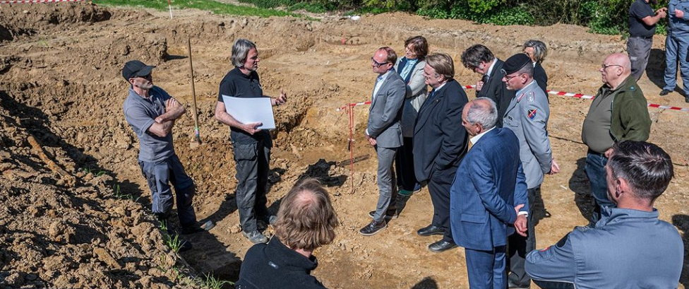
World War I: Exhumation on a golf course in Ypres
The services of the four nations GBR, BEL, FRA, and DEU have been combined for the first time.
Notes:
Summary of the project to recover the remains of soldiers who fell in World War I
A joint project between the German War Graves Commission and the Commonwealth War Graves Commission (CWGC) has led to the exhumation of soldiers from World War I at the Palingbeek golf course in Belgium. An international team recovered 22 war dead, whose remains will be handed over to the Belgian police before being forwarded to the War Heritage Institute (WHI) for identification.
The project, which began on March 31, 2024, demonstrates the close cooperation between various national organizations. Rich Hills of the CWGC highlights the support provided by local authorities and emphasizes that the project sets a new standard for future measures. The identification and reburial of the fallen is being coordinated by the Volksbund and the CWGC.

Slide 11
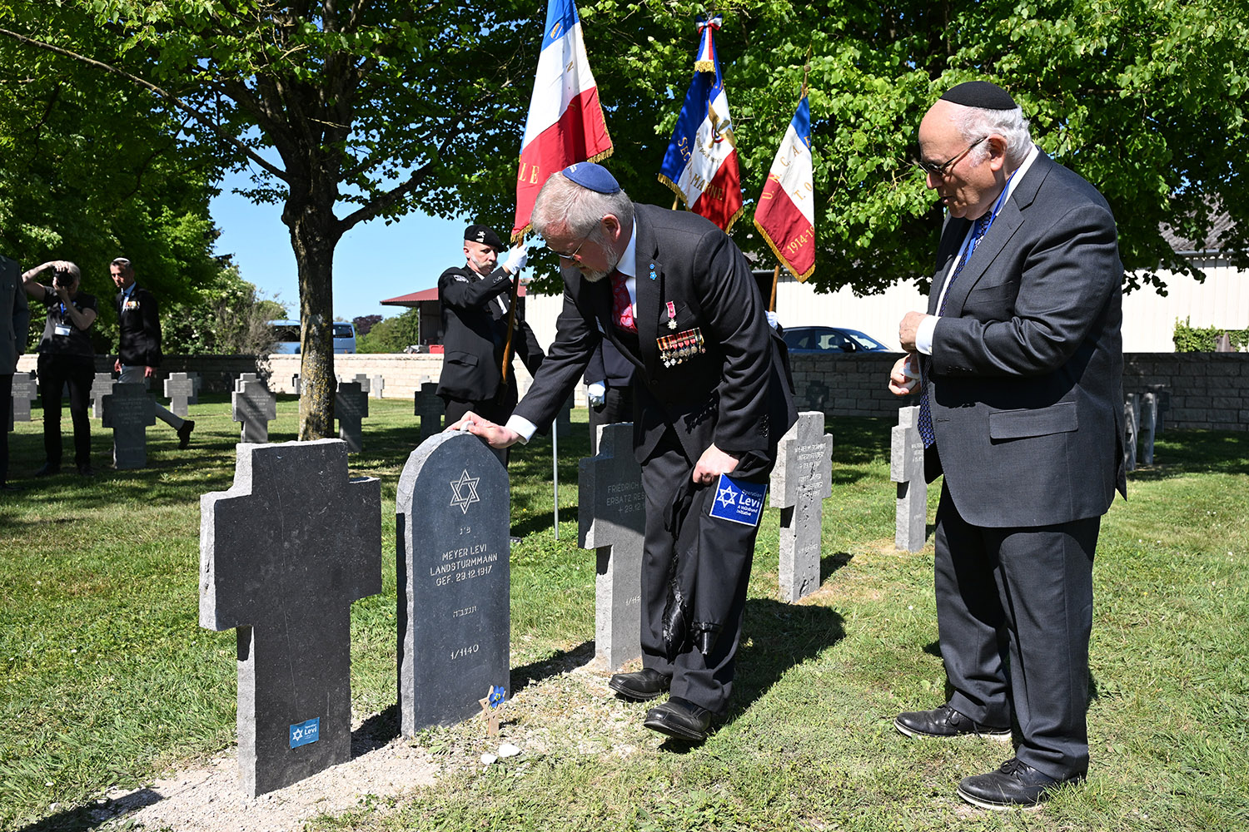
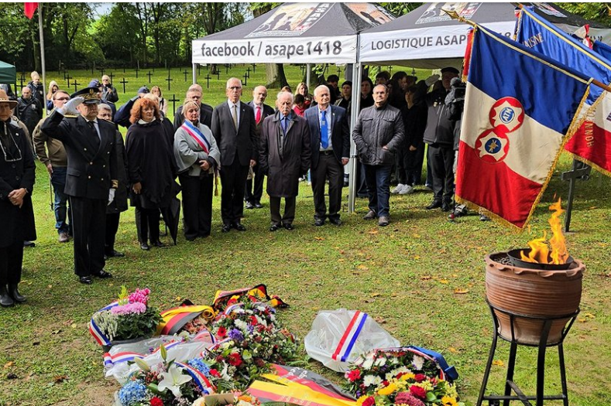
“Operation Levi”: Remembering Jewish soldiers of World War I
Warmeriville and Bertrimoutier:
Inauguration of Jewish gravestones, May 2025
The German War Graves Commission has replaced Jewish gravestones destroyed by vandalism at the Moulin-sous-Touvent war cemetery, Oct 2024
Notes:
What is often unknown today is that around 100,000 Jewish soldiers served in German uniforms between 1914 and 1918.
Since 2023, the Volksbund's efforts to give them a grave marker with a Star of David have been known as Operation Levi.The Volksbund currently knows of around 2,500 individual graves with Stars of David in German war cemeteries in western and southern Europe. However, many German soldiers of the Jewish faith are buried under Christian grave crosses. The reason: especially in France, many temporary German military cemeteries were dissolved after 1918 and merged into larger units. In the turmoil of the post-war years, Jewish grave markers were often replaced by crosses (mostly made of birch wood). In recent decades, the Volksbund has been able to mark a number of Jewish individual graves with steles and the Star of David instead of crosses.

Slide 12
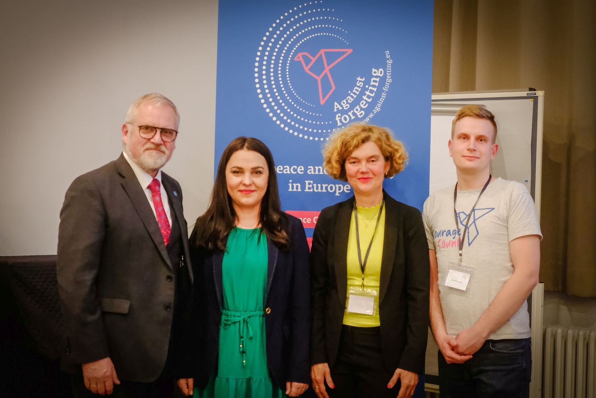
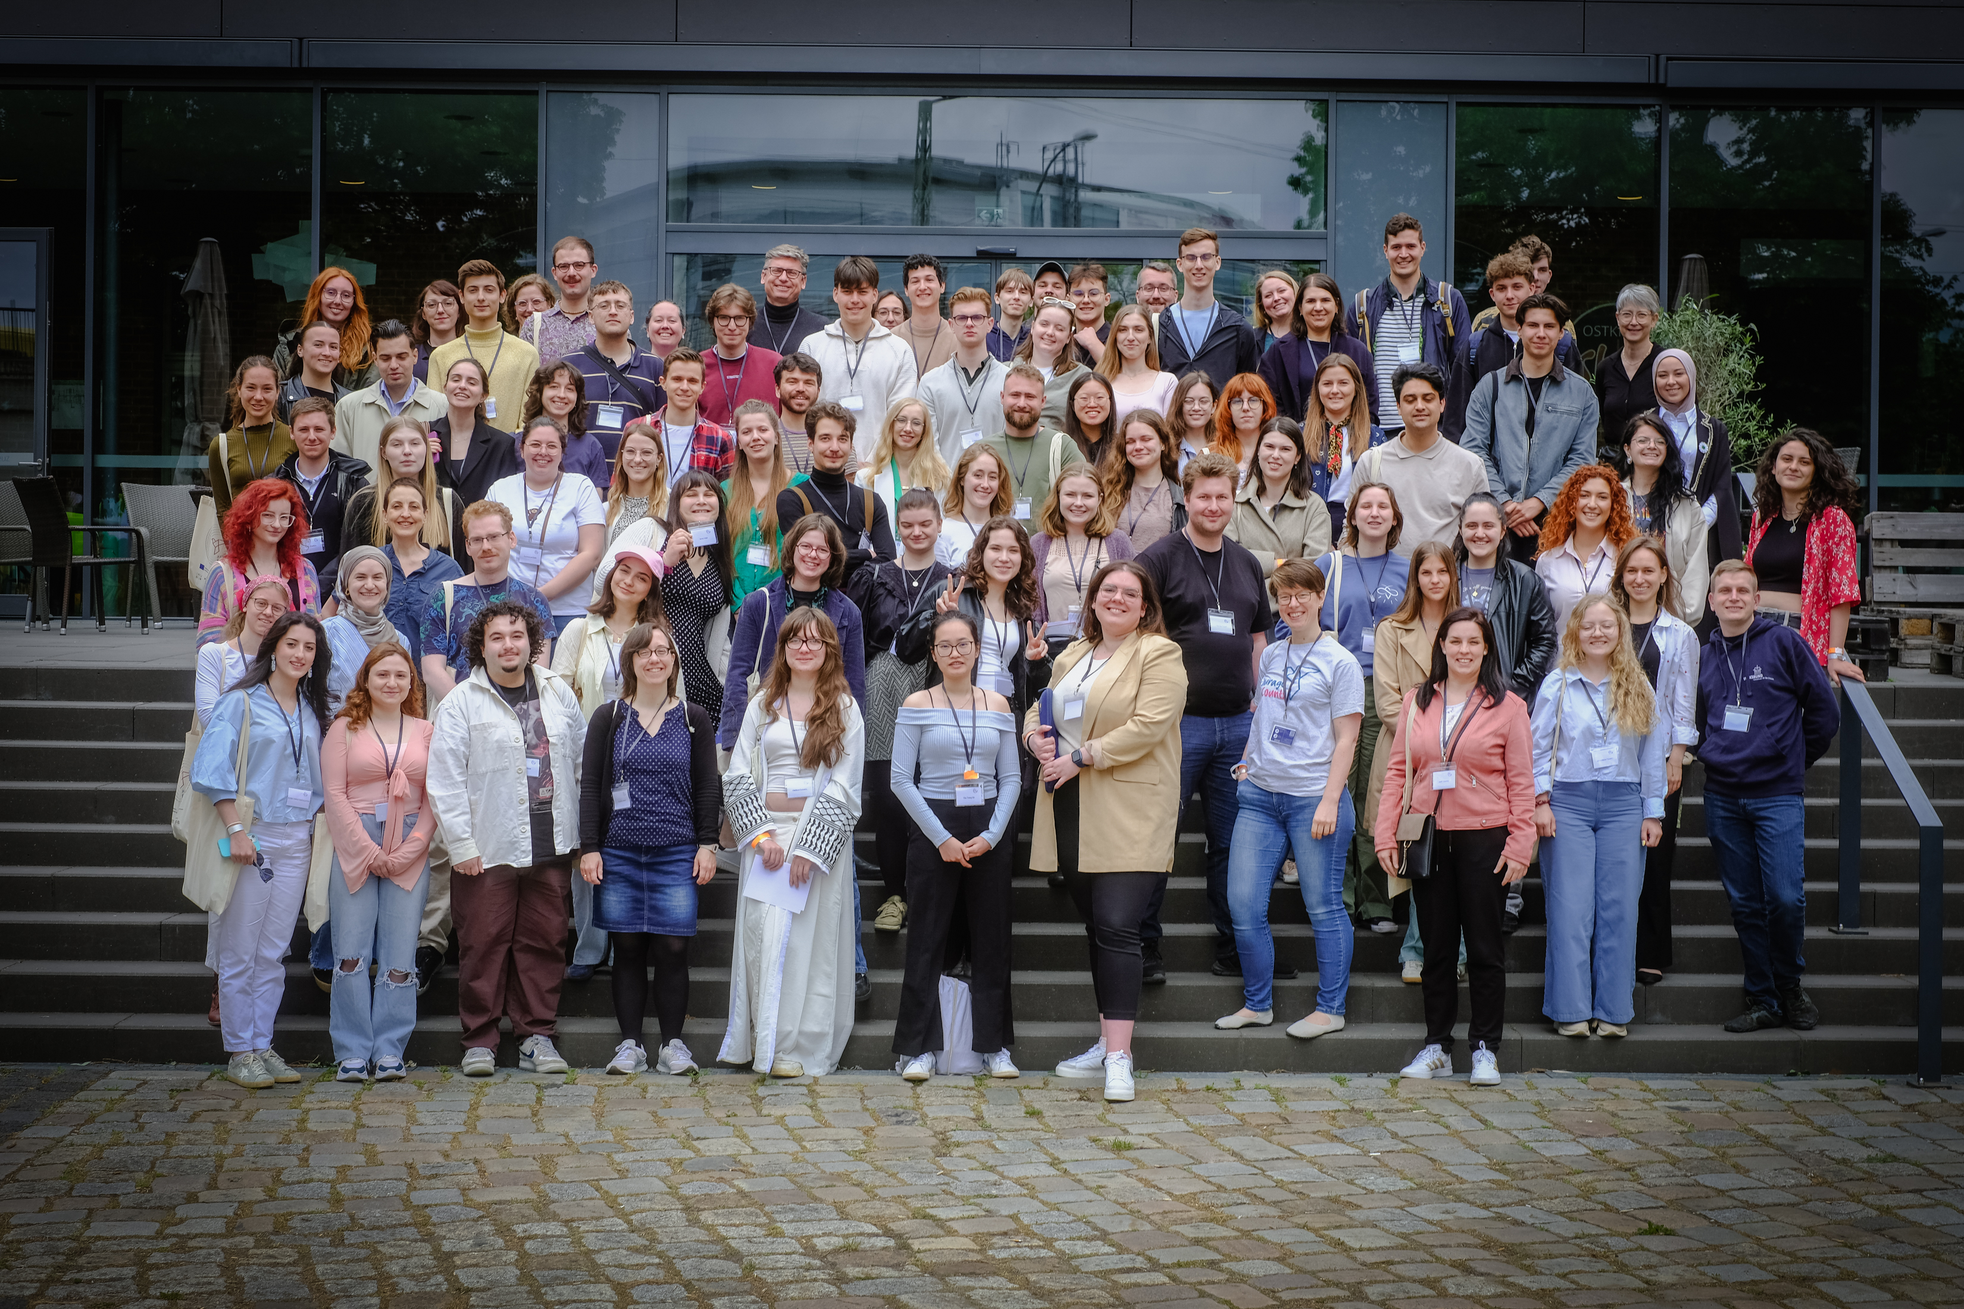
“Peace Congress” May 2025 in the framework of CERV –
First use of these EU-funds by Volksbund
They came from 17 countries to attend the Peace Congress in Berlin: 110 participants aged between 15 and 30.
Notes:
This was the second time that the German War Graves Commission had issued invitations to attend. The core topics of the three-day event were war crimes, human rights, and shared European values. Lectures were given by Ukrainian journalist and human rights activist Tetiana Pechonchyk and criminal and international law expert Prof. Claus Kreß.
“Against forgetting – for Peace and Solidarity in Europe” is funded by the EU program ‘CERV’ (“Citizens, Equality, Rights and Values”). Grants come from the Federal Foreign Office, the Children and Youth Plan of the Federal Ministry for Youth, and the Franco-German Youth Office.

