Slide 1
European War heritage Working Group
Prague 17 septembre 2025
Christian DOUALE
Ministry of armed forces - FRANCE
Christian Douale – Prague Sept. 2025 – European War Heritage Working Group

Slide 2
From 1871, the desire to individualize burials
Law of 2 July 1915
Mention « Dead for France »
Soldiers bodies returned to their families
Soldiers bodies not returned
To their families
Law of 29 December 1915
Perpetual maintenance by the French State
Private burial
Christian Douale – Prague Sept. 2025 – European War Heritage Working Group

Slide 3
The State operators
Veterans affairs agency
Office national des combattants et victimes de guerre
(ONaC-VG)
The overseas military headquarters
Commandements supérieurs des forces armées dans les territoires ultramarins
The Embassy Defense Attaches
Attaché de défense près l’ambassade
290 national cemeteries
2 170 military corners
10 France national remembrance high sites
47 overseas military cemeteries
1 000 sites of perpetual burials in 89 countries
Christian Douale – Prague Sept. 2025 – European War Heritage Working Group

Slide 4
Typologies of remembrance sites in France
Christian Douale – Prague Sept. 2025 – European War Heritage Working Group

Slide 5
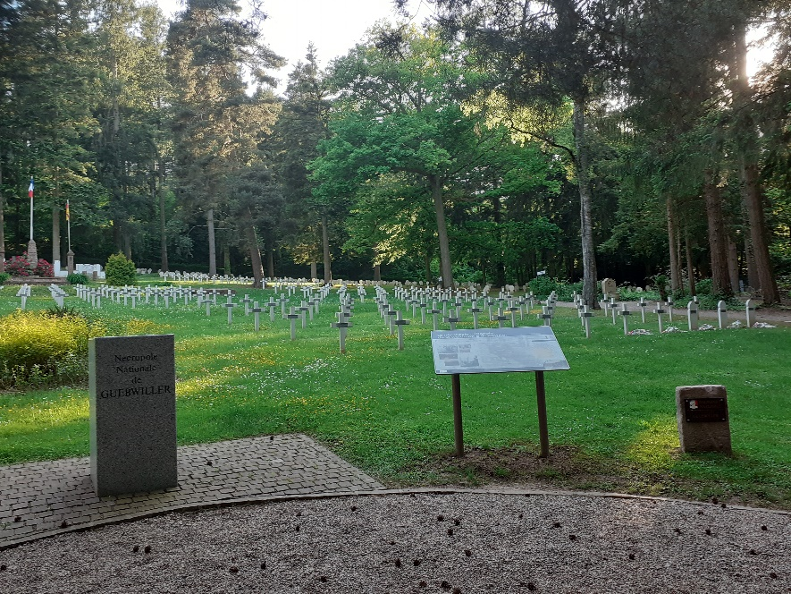
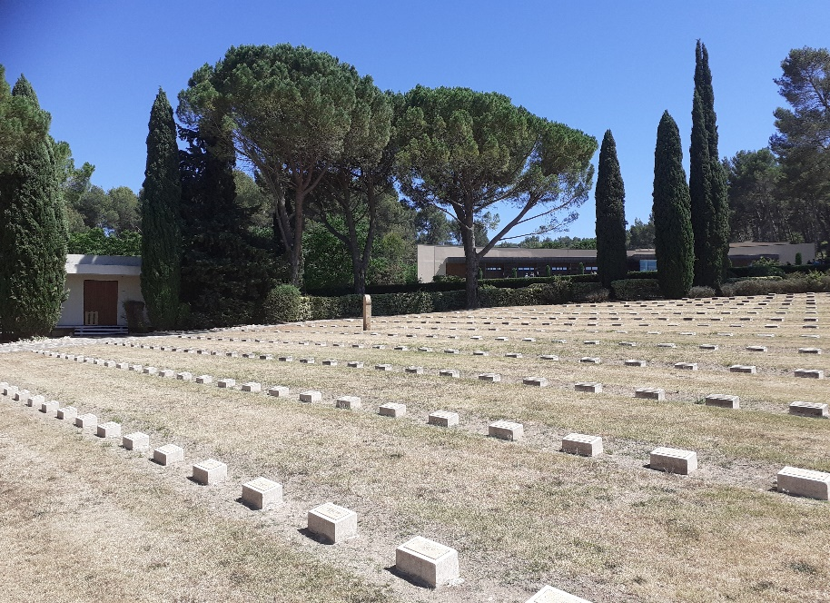
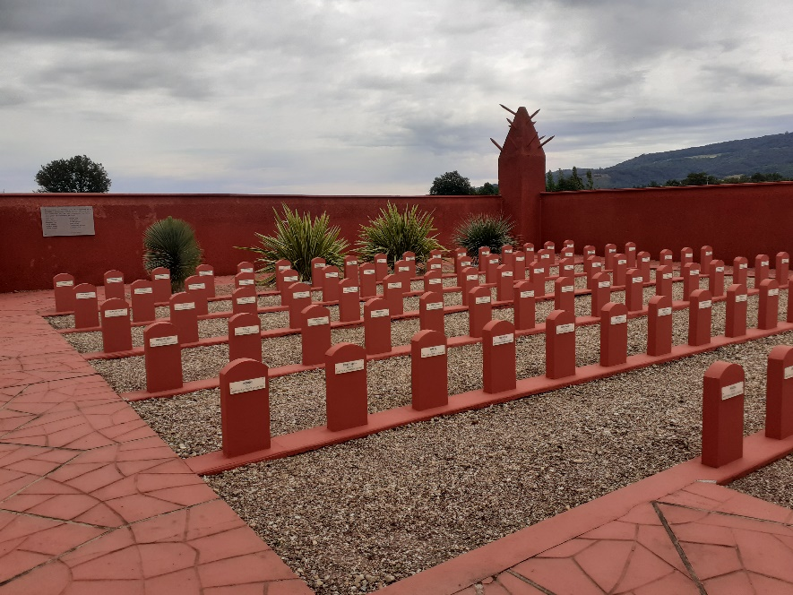
The 290 national cemeteries
Guebwiller (68)
Aix-en-Provence (13)
Luynes
Chasselay (69)
Tata sénégalais
Christian Douale – Prague Sept. 2025 – European War Heritage Working Group

Slide 6
The 290 national cemeteries
Property of the Ministry of Armed Forces (Land, builts elements)
ONaCVG ensures the maintenance and the restoration work
Ministry of Armed Forces delegates the budget to ONaCVG
Christian Douale – Prague Sept. 2025 – European War Heritage Working Group

Slide 7
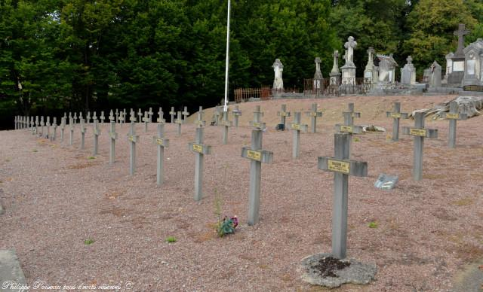
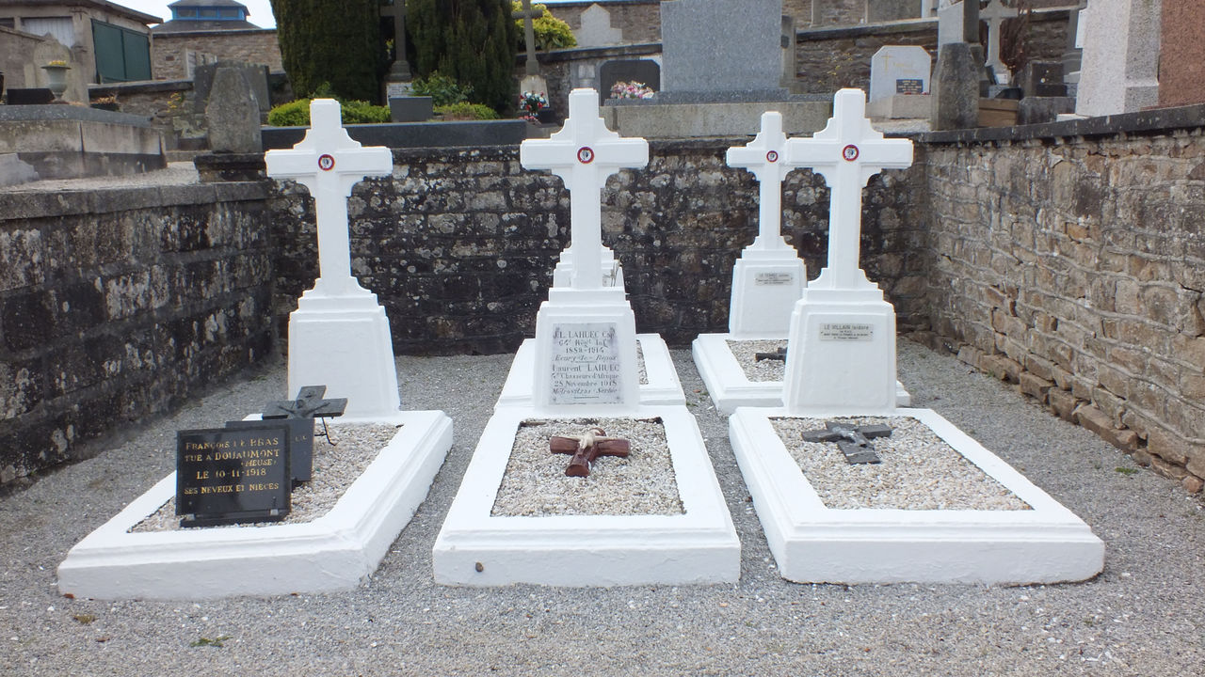
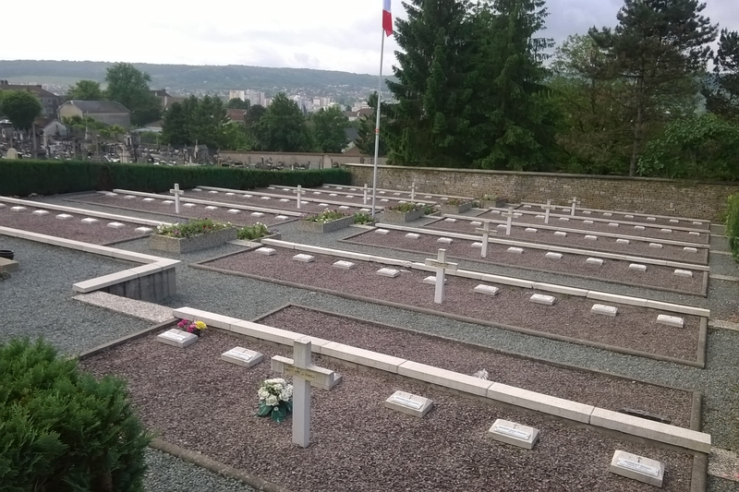
The 2170 military corners
Corbigny (58)
Perpetual burials
Concarneau (29)
Private burials
Proyart (70)
Perpetual burials
Christian Douale – Prague Sept. 2025 – European War Heritage Working Group

Slide 8
The 2170 military corners
Property of local authority (Land) builts elements)
Responsible of the Ministry of Armed Forces for built elements and for the bodies
ONaCVG delegates the maintenance to local autorities for main of them
and ensures the restoration work
Ministry of Armed Forces delegates the budget to ONaCVG
Christian Douale – Prague Sept. 2025 – European War Heritage Working Group

Slide 9
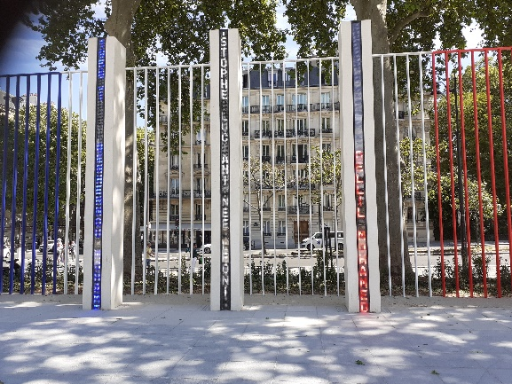
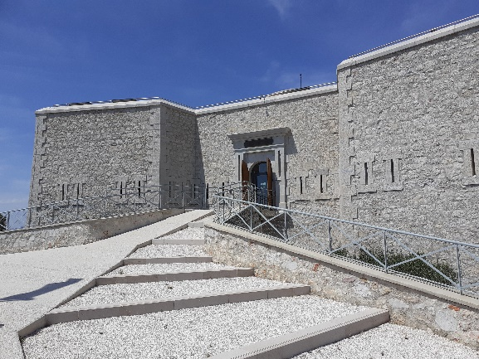
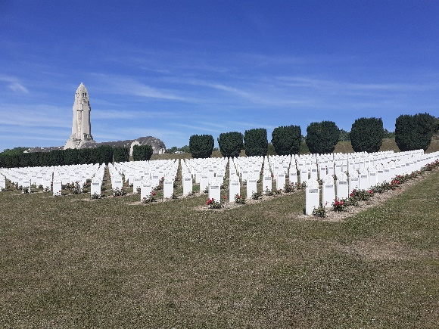
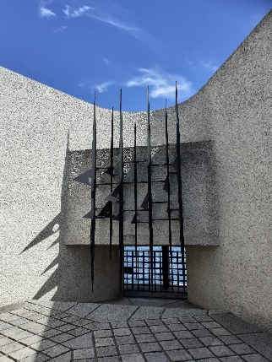
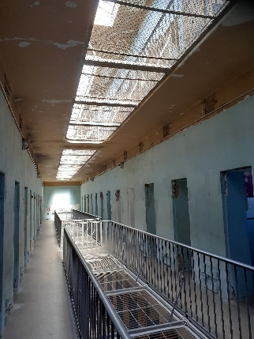
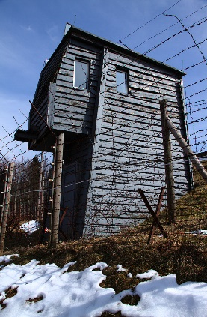
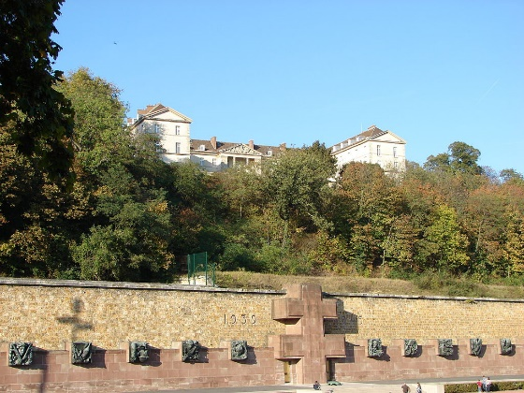
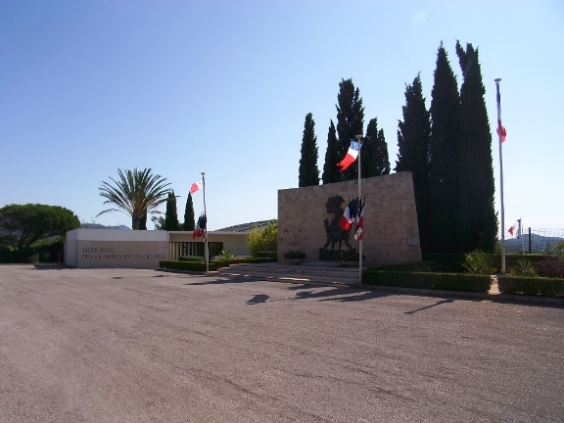
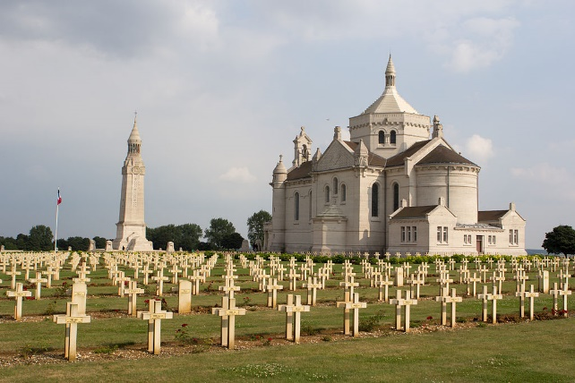
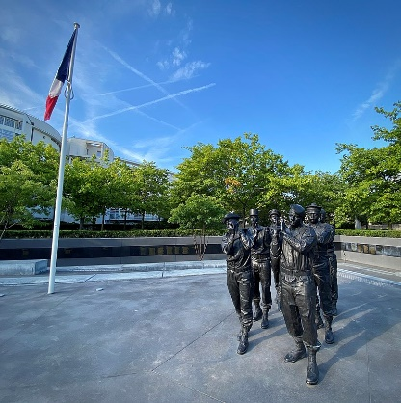
The 10 France national remembrance high sites
War monument of Algeria
Paris
Memorial of the Martyrs of the Deportation - Paris
Memorial of the landings in Provence - Toulon
Prison of Montluc
– Lyon
The Fleury-sous-Douaumont cemetery
Struthof camp - Natzweiler
Mont Valérien - Suresnes
Memorial of Indochina wars - Fréjus
Notre-Dame de Lorette cemetery
OPEX memorial

Slide 10
The 10 France national remembrance high sites
Property of the Ministry of Armed Forces
ONaCVG ensures the maintenance and the restoration work
ONaCVG welcomes the public with a mediation team
Ministry of Armed Forces delegates the budget to ONaCVG
Christian Douale – Prague Sept. 2025 – European War Heritage Working Group

Slide 11
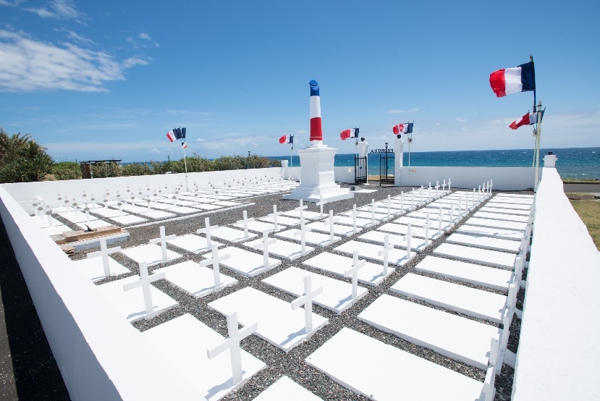
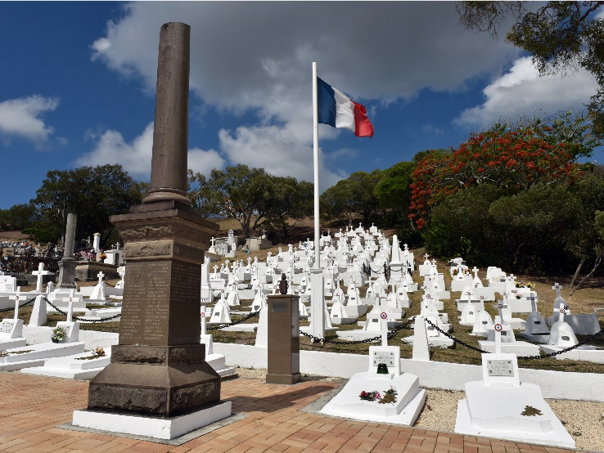
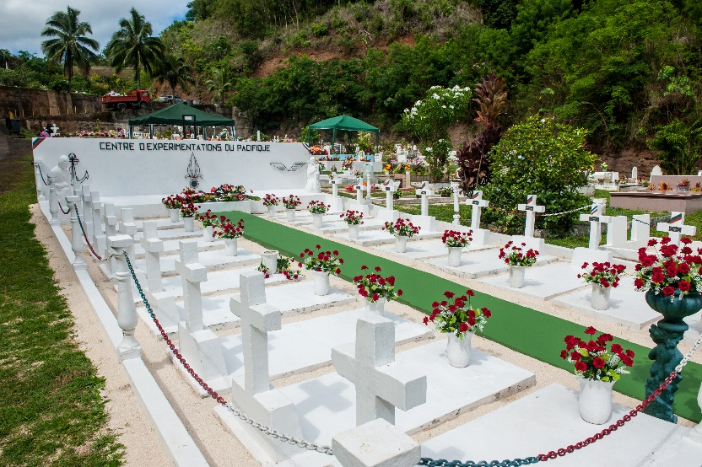
47 Overseas military cemeteries
Fazsoi– La Réunion
Cimetière km 4 - Nouvelle-Calédonie
Cimetière Uranie – Polynésie française
Christian Douale – Prague Sept. 2025 – European War Heritage Working Group

Slide 12
47 Cimetières militaires ultramarins
Property of the Ministry of Armed Forces and responsible for the bodies (garrison graves)
Overseas military headquarters ensures the maintenance and restoration work
Ministry of Armed Forces delegates the budget to Overseas military headquarters
Christian Douale – Prague Sept. 2025 – European War Heritage Working Group

Slide 13
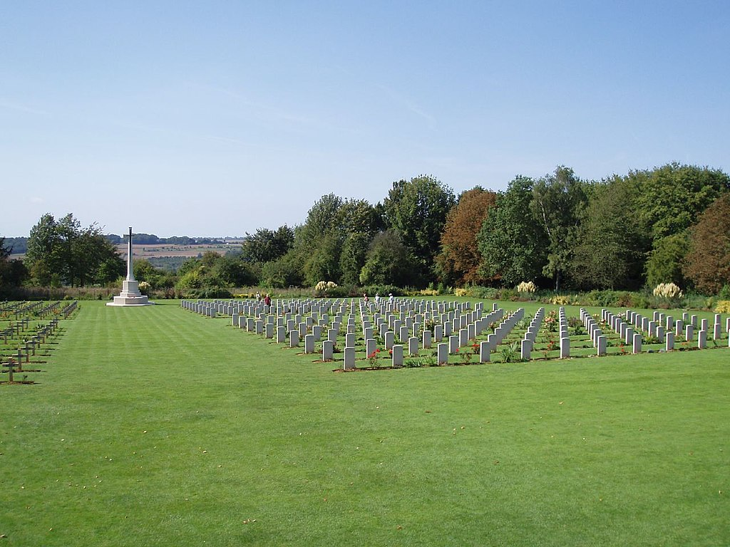
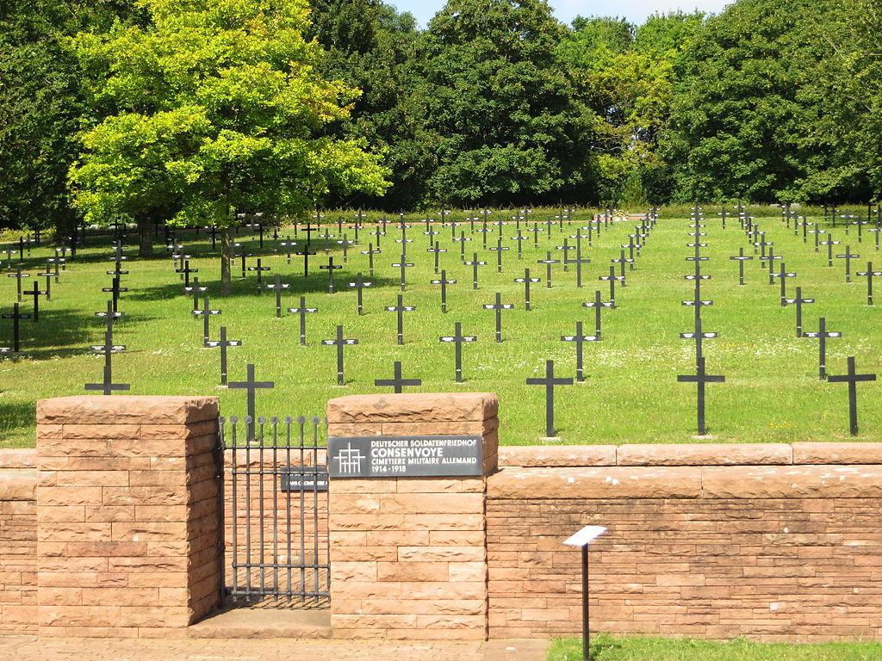
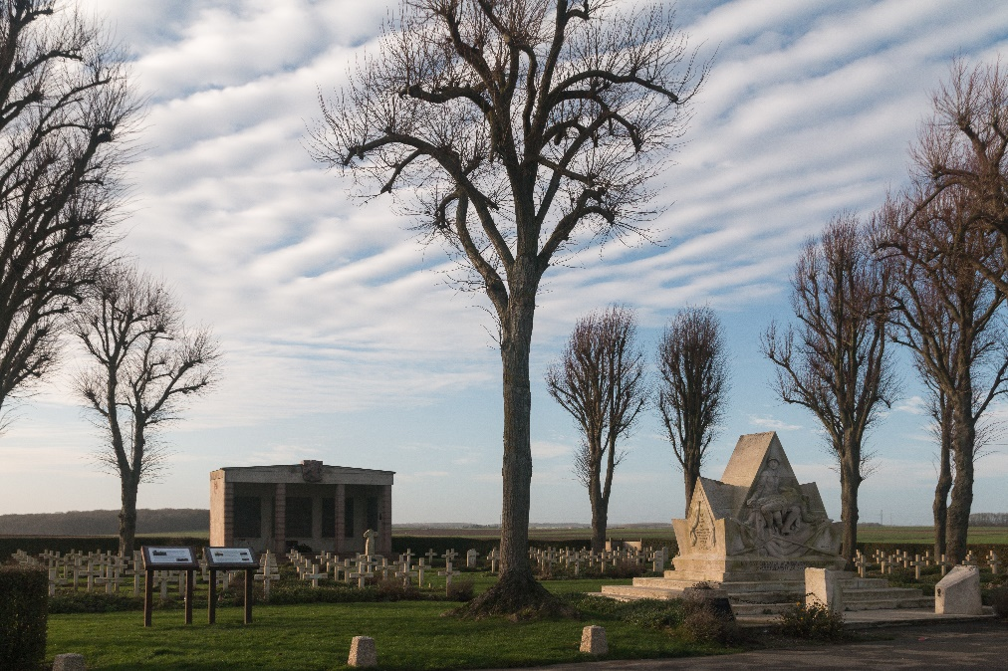
The 3 500 foreign cemeteries in France
CWGC Thiepval cemetery (80)
Consenvoye German cemetery (55)
La Targette, czechoslovak cemetery
Neuville-Saint-Vaast (62)
Christian Douale – Prague Sept. 2025 – European War Heritage Working Group

Slide 14
The 3 500 foreign cemeteries in France
Property of the Ministry of Armed Forces (land)
If there’s an international convention, the french ministry of Armed Forces is not
responsible for the maintenance and restoration work
If there’s NOT an international convention, the french Ministry of Armed Forces is
responsible for the maintenance and restoration work
The ministry is in charge of land acquisitions for all the countries
Christian Douale – Prague Sept. 2025 – European War Heritage Working Group

Slide 15
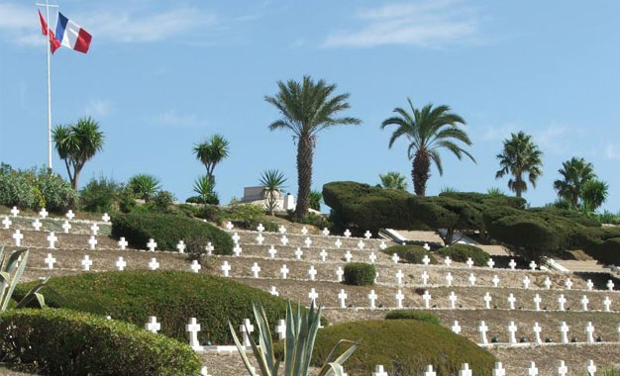
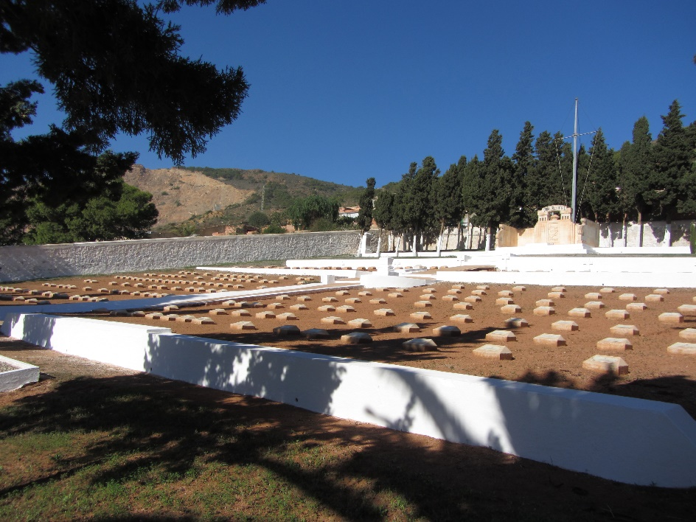
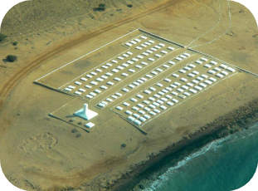
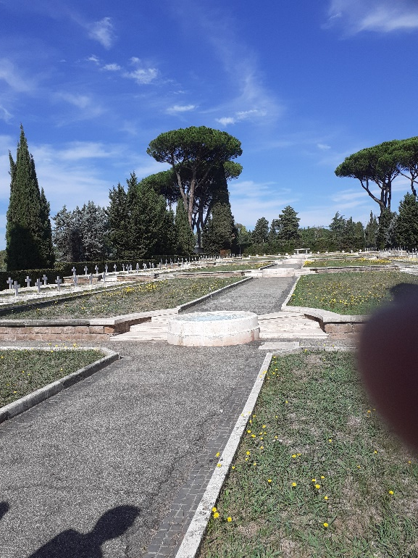
1000 lieux de mémoire français
dans 89 pays
Cimetière français de Gammarth - Tunisie
Cimetière français de Mers-El-Kebir - Algérie
Cimetière français de Monte Mario à Rome - Italie
Christian Douale – Prague Sept. 2025 – European War Heritage Working Group

Slide 16
1000 lieux de mémoire français
dans 89 pays
Property of local authority or state
Embassy (defense attache) ensures the maintenance and restoration work
Ministry of Armed Forces delegates the budget to the french Embassy
Christian Douale – Prague Sept. 2025 – European War Heritage Working Group

Slide 17
I thank you a lot for your attention
and I am pleased to answer your questions !
Christian Douale – Prague Sept. 2025 – European War Heritage Working Group

