Slide 1

European War Heritage Working Group – Prague Sept. 2025
What has been done in the past and what is planned in the future?
French military cemeteries,
the future is now !
The Douaumont case…
Andre Rakoto, PhD

Slide 2
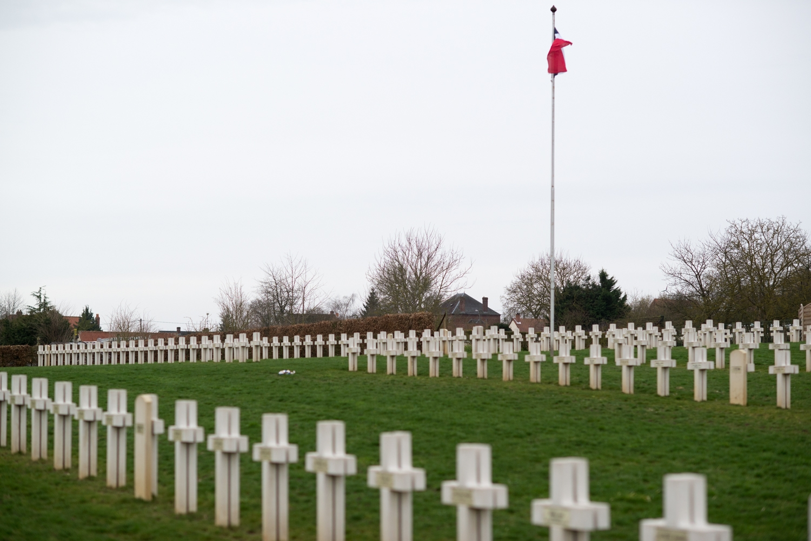
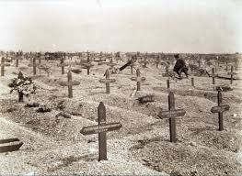
European War Heritage Working Group – Prague Sept. 2025
What has been done in the past and what is planned in the future?
1. Military cemeteries in France
Individual graves became standard in 1915
- July 2, 1915 : creation of the “Fallen for France” title
- December 29, 1915 : perpetual graves in military cemeteries placed under the financial responsibility of the State
A few figures…
- 275 national military cemeteries / 740,000 remains
- 90% from WW1

Slide 3
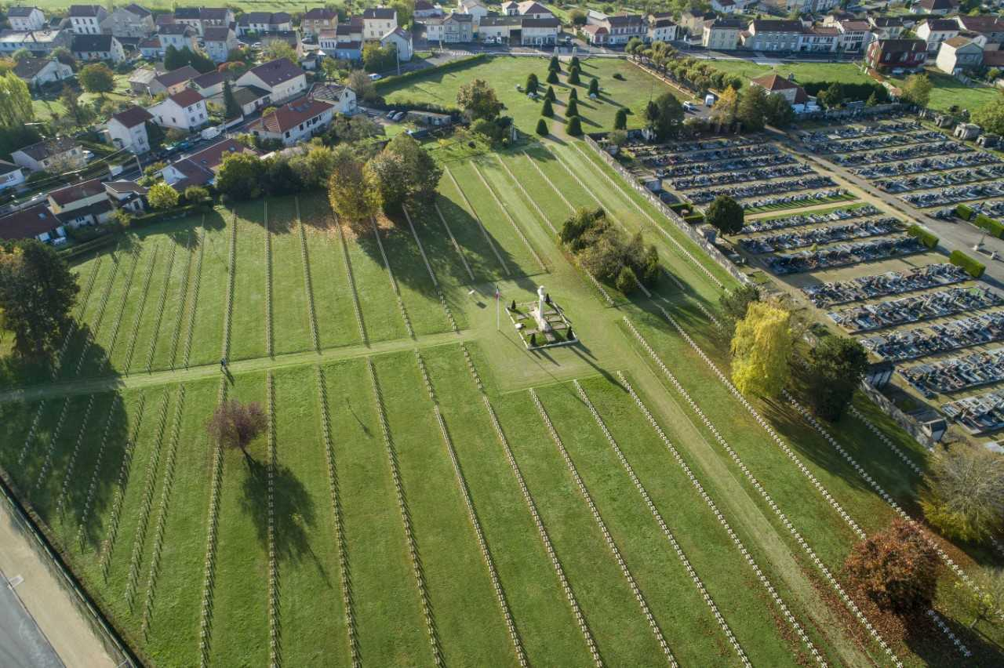

European War Heritage Working Group – Prague Sept. 2025
What has been done in the past and what is planned in the future?
Also…
- 2,200 municipal military cemeteries / 98,000 remains
- 1 000 military cemeteries spread in 80 countries / 239,000 remains

Slide 4
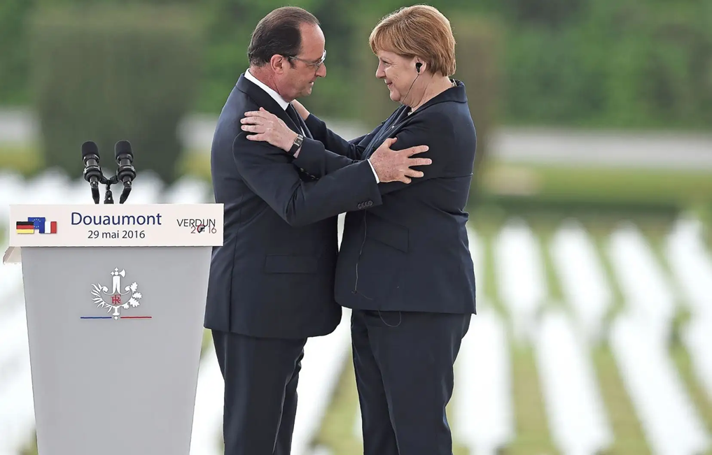
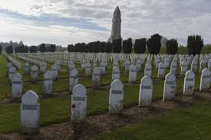
European War Heritage Working Group – Prague Sept. 2025
What has been done in the past and what is planned in the future?
2. The Douaumont case
Cemetery inaugurated in 1929 on the Verdun battle site
- 16,142 graves
- A “Lantern of the Dead” ossuary with 130,000 unidentified soldiers
Supervised by ONaCVG
240,000 visitors / year prior to WW1 Centennial
1,8 million euros restoration
500,000 visitors in 2016

Slide 5
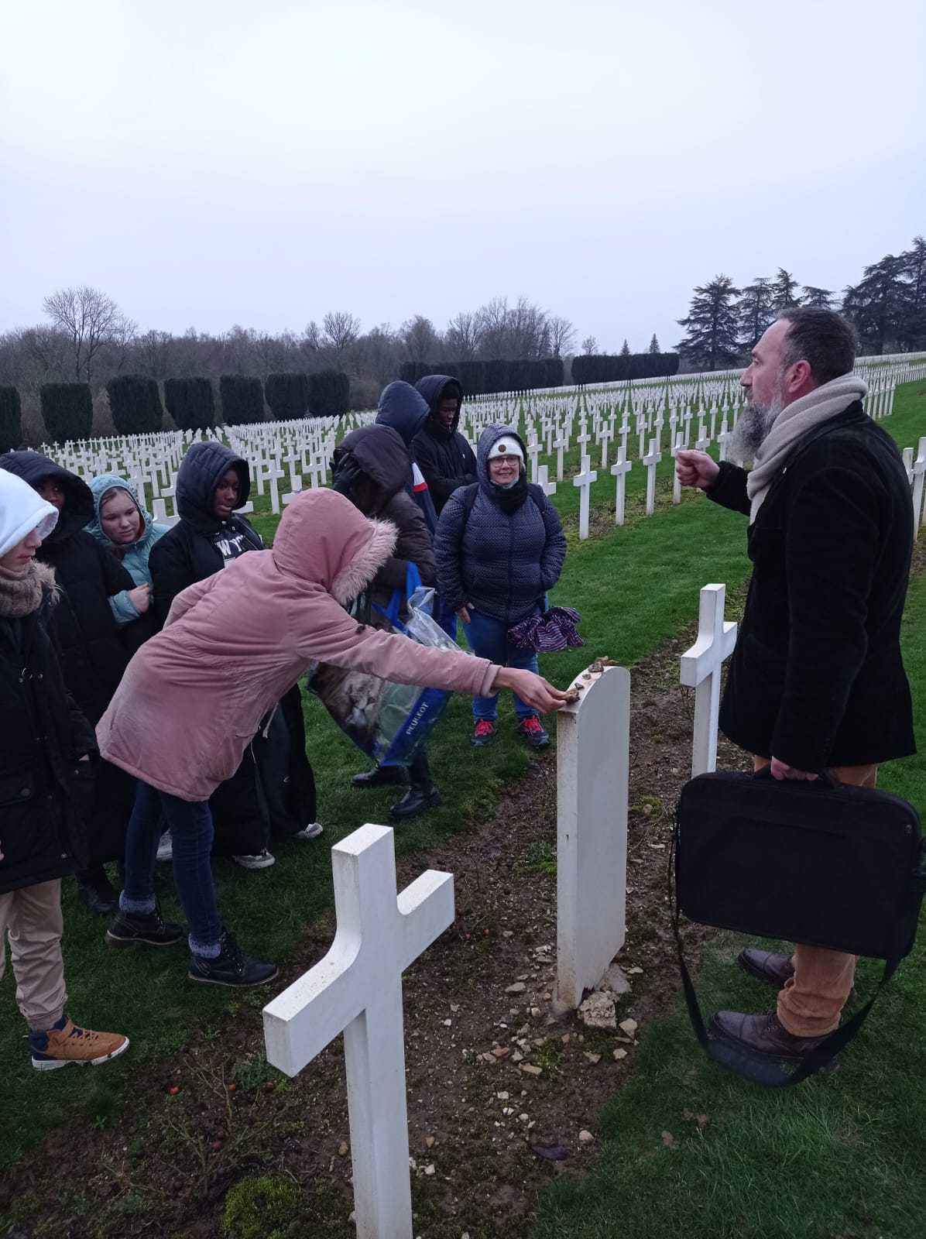

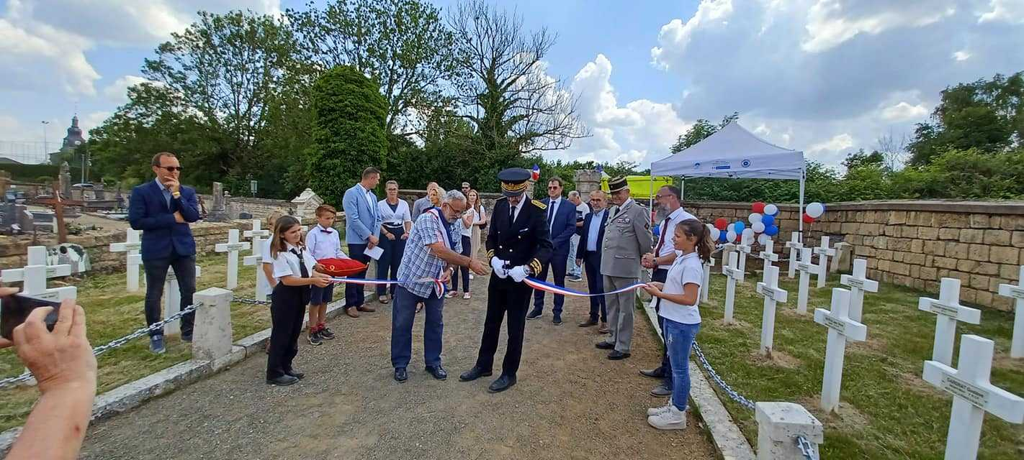
European War Heritage Working Group – Prague Sept. 2025
What has been done in the past and what is planned in the future?
Post-Covid measures
Recruitment of mediators implementing a riddle trail
Baludik app on site based on the riddle trail

Slide 6
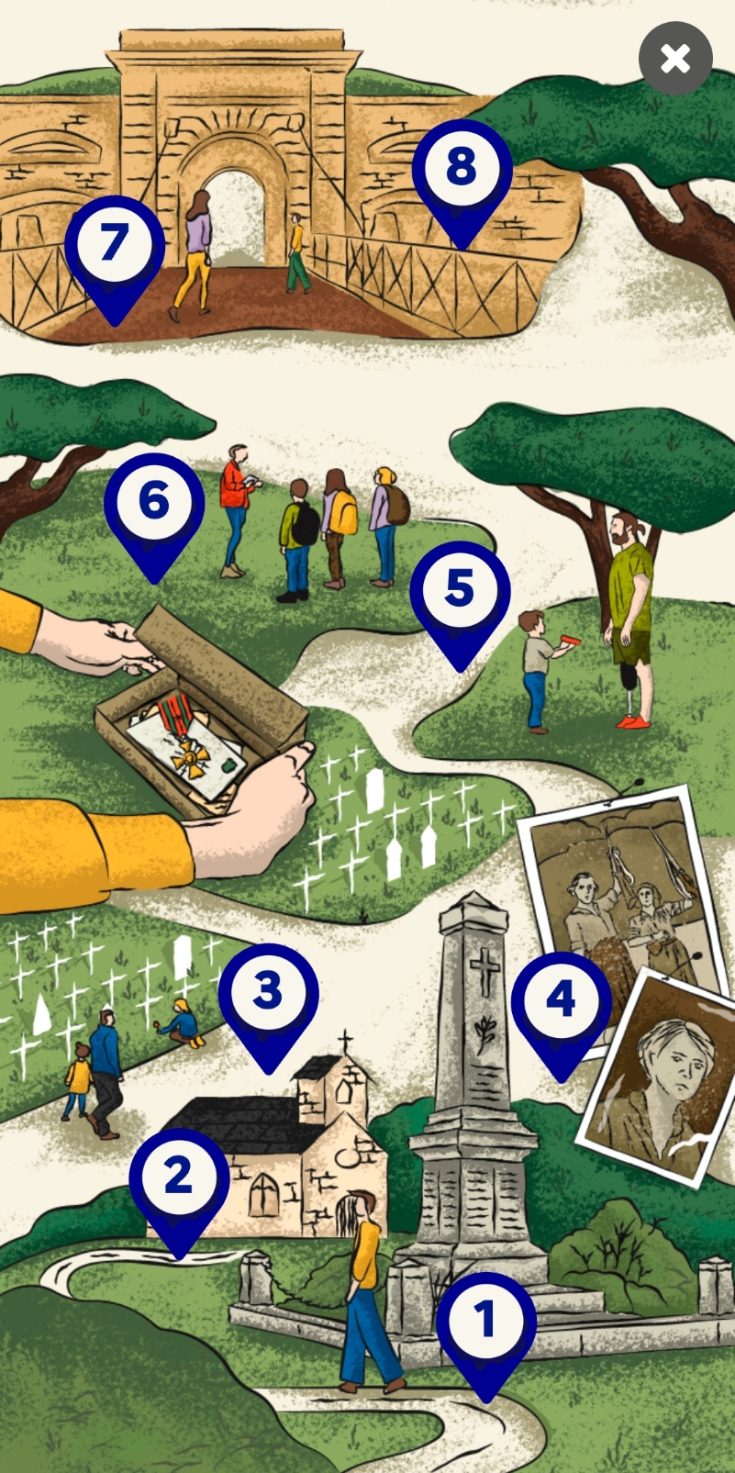
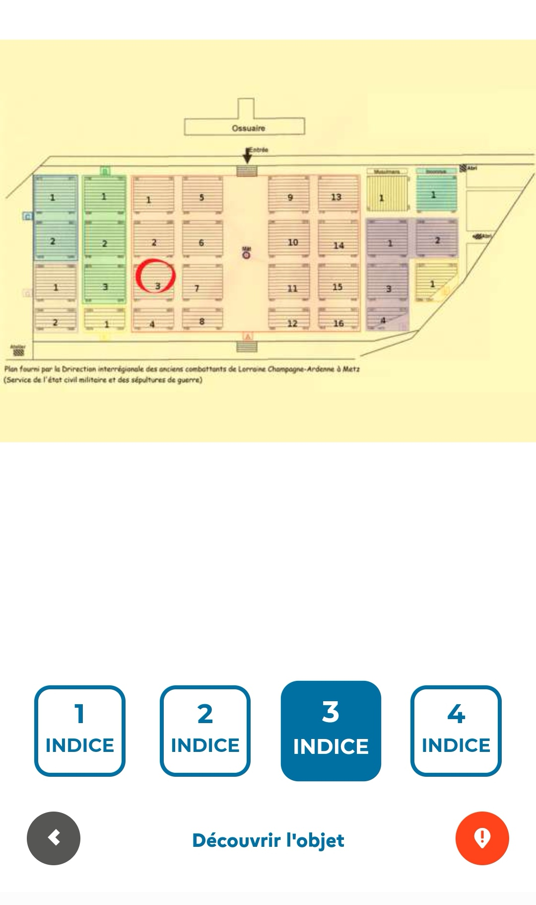
European War Heritage Working Group – Prague Sept. 2025
What has been done in the past and what is planned in the future?
One of 13 national ONaCVG Baludik applications, the Douaumont cemetery application creates an alternative personal learning experience about the war through the personal histories of soldiers buried there:
brigadier general Ernest Anselin, who died in combat in Verdun
private Achache, a Jewish soldier
private Marche, a military courier who died while delivering a letter
captain Millant, who was executed for retreating with his company and was later rehabilitated
private Zerzour, an Algerian “tirailleur”
private Giansily, identified in a mass grave thanks to a paybook
private Fournier, the first WW1 casualty to be identified through DNA

Slide 7
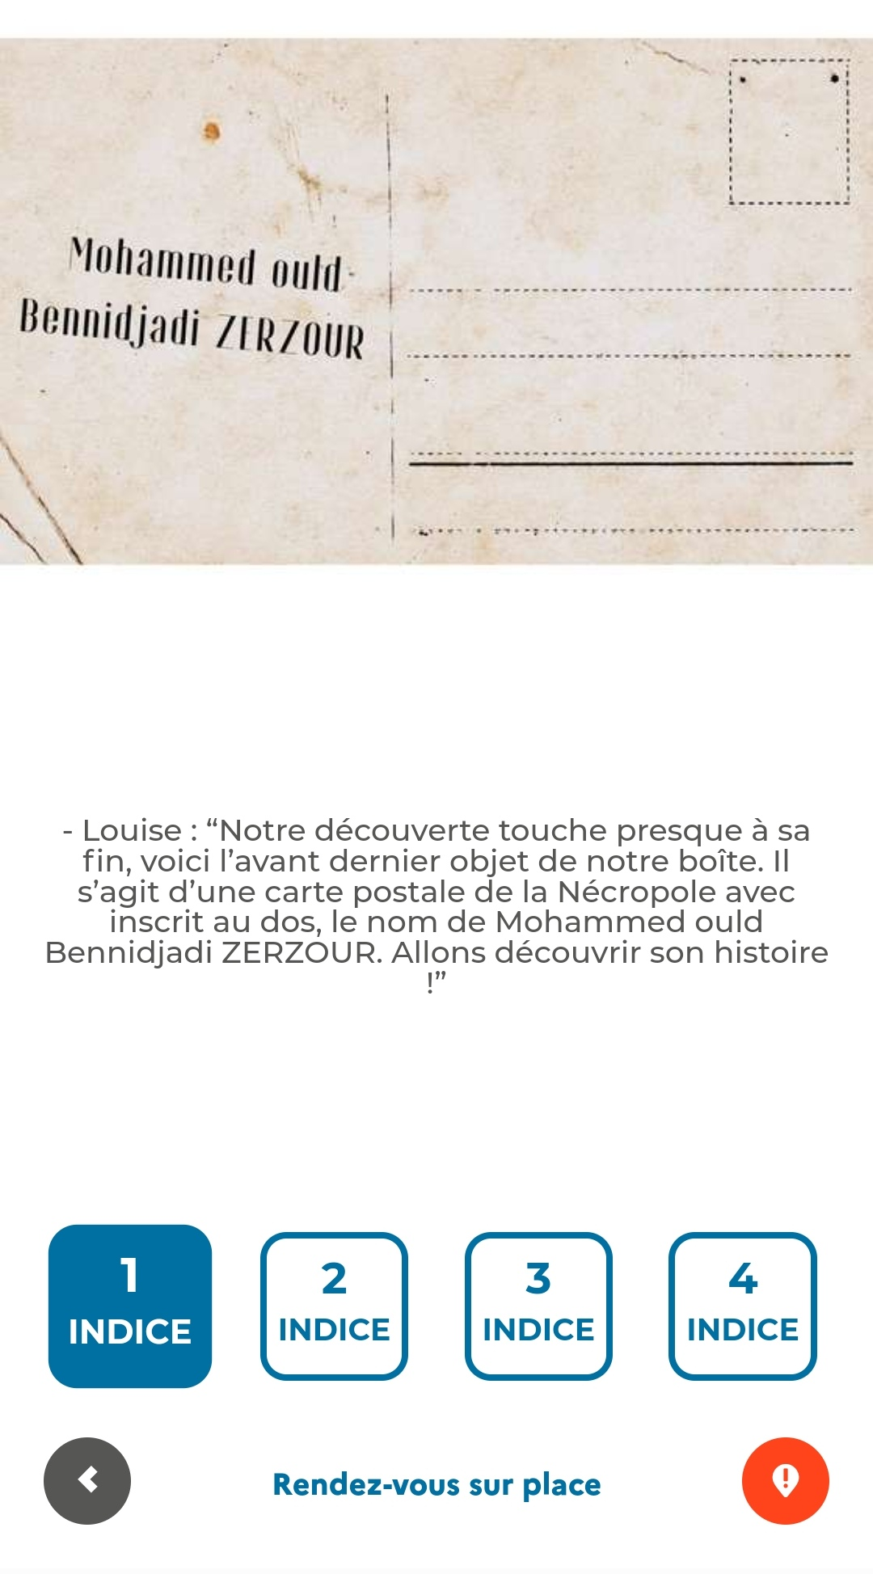

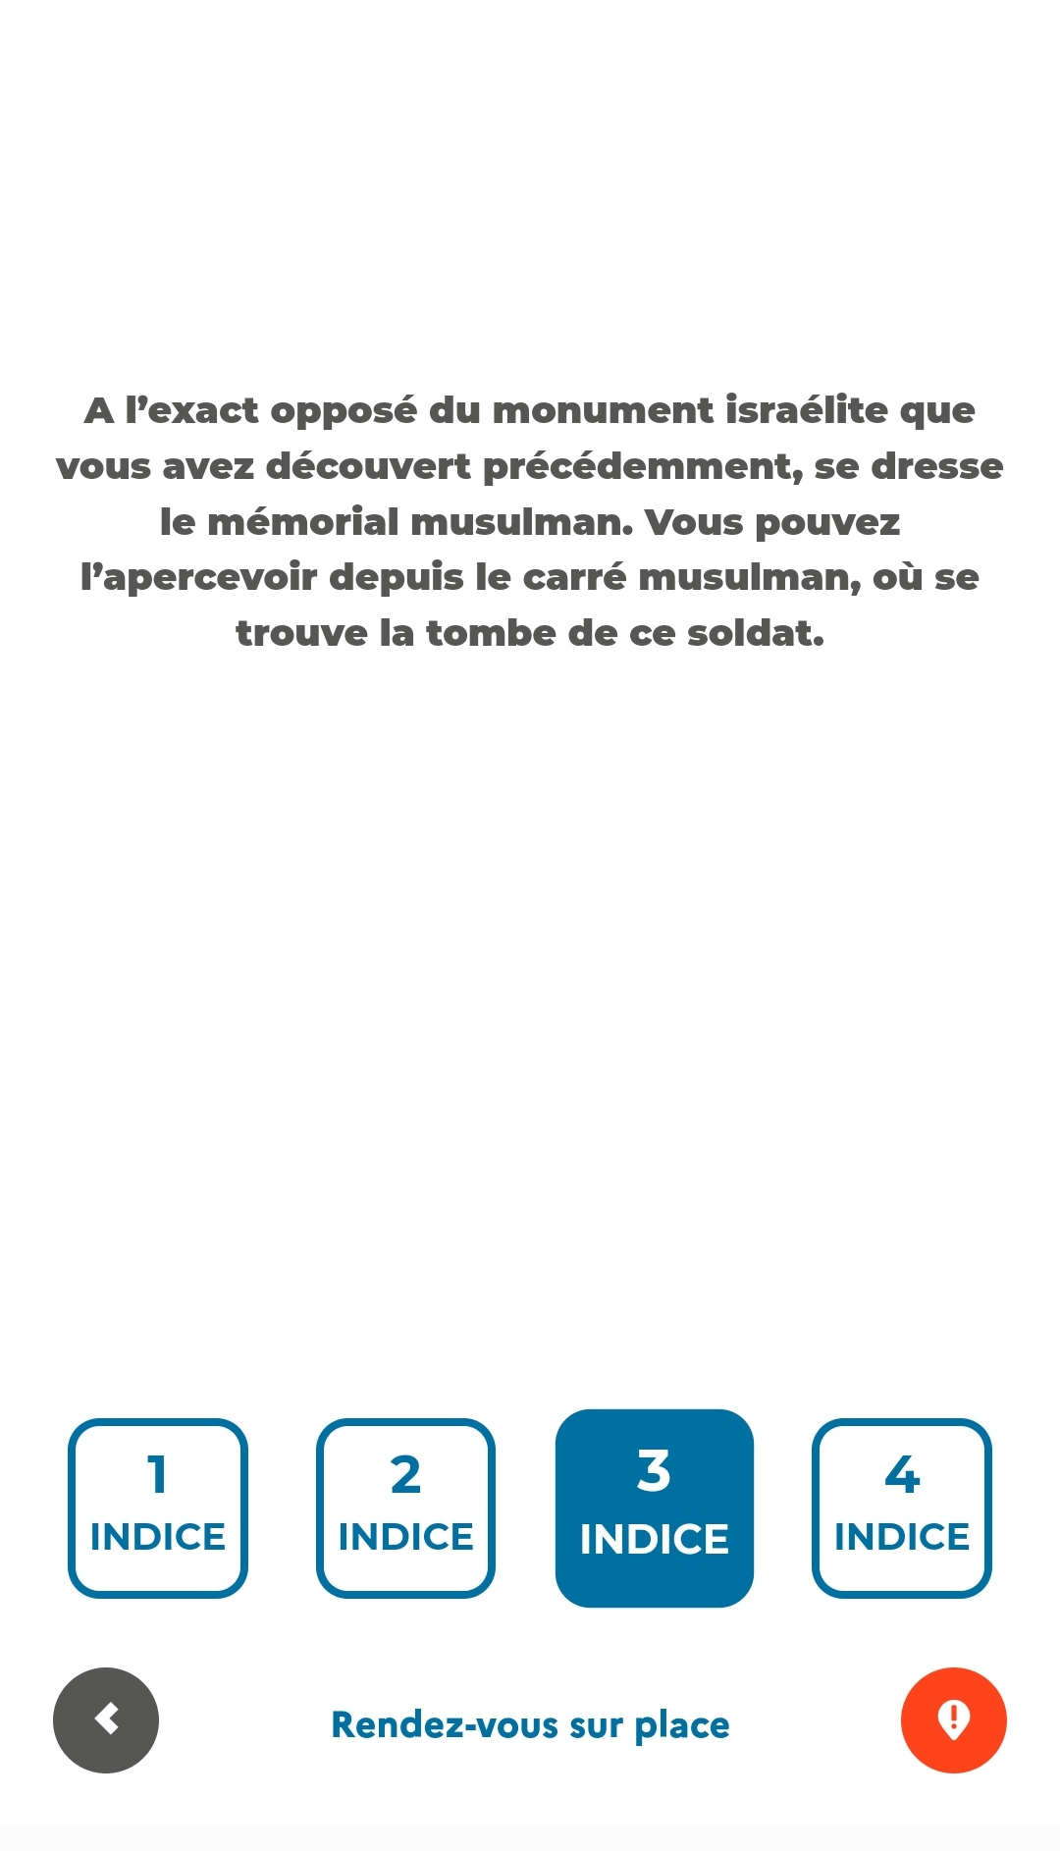
European War Heritage Working Group – Prague Sept. 2025
What has been done in the past and what is planned in the future?
Practical example - riddle # 6 - Mohammed ouid Bennidjadi Zerzour

Slide 8
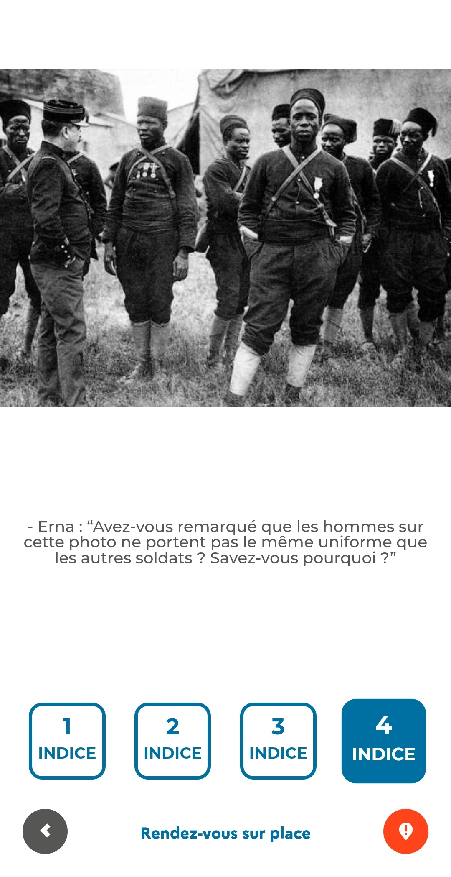
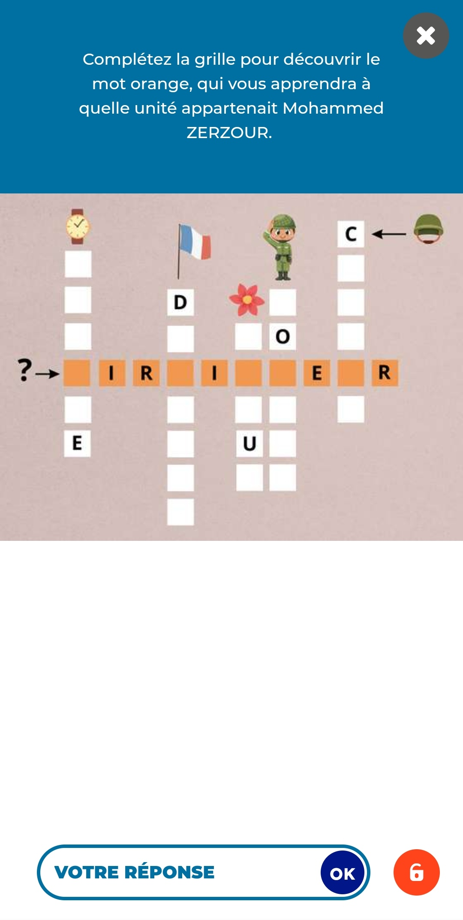
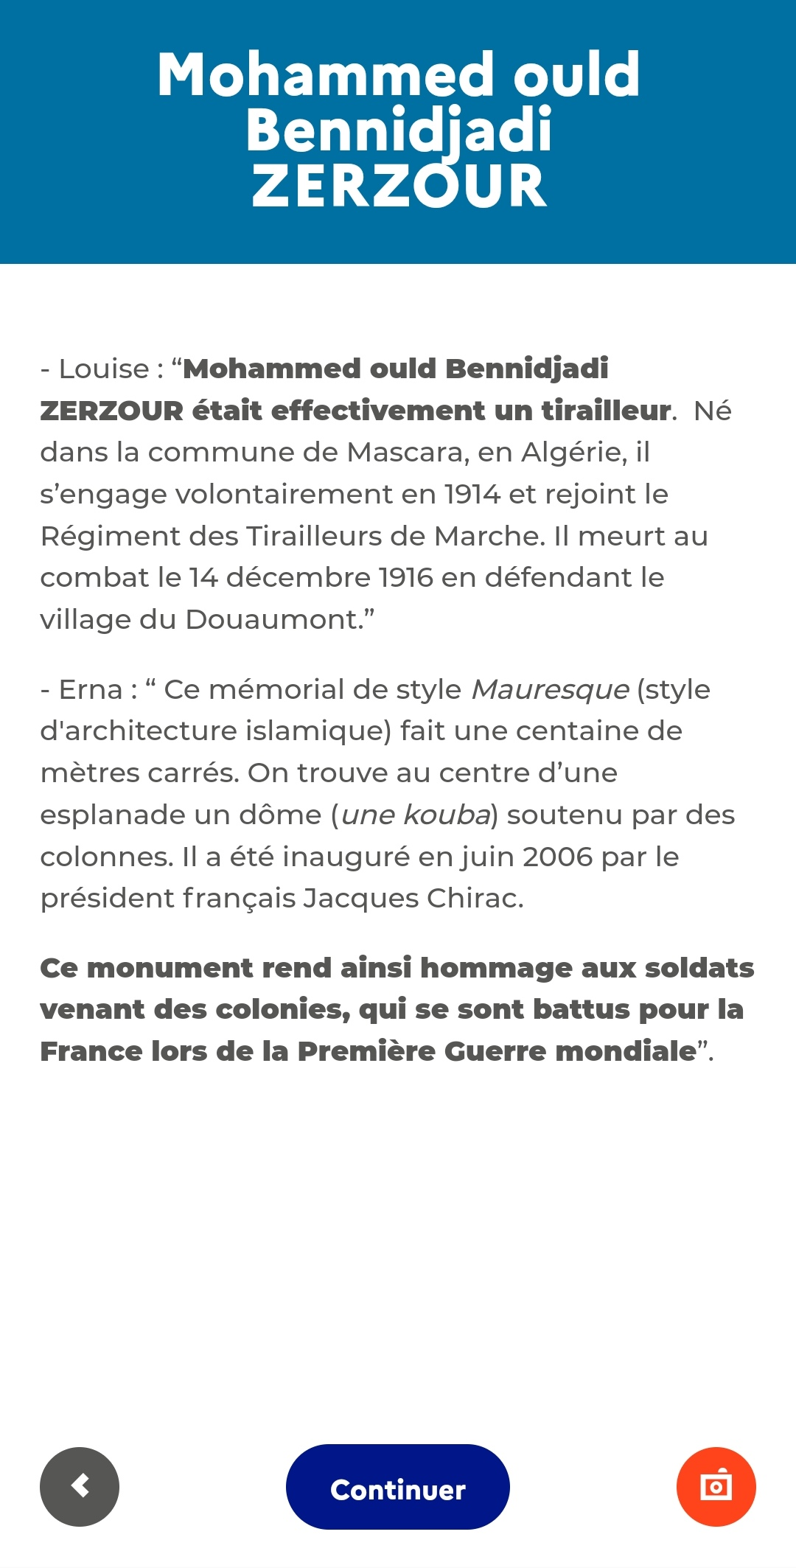
European War Heritage Working Group – Prague Sept. 2025
What has been done in the past and what is planned in the future?
Practical example - riddle # 6 - Mohammed ouid Bennidjadi Zerzour

Slide 9

European War Heritage Working Group – Prague Sept. 2025
What has been done in the past and what is planned in the future?
Since 2023, the thirteen ONaCVG Baludik applications were downloaded 2093 times so far and they are rated 4.30/5 by users.
The Douaumont application was downloaded 142 times. An estimated 2.5 people are behind each download, mostly families. The Douaumont application is rated 4.30/5 by users.

Slide 10
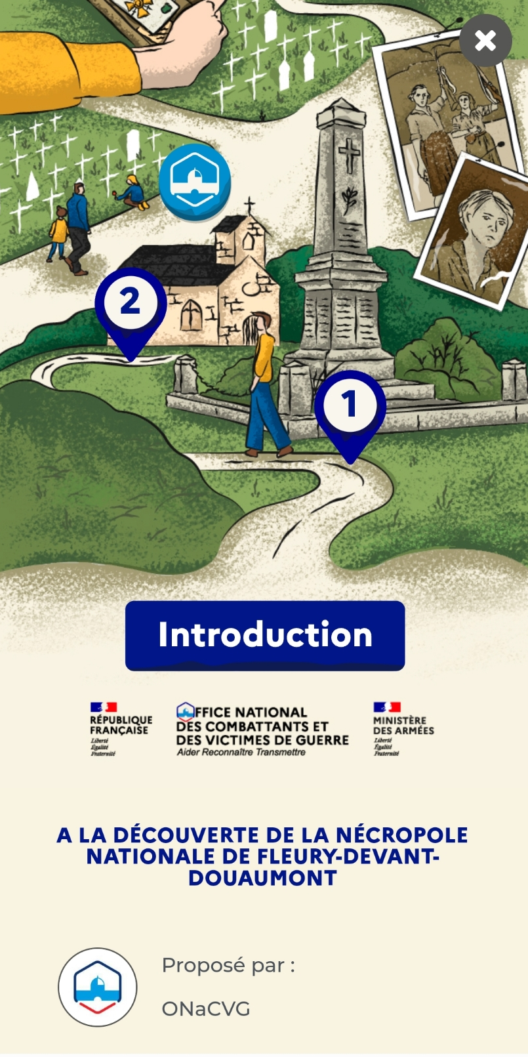
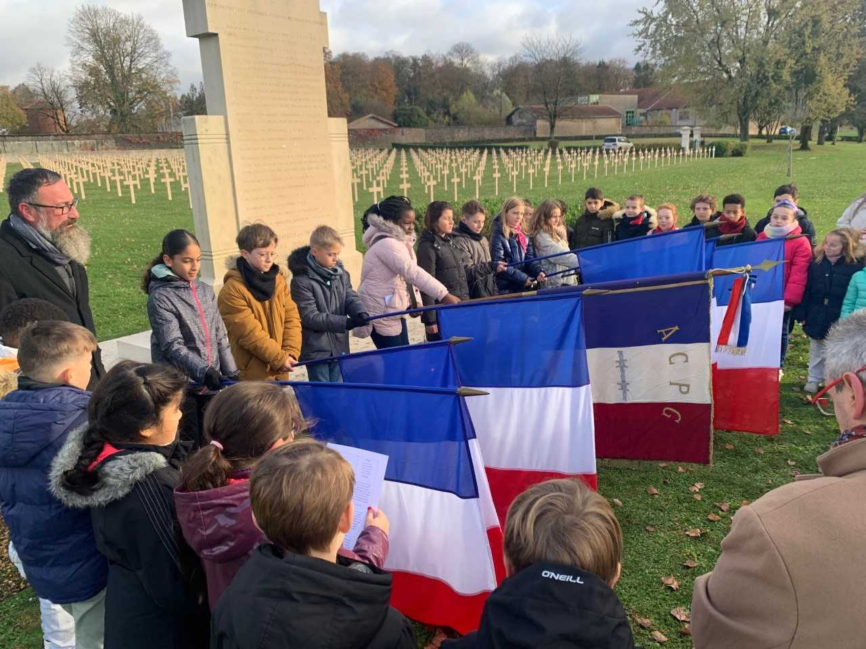
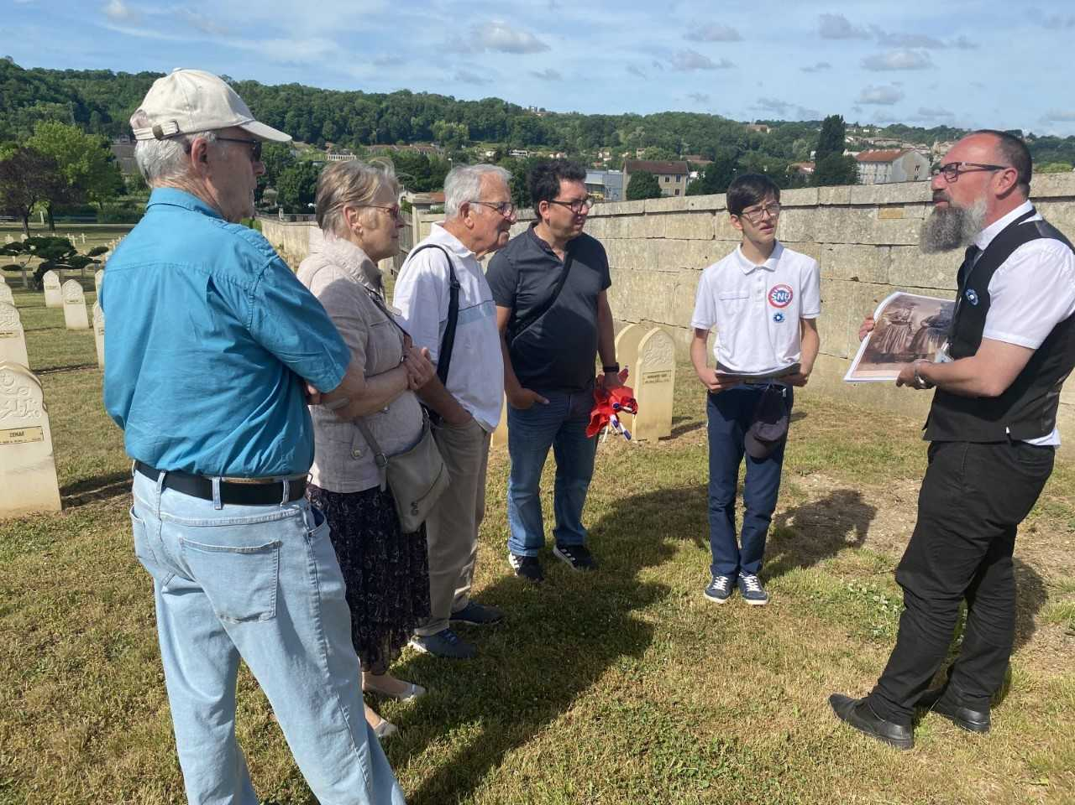
European War Heritage Working Group – Prague Sept. 2025
What has been done in the past and what is planned in the future?
3. Conclusions and recommendations
It is capital to adapt to the public
Place historical markers and other information relays when possible
Use modern technologies – QR codes, apps...
Above all, have historical mediators interact with the public

