Slide 1
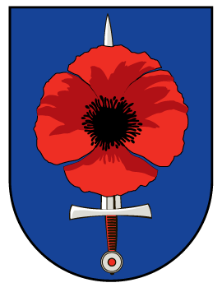
War veterans and war graves
Department
Care of war graves
valecnehroby.mo.gov.cz
evidencevh.mo.gov.cz
facebook.com/valecne.hrobymo
1

Slide 2
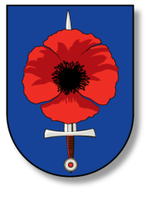
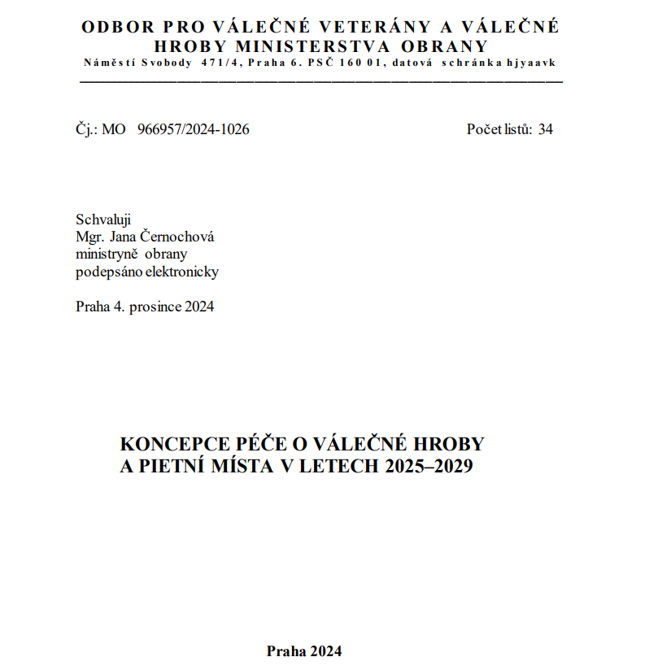
Concept for the care of war graves 2025 - 2029
In December 2024
the Minister of Defence
approved our new Concept
for the care of war graves,
which sets the framework
for our activities
for the next five years.

Slide 3
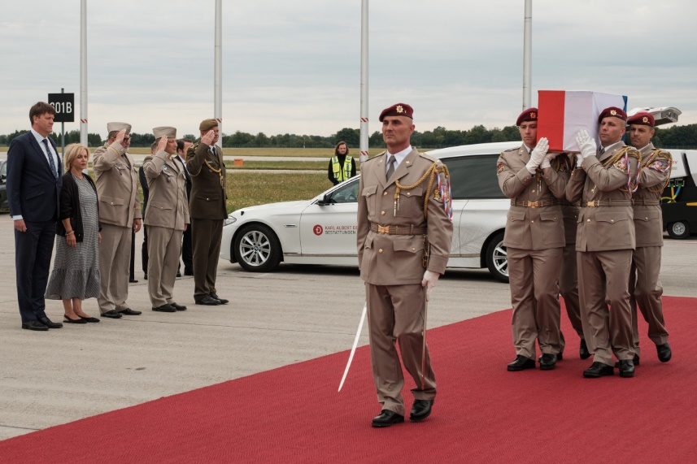
The remains of nine heroes returned to the Czech Republic
On August 22nd of this year, an Airbus landed at Prague–Kbely Airport with the remains of the SOE Iridium and Bronse paratroopers, the local resistance fighter Josef Doskočil, as well as two murdered members of the State Defense Guard, who were kidnaped and taken to Glubczyce, Poland (before Germany). The army special aircraft picked up the remains in Katowice, Poland, and Munich.
2 members of the State Defense Guard - murdered in September 1938
6 members of paratroopers shot down in 1943 over Munich
1 executed member of the anti-Nazi resistance (1944)
3

Slide 4
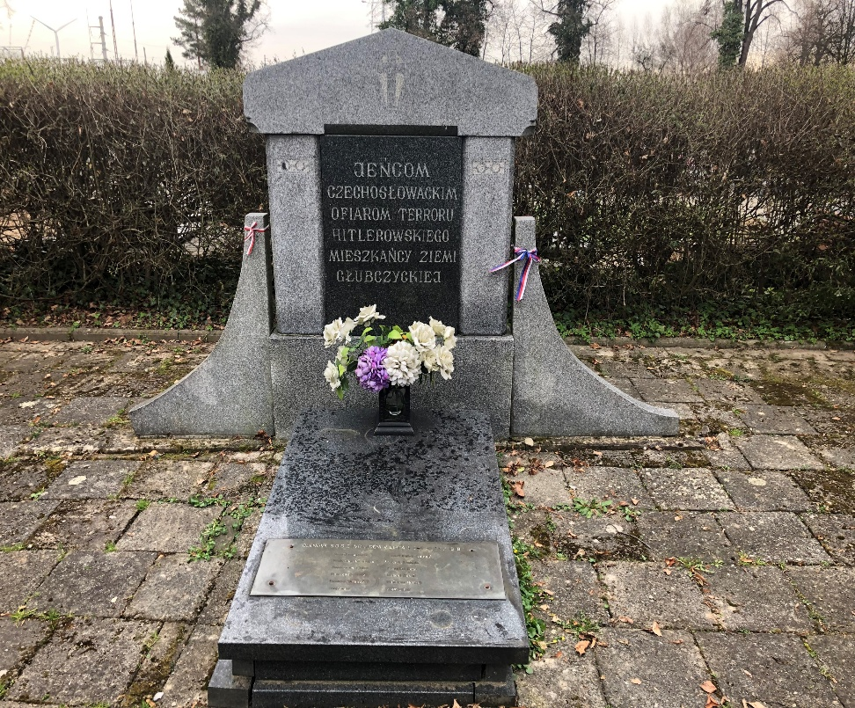
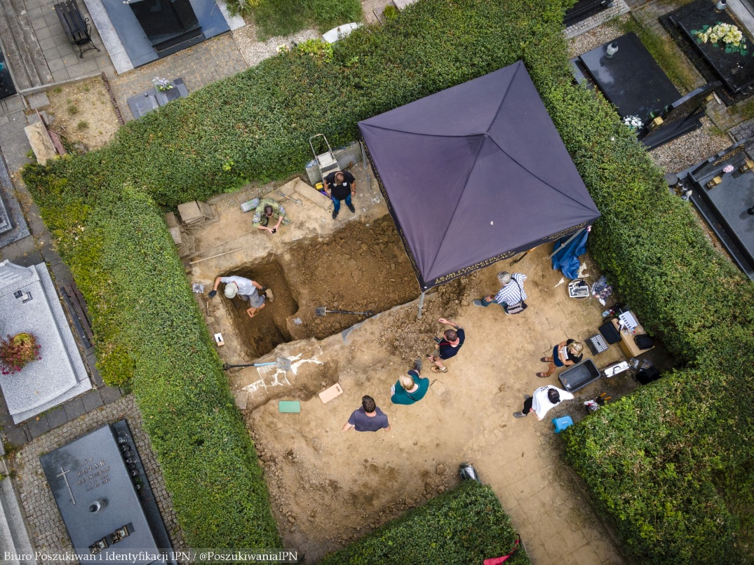
The remains of nine heroes returned to the Czech Republic
original monument in the Polish town of Glubczyce - grave of Czechoslovak gendarmes murdered by the Nazis in September 1938.
exhumation work
4

Slide 5
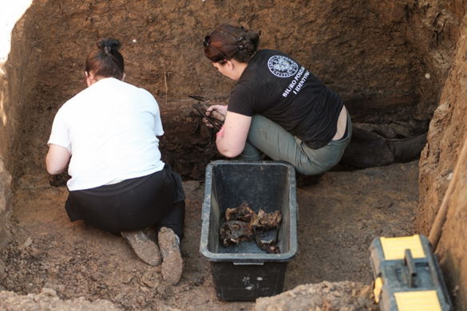
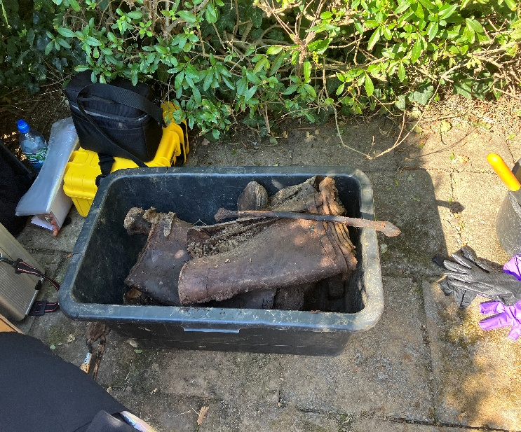
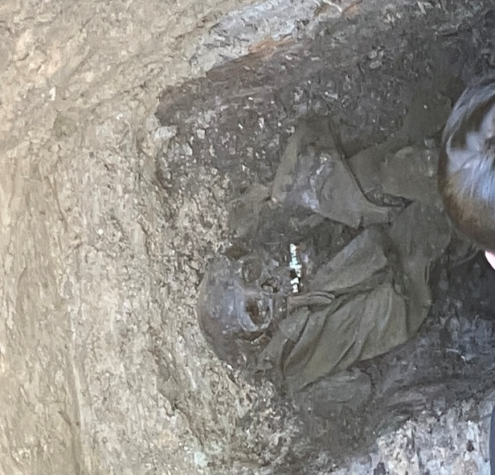
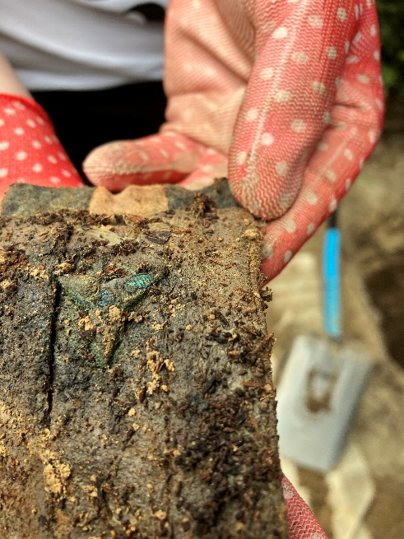
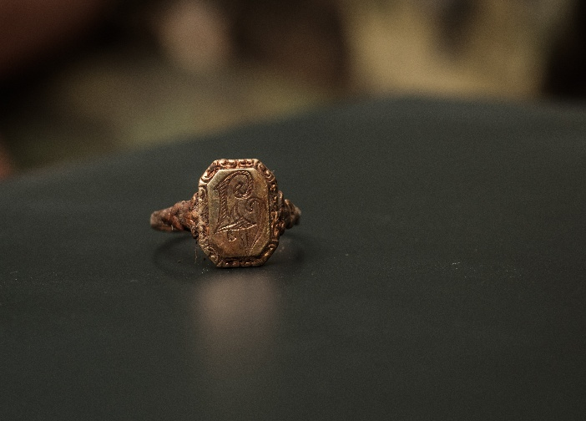
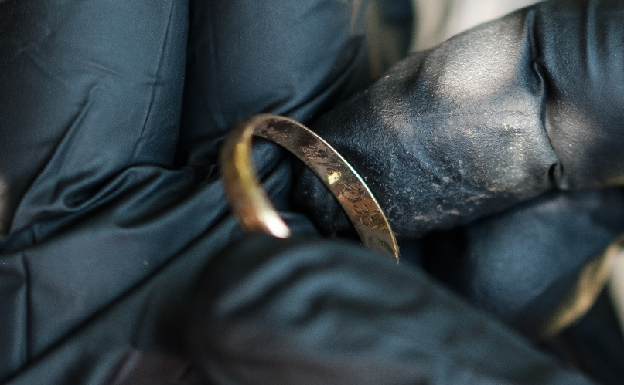
Glubczyce - Exhumation
5

Slide 6
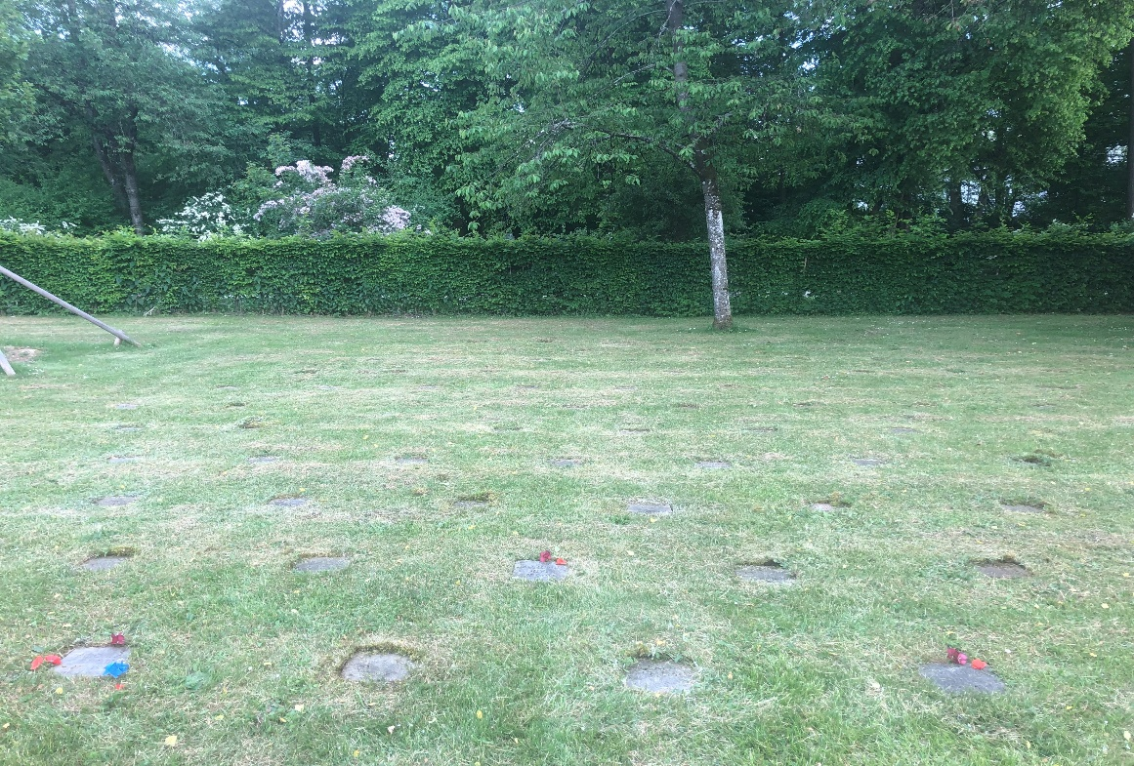
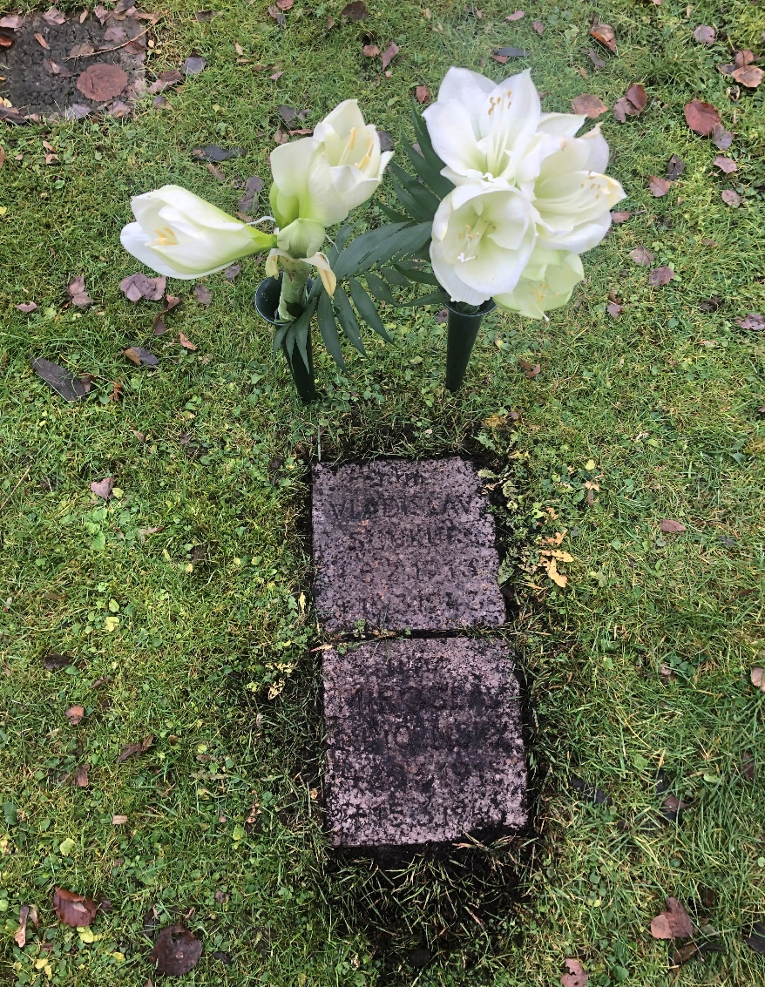
The remains of nine heroes returned to the Czech Republic
the condition of the graves of our paratroopers in 2023
(Munich, 2023)
exhumation work
6

Slide 7
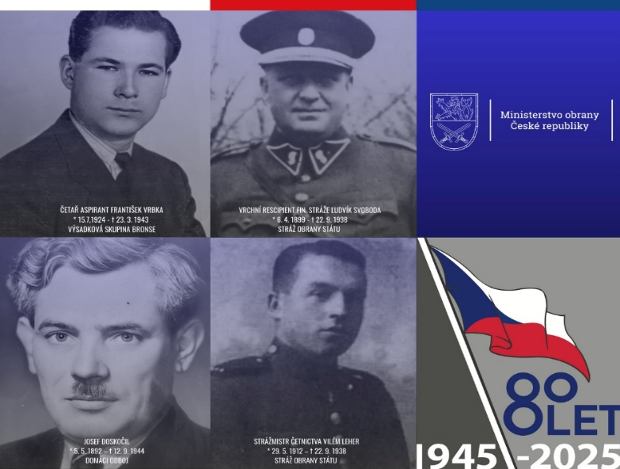
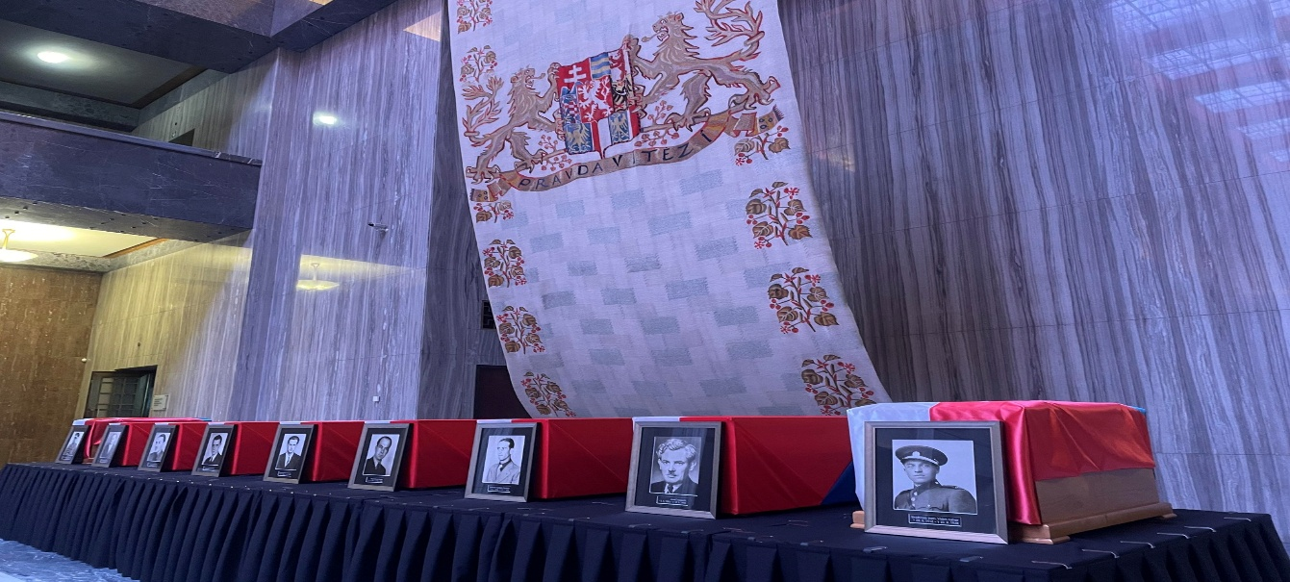
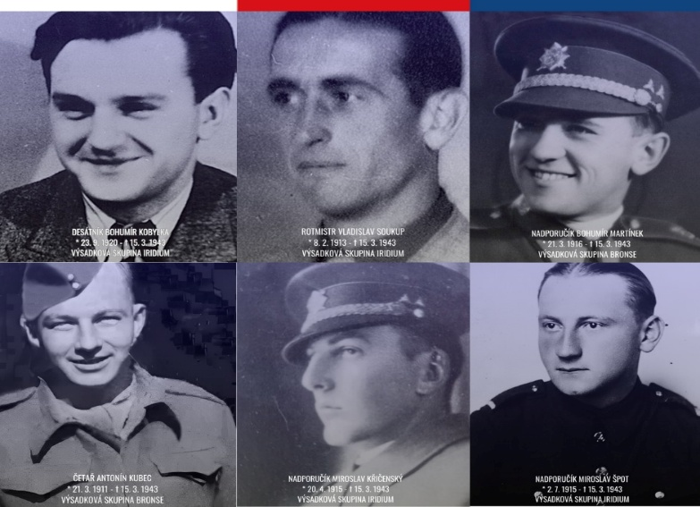
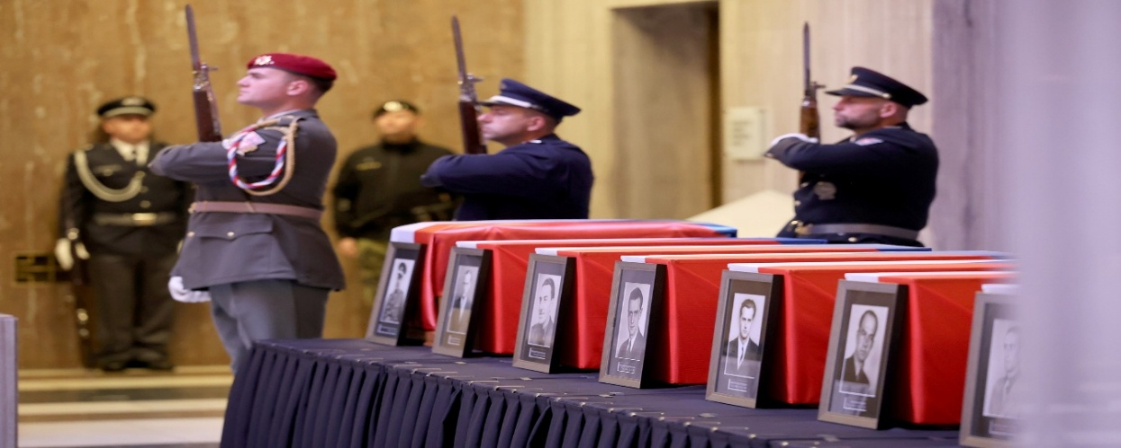
act of reverence – Prague, 12.9.2025
7

Slide 8

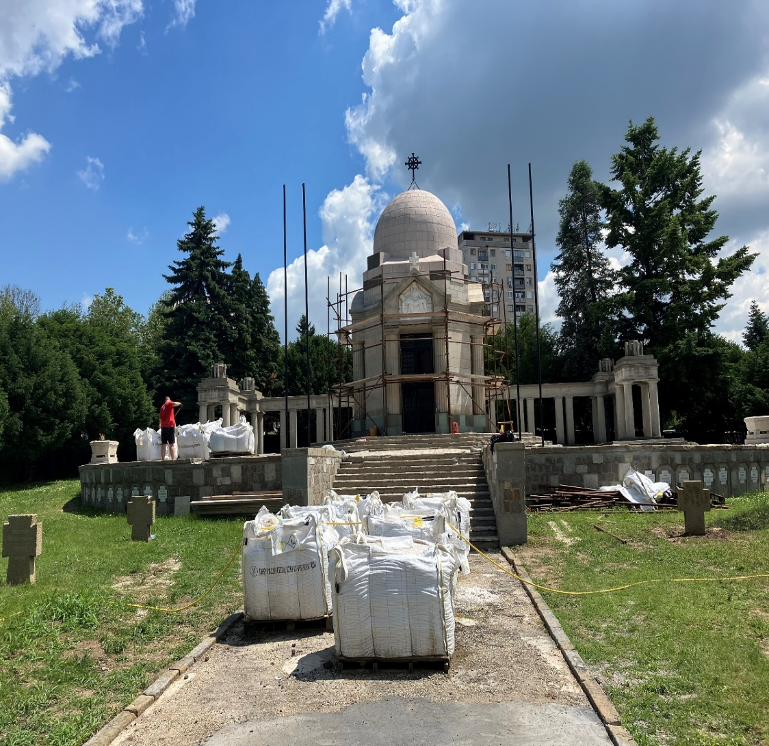
SERBIA, Beograd – Novo groblje
WW I
CENTRAL CEMETERY OF SOLDIERS OF THE AUSTRO-HUNGARY ARMY IN SERBIA
JOINT CEMETERY RECONSTRUCTION PROJECT IN COOPERATION WITH THE CZECH REPUBLIC, AUSTRIA AND HUNGARY
FINANCIAL PARTICIPATION OF THE CZECH REPUBLIC IN PHASE I – APPROXIMATELY 30,000 EUROS
PROJECT DIVIDED INTO 2 PHASES (BASIC + RECONSTRUCTION) – A PROJECT FOR SEVERAL YEARS
INTERGOVERNMENTAL AGREEMENT SIGNED WITH SERBIA SINCE 2016
8

Slide 9
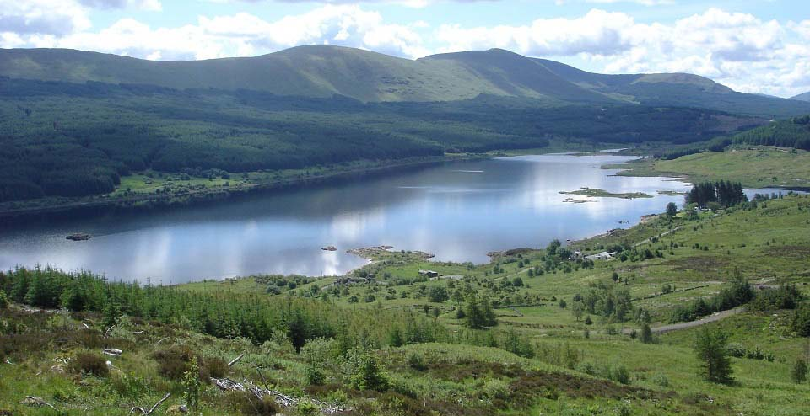
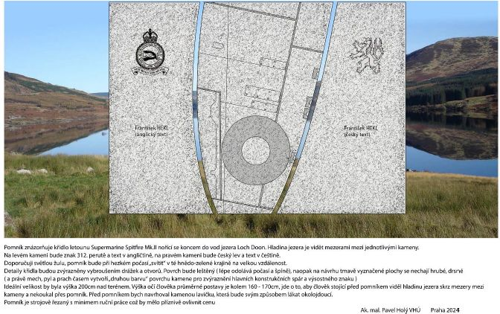
UNITED KINGDOM, Loch Doon
WW II, Czech pilot, 24 000 EUR
A monument was built to commemorate Lieutenant František Hekl (born 24 January 1915 in Nemojany near Vyškov), who crashed his plane into the lake on 25 October 1941. The remains of the Supermarine Spitfire P7540 are located in the Dumfries & Galloway Aviation Museum.
9

Slide 10
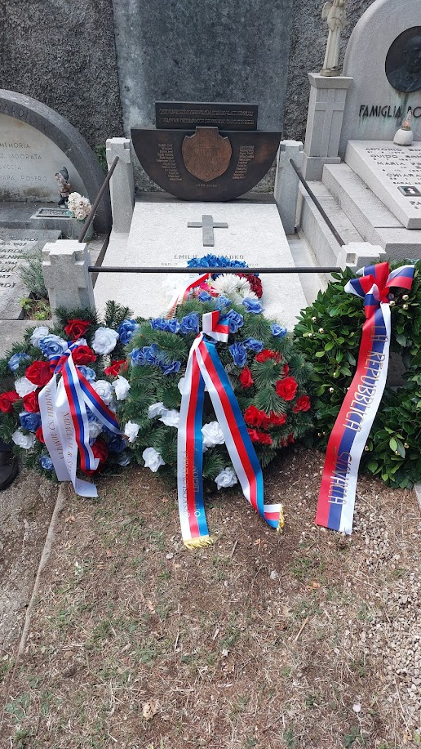
ITALY, Trieste
Czechoslovak Legion
In September 2024, a memorial to the Czechoslovak legionnaires in Trieste who died during the voyage from Russia to their homeland was ceremonially unveiled at the St. Anne cemetery in Trieste. It was symbolically erected on the tomb of Mrs. Emília Hromádková, who, together with her husband Vilém, campaigned for the Czechoslovak legions in Russia, supporting them materially and in other ways. Mrs. Hromádková died, like many of the legionnaires she cared for on the way from Russia, from typhus, which she contracted during the ship transport.
10

Slide 11
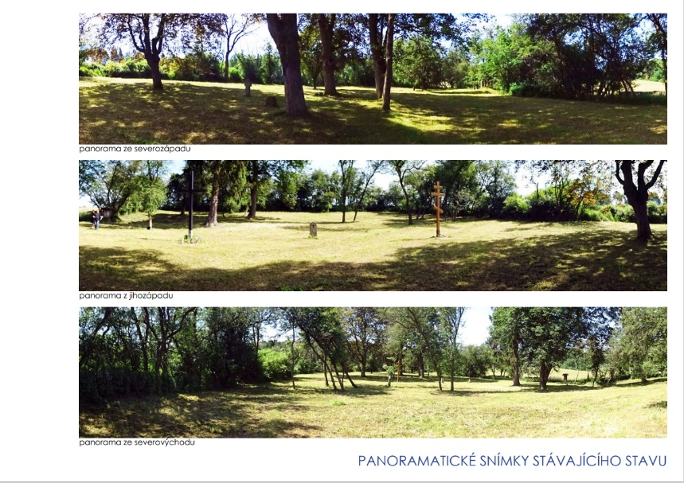
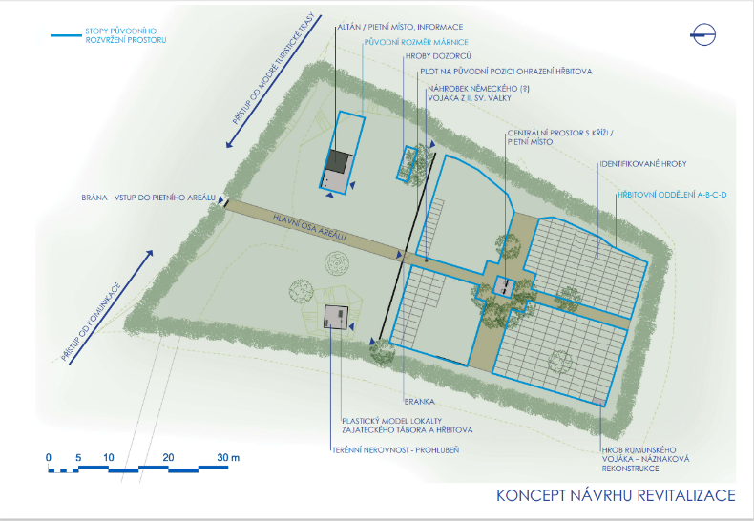
WW1 POW cemetery Chodský újezd
The only military cemetery that is directly owned by the Ministry of Defense.
287 prisoners of war and one Czech guard from the Austro-Hungarian army are buried here.
24 Italians, 8 Lithuanians, 190 Poles, 2 Romanians, 59 Russians and 4 soldiers of unknown nationality are buried here.
Currently a revitalization project has been developed.
Financial resources of CZK 3,000,000 have been prepared for the repair.
11

Slide 12
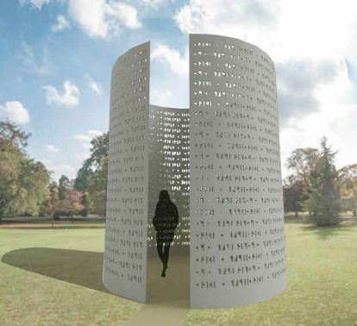
POLAND, Dukla
WW II, 623 casualties
MONUMENT DEDICATED TO THE MEMORY OF THE FALLEN CZECHOSLOVAK SOLDIERS WHO FELL ON THE POLISH SIDE OF THE DUKEL PASS - AUTUMN 1944 AND DO NOT HAVE EVEN A SYMBOLIC GRAVE ANYWHERE
ESTIMATED COSTS FOR THE BUILDING OF THE MONUMENT - 120,000 EUROS
THE PROJECT WAS STARTED IN 2016 AFTER OUR ORIGINAL GRAVES WERE RECONSTRUCTED BY THE RUSSIAN SIDE WITHOUT OUR KNOWLEDGE
12

Slide 13
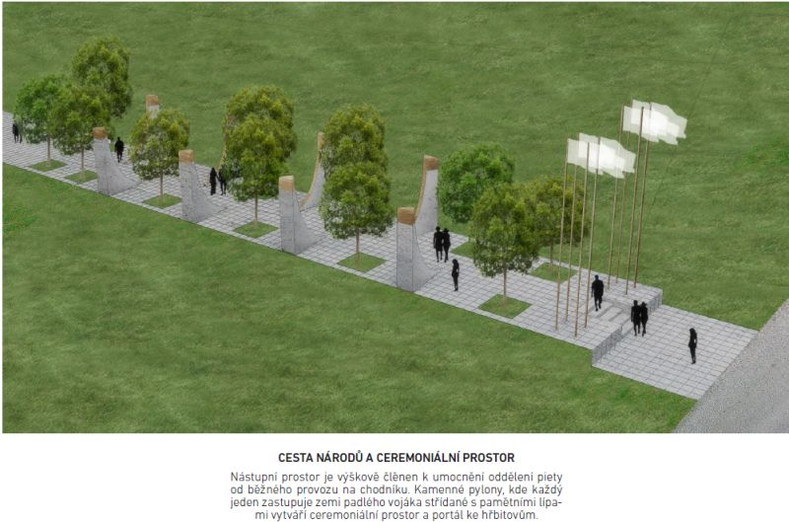
UKRAINE, Uzhorod
WW I and II, multinational project, WW I 1081 burried
234 from Czechoslovakia
215 Hungarians
181 Romaniens
110 from Yugoslavia
107 Poles
Austrians
18 Russians
12 Italians
Germans
81 Unknown
Road of Nations
13

Slide 14
UKRAINE, Uzhorod
WW I, another cemetery does not exist, almost 11 000
879 Hungarians
686 Romanians
539 from Czechoslovakia
355 from Yugoslavia
324 Russians
259 Poles
206 Austrians
Italians
Germans
More than 7000 unknown
Each nation can erect one or more columns
We invite you to participate
14

Slide 15
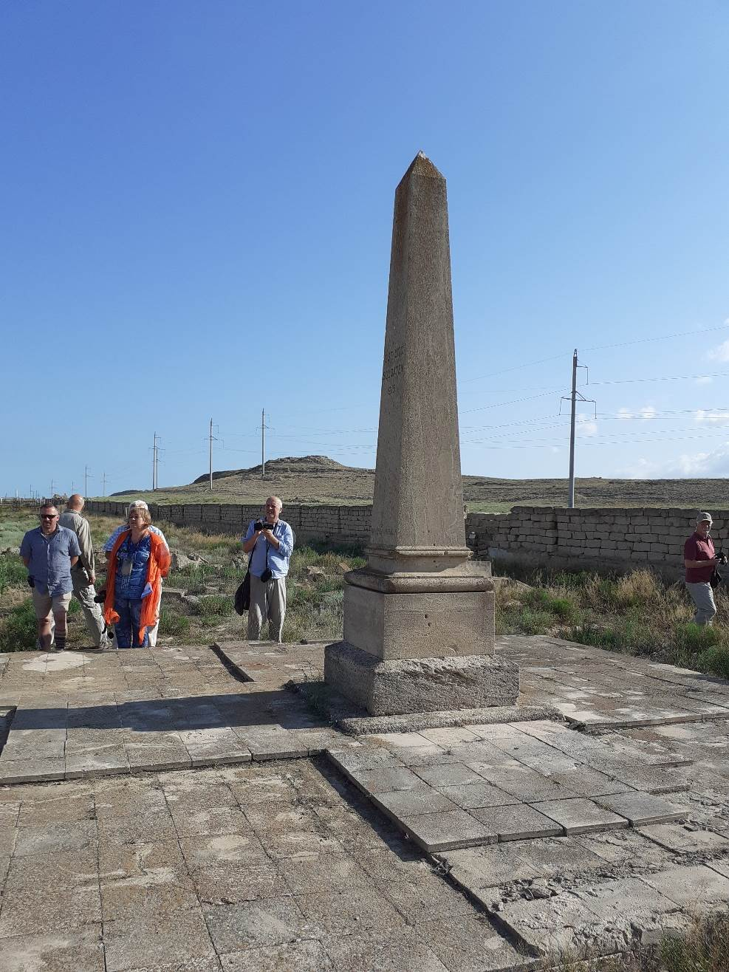
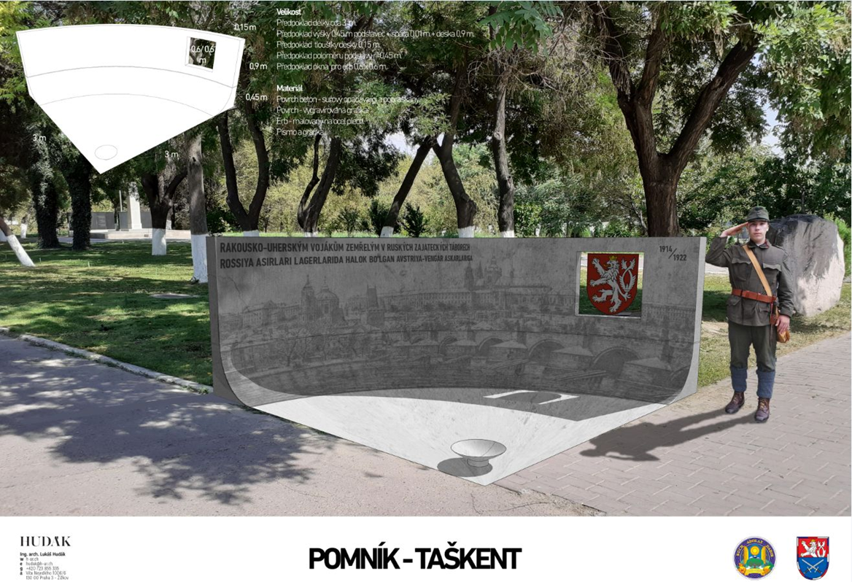
KAZAKHSTAN, Fort Shevhcenko WW I, POW
UZBEKISTAN, Tashkent WW I, 576 POW from the Czech lands
15

Slide 16
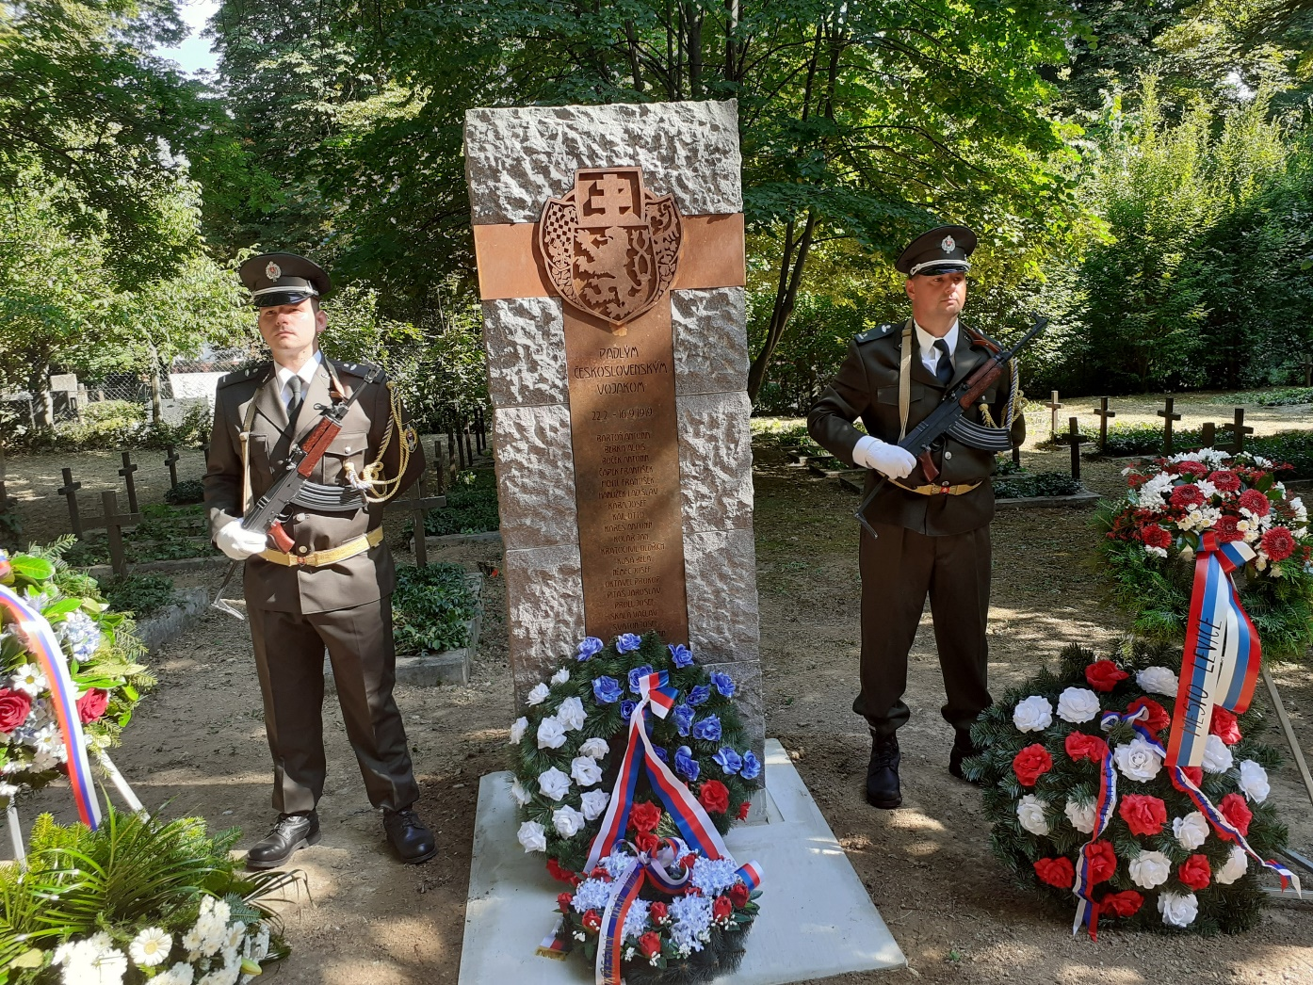
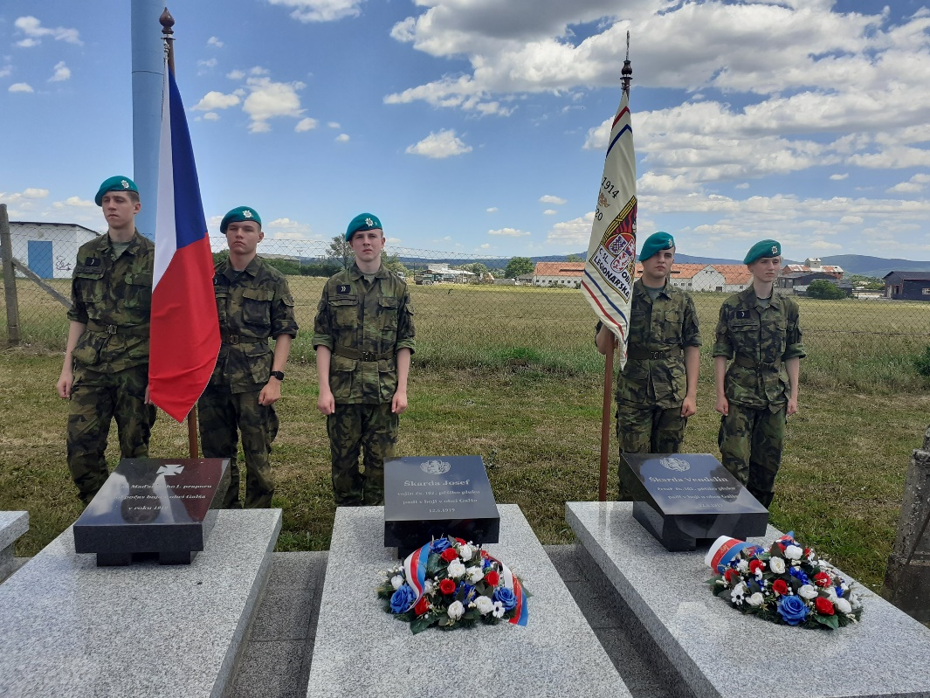
SLOVAKIA
War Czechoslovakia – Hungary 1918 - 1919

