Slide 1

War veterans and war graves
Department
Care of war graves
valecnehroby.mo.gov.cz
evidencevh.mo.gov.cz
facebook.com/valecne.hrobymo
1

Slide 2

department structure
War Veterans and War Graves Departament
War Veterans Support Agency
Care and Support Unit
War Graves and Memorial Sites Unit
Certification and Administrative Affairs Unit
10 people

Slide 3

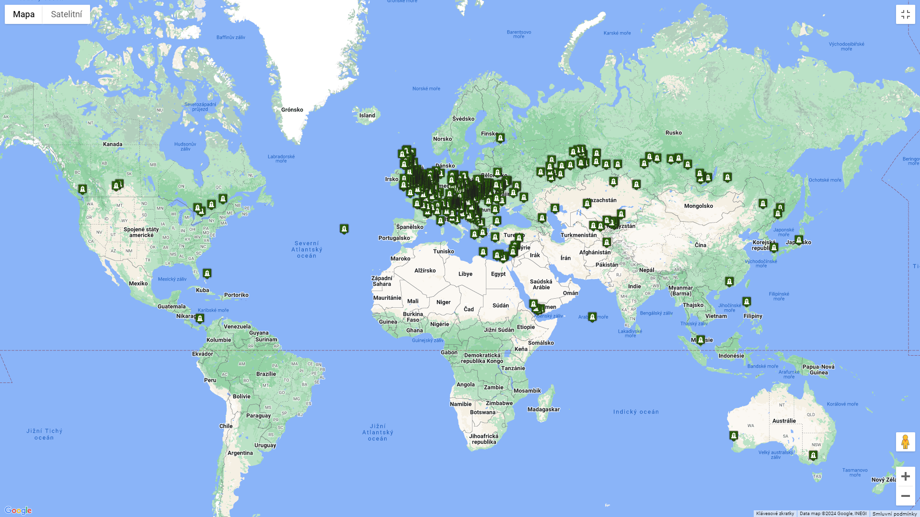
War Graves Register
Czechia 38 719 WG, with 449 582 cassualties
Abroad 4 089 WG (50 countries), with 19 377 casualties

Slide 4
War Graves Register
Abroad 4 089 CWG, with 19 377 casualties
Country | Graves | Fallen
Slovakia | 1095 | 3758
France | 591 | 983
Poland | 534 | 2153
Italy | 464 | 1600
UK | 396 | 640
Russia | 237 | 3464
Ukraine | 201 | 3298
Slovenia | 155 | 516
Belgium | 61 | 62
Hungary | 32 | 73
Germany | 29 | 241
Netherlands | 29 | 58
Uzbekistan | 17 | 965
Austria | 15 | 123
Croatia | 14 | 48
Israel | 14 | 14
Libya | 13 | 15
Serbia | 11 | 422
Kazakhstan | 10 | 94
Bahamas | 7 | 12
Egypt | 6 | 11
Kyrgyzstan | 4 | 33

Slide 5
main categories
main categories divided by individual historical events as follows:
graves originating in wars before World War I – the oldest recorded grave is the commemorative site of king Ottokar II of Bohemia near Dürnkrut, Austria (1278); Seven Years War, Napoleonic Wars, Austro-Prussia War 1866
graves of Austro-Hungarian service members from the territory of the now Czech Republic fallen in World War I (1914–1918);
graves of Czechoslovak legionnaires (1914–1920);
graves of Czechoslovak service members fallen or missing in combat against Hungarians and Hungarian Bolsheviks (1918–1919);
graves of members of the Czechoslovak armed corps fallen or missing defending the state border (1938–1939);
graves of Czechoslovak service members fallen or missing in World War II (1939– 1945);
graves of fallen members of peacekeeping missions (1994–2020)
5

Slide 6
The care of war gravEs - Legislation
Act No. 122/2004 Coll., on War Graves and Commemorative Sites.
Intergovernmental agreements on the care of war graves:
United Kingdom (1949), Russia (1999), Slovakia (2003), Slovenia (2005), Romania (2015). Ukraine (2017), Serbia (2017)
Perspective intergovernmental agreements on the care of war graves:
Kazakhstan, Italy, Germany, Hungary
Resolution of the Government of the Czech Republic No. 427/1999 on ensuring care for war graves in the Czech Republic and abroad.
Resolution of the Government of the Czech Republic No. 1292/1999, on the rules for providing and utilizing subsidies from the state budget for the care of war graves in the Czech Republic and financial donations abroad.
Geneva Conventions of August 12, 1949, on the protection of victims of war and Additional Protocols to these conventions of June 8, 1977

Slide 7
Act No. 122/2004 Coll., on War Graves and
Commemorative Sites.
The Act No. 122/2004 Coll. was passed in 2004
The Act No. 122/2004 Coll. defines two primary categories of war graves:
war graves holding buried human remains
commemorative sites, which are structures without human remains designed to preserve and honour the memory of the fallen
Fundamental principles:
- war graves are tended regardless of their origin or time of creation;
all the fallen are victims of the horrors of war and therefore are not judged by nationality, uniform colour, nor conviction;
the aim of war graves care is to maintain their dignified and recognisable state. War graves care in the Czech Republic is performed mainly by municipalities, which own the majority of war graves;
- war graves care is managed by their owner or, if the owner is not known, the owner of the immovable property on which the grave is located.
7

Slide 8
The position of the Ministry of Defence in the war graves care system.
The MoD is responsible for the coordination of war graves care.
Where there is doubt, decide whether an installation is or is not a war grave
Manage the Central War Graves Registry
Provide grants in accordance with special legislation for war graves care to their owners, or, if the owner is not known, the owner of the property on which the grave is located;
8

Slide 9
Amendment to the War Graves Act planned for 2026
A change to the law is planned in 2026 due to react on the current situation
Some unclear categories:
Czech soldiers killed in modern peacekeeping missions (Persian Gulf; wars in the former Yugoslavia; Iraq and Afghanistan)
Clarification of the category victim of persecution for religious, political and racial reasons in accordance with the Geneva Conventions (concentration camps, Holocaust)
Inclusions of victims of air strikes during the war, death marches, expulsion of Germans after 1945 and occupation of Czechoslovakia in 1968 into war graves care;
Czechoslovak citizens who died during forced labor abroad
Provide financing and realization of exhumations
9

Slide 10
financing
The Ministry of Defense provides 20,000,000 crowns (800 000 Euro) in subsidies each year for the care of war graves in the Czech Republic. The beneficiary is the owner of the war grave (the vast majority are municipalities).
Subsidies are provided through the grant program “Preservation and restoration of historic values I”, which is open for 2020–2029. The process of development of the program documentation reflected the requirement the quantity of discharged applications above 60%.
10

Slide 11
financing
Main criteria for assessing applications:
a) whether this is a war grave with remains
b) what period is the war grave from (World War II is preferred)
c) the cost of building a monument
d) size of the municipality applying for a subsidy (smaller municipalities are preferred)
The Ministry of Defense provides 5,000,000 crowns (200 000 Euro) in the form of a financial donation abroad each year for the care of Czech war graves in other countries.
- The beneficiaries are mainly municipalities and non-profit organizations.
- The donation can be used for the construction of a war grave, reconstruction of a war grave, exhumation and archival and documentation research.
11

Slide 12
Financing - changes planned in the coming years
increase in funds for the care of war graves in the Czech Republic from 20,000,000 crowns (800 000 Euro) to 25,000,000 crowns (1 000 000 Euro)
increase in funds for the care of Czech war graves abroad from 5,000,000 crowns (200 000 Euro) to 8,000,000 crowns (320 000 Euro)
to ensure funding for monuments/memorials related to the military history of the Czech Republic, but which do not meet the definition of a war grave
simplify the process of providing donations abroad for the care of Czech war graves (today the entire process takes about 2 years)
12

