Slide 1
Prague Conference
17 September 2025

Slide 2
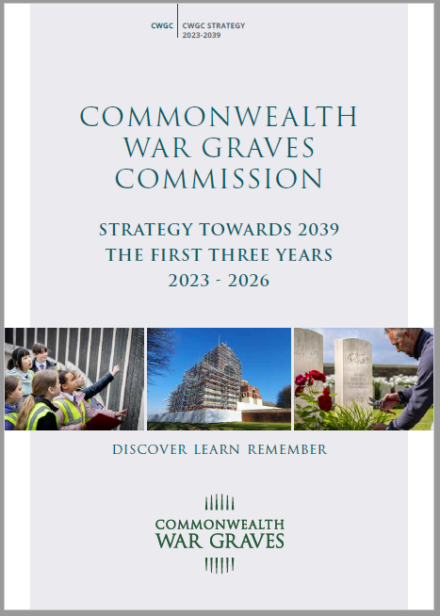
CWGC’s strategic priorities
Caring Sustainably & Safely
Sharing the Stories
Deepening Relations
Review now underway for the next iteration

Slide 3
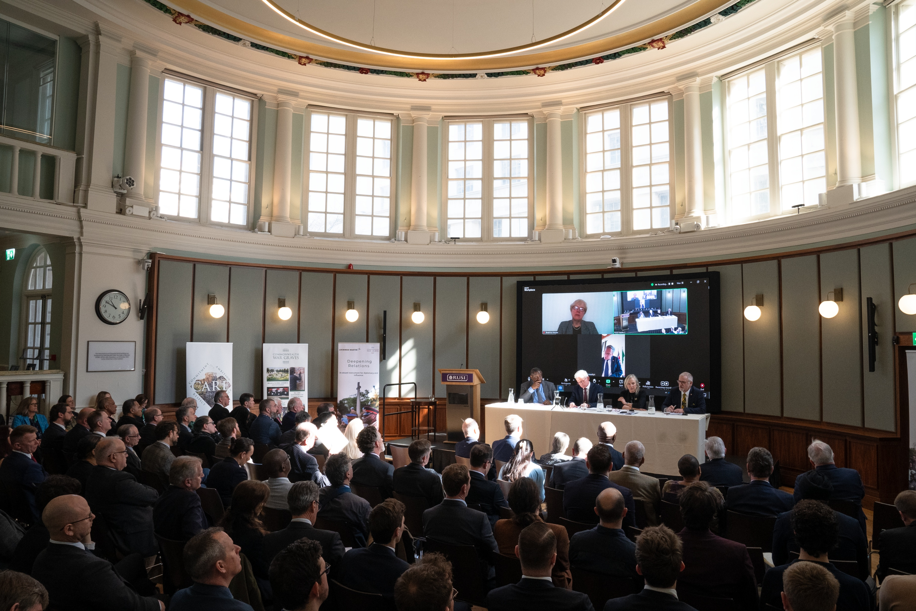

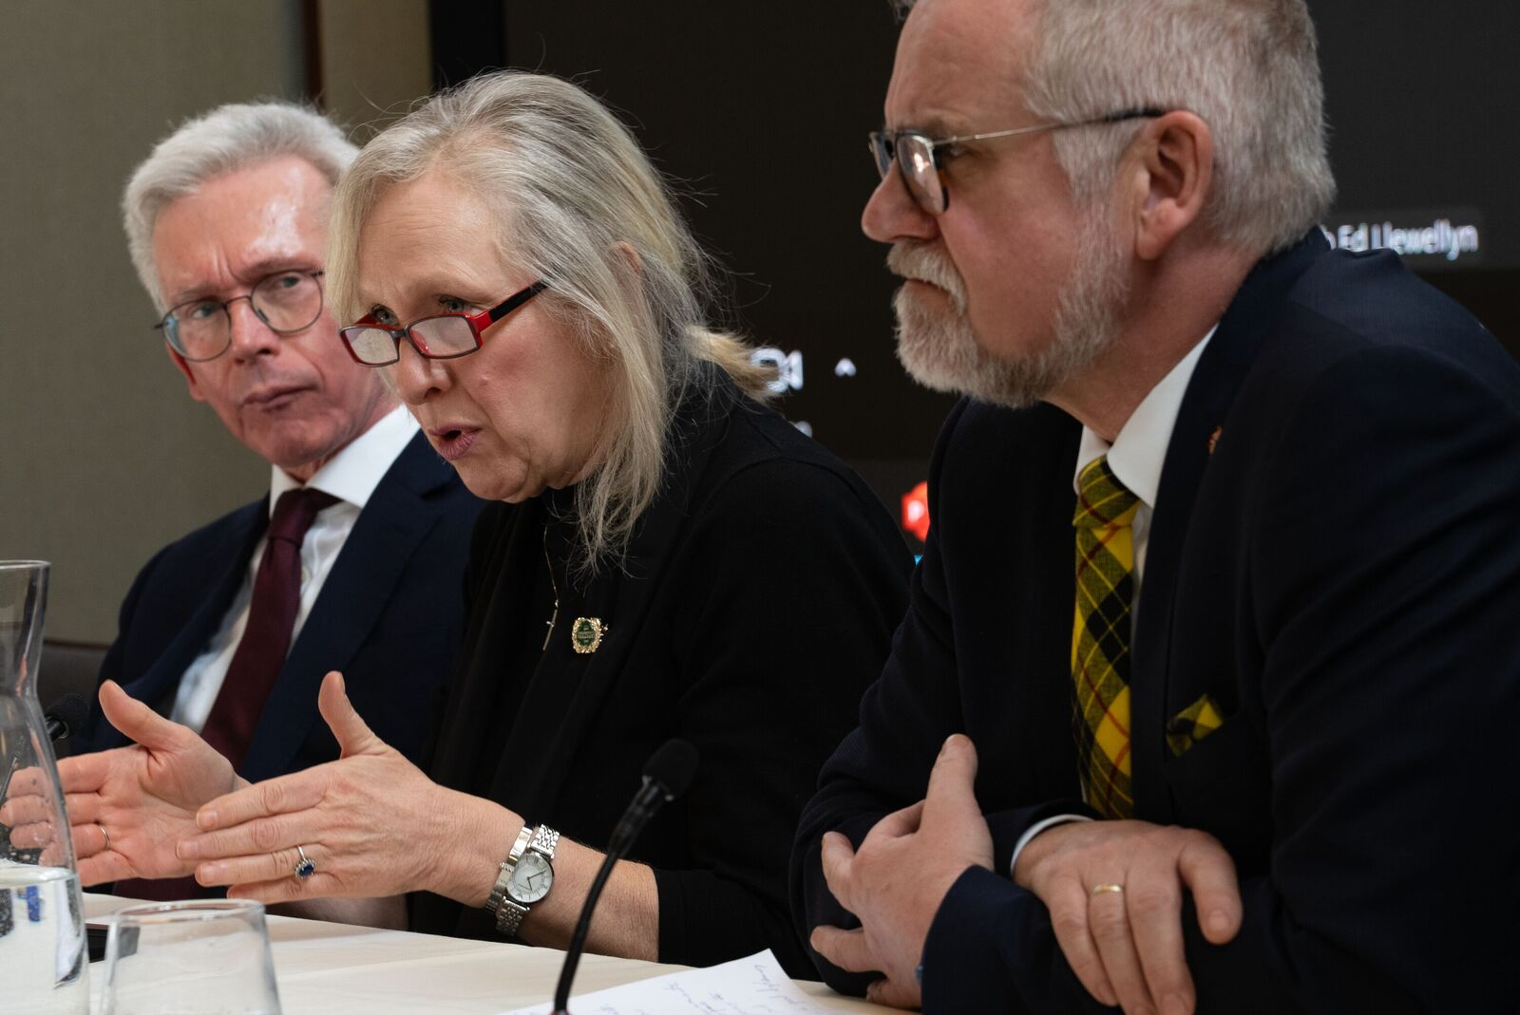
The Role of Commemoration in Diplomacy
Why should we commemorate the casualties of war?
Event at RUSI March 2025
Themes arising from discussions
  Commemorations and diplomatic relations in a post-colonial world
  Contested memory and diplomatic tension
  Soft power and historical narratives
  The role of digital commemoration
CWGC academic partnership with the University of Chester

Slide 4

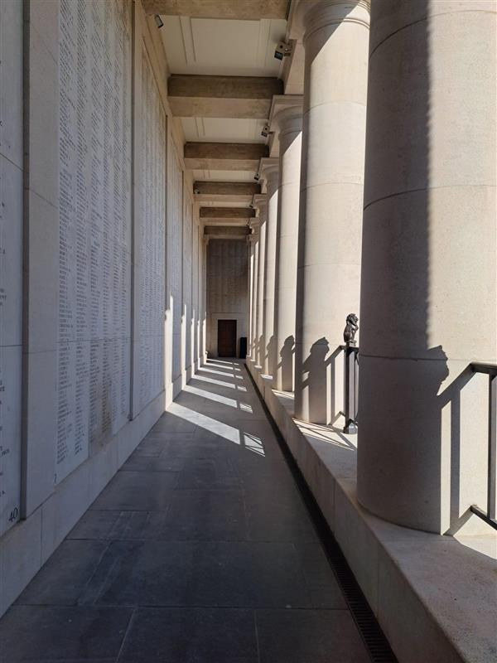
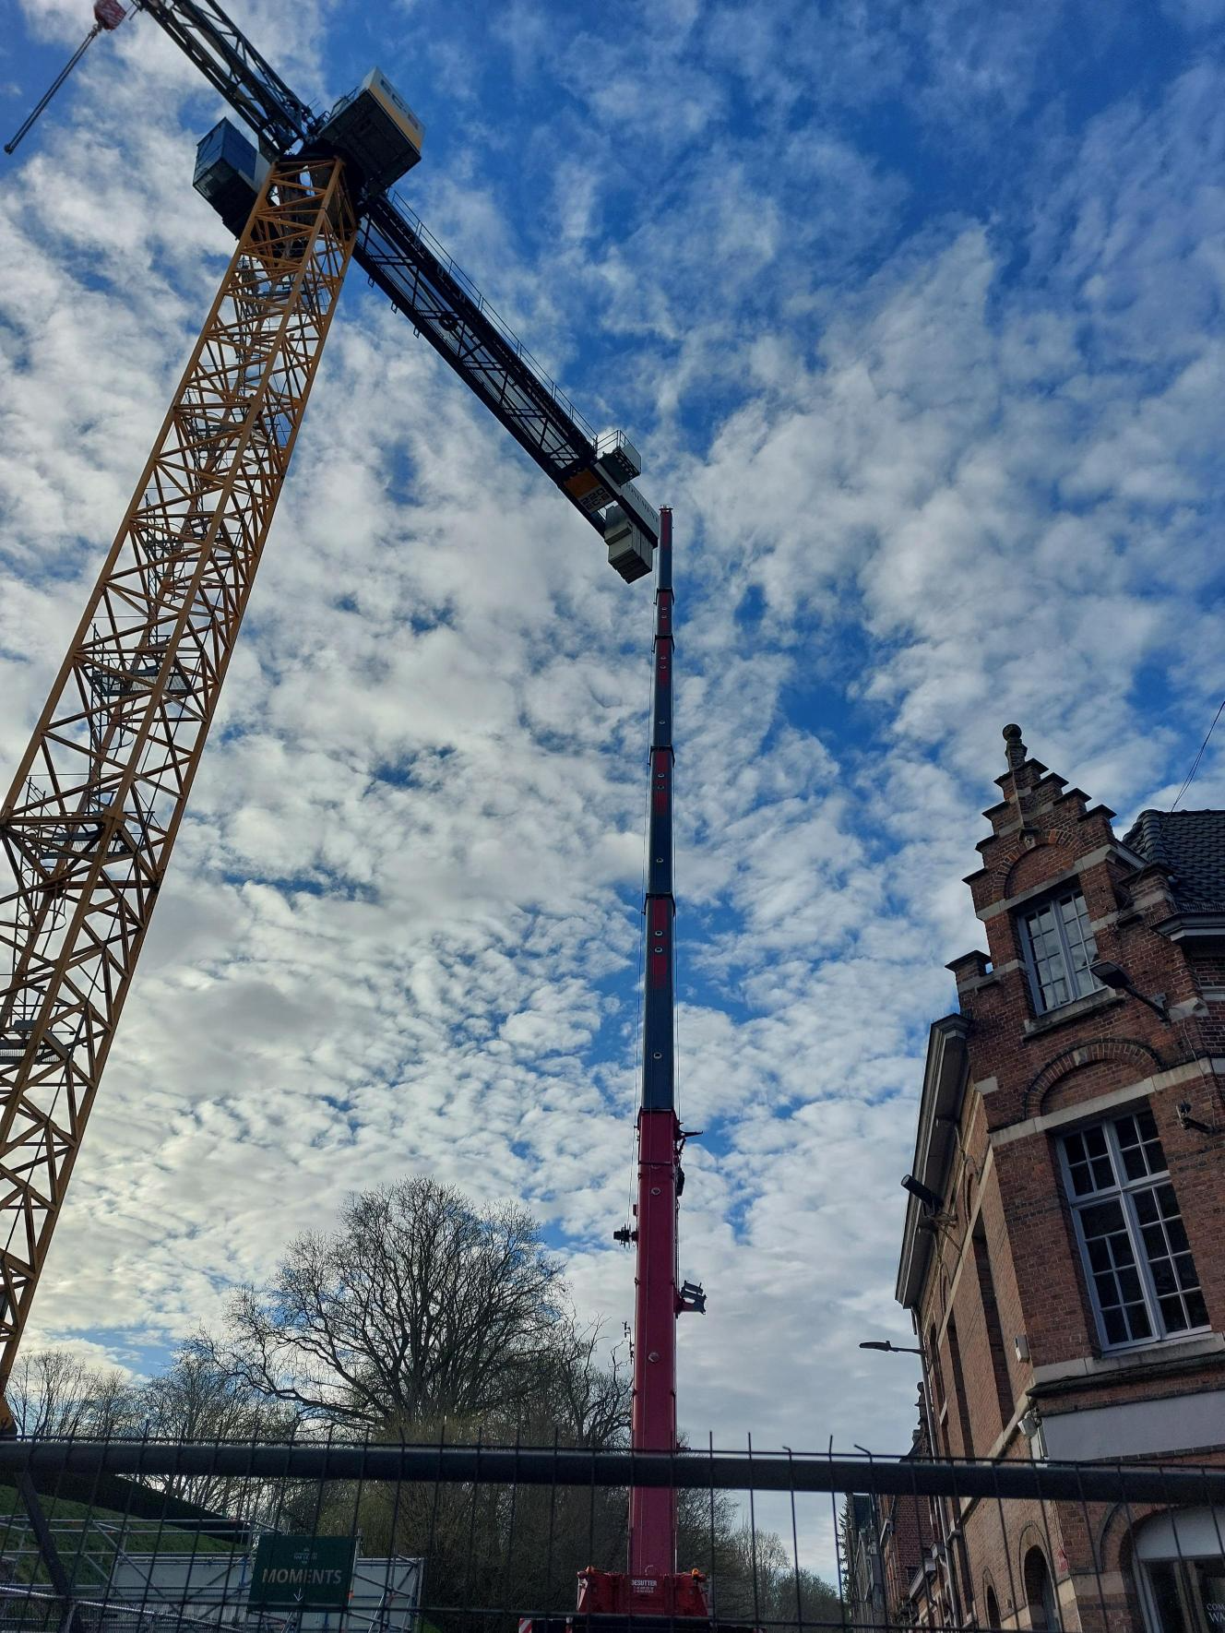
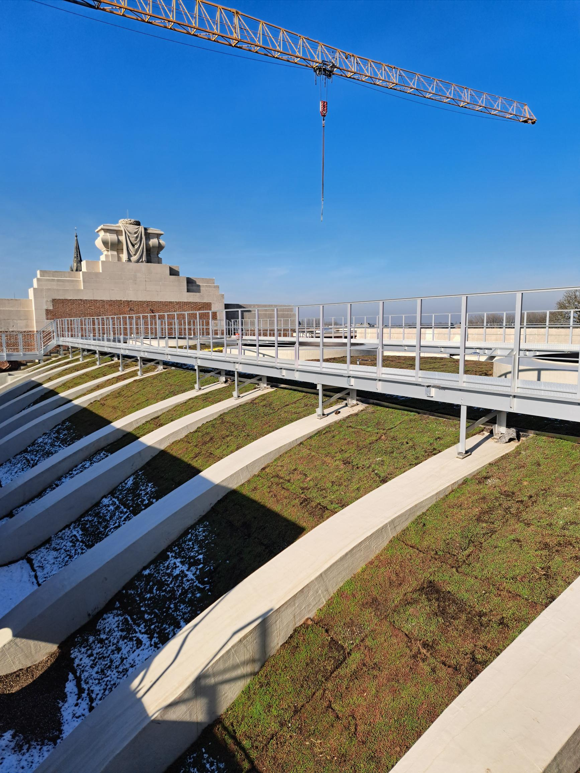
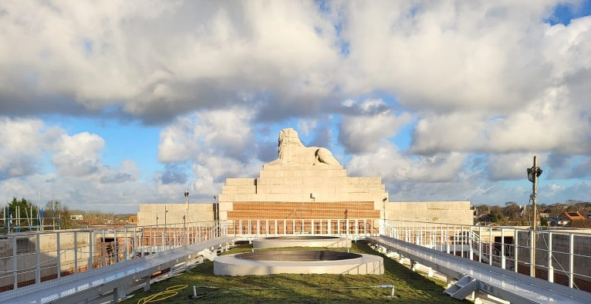
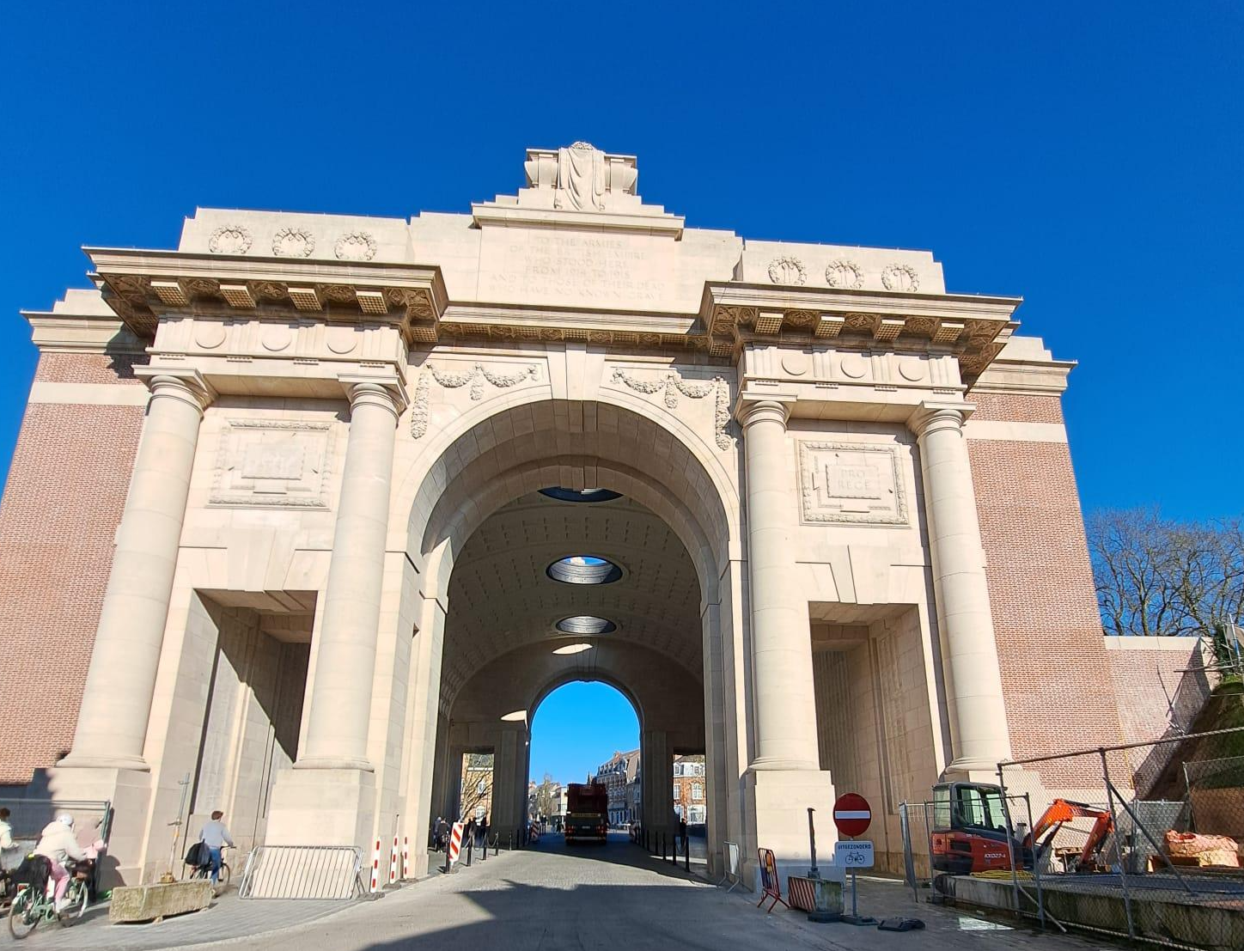
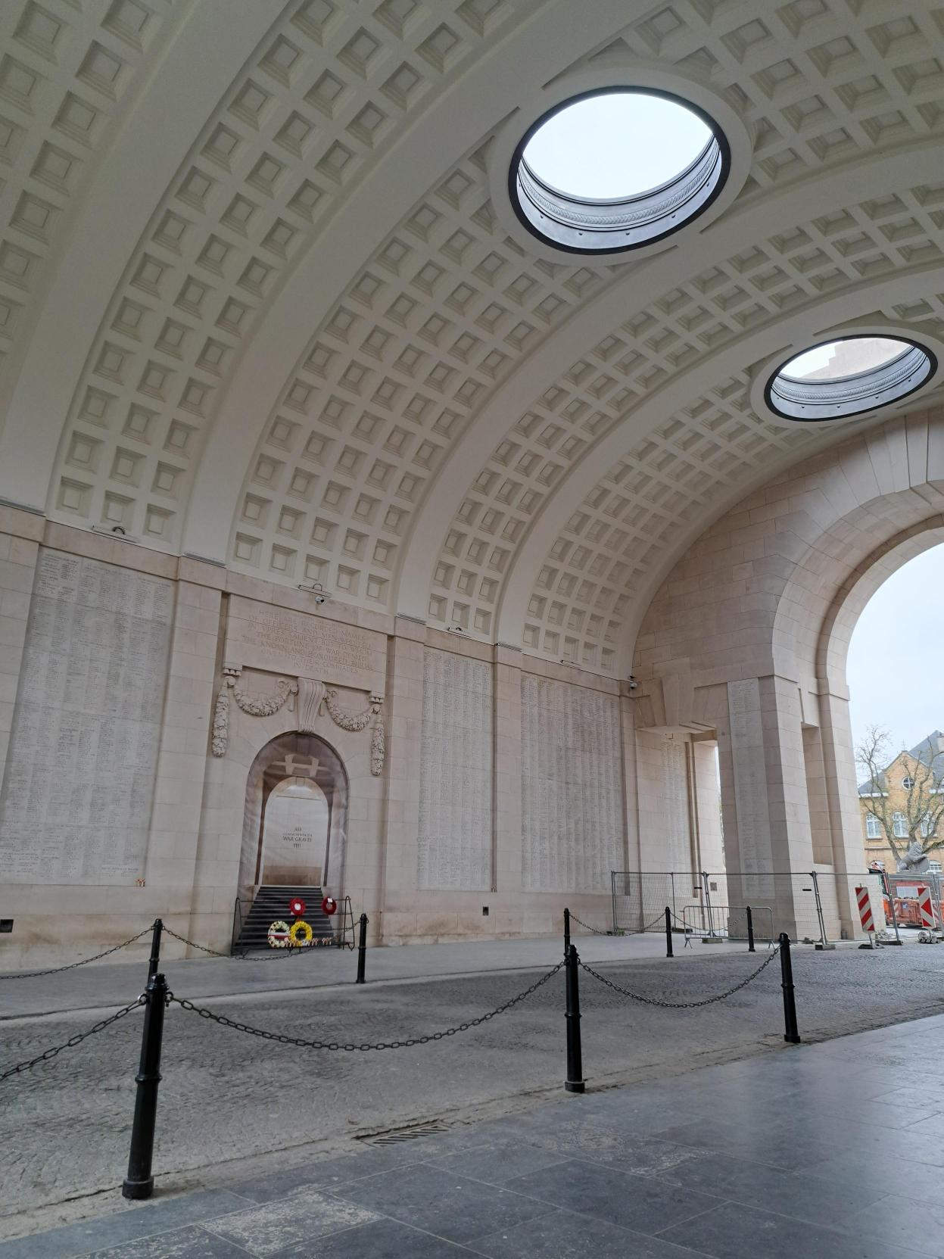
Menin Gate
Most visited CWGC memorial
Inaugurated in 1927
Last Post every evening at 20h00
Inscribed on UNESCO World Heritage List
54,000 names commemorated
2 year restoration campaign
Vault, façades and name panels cleaned and restored
Roof repaired and living roof installed
New lighting system in place
Official opening on 7 July 2025

Slide 5
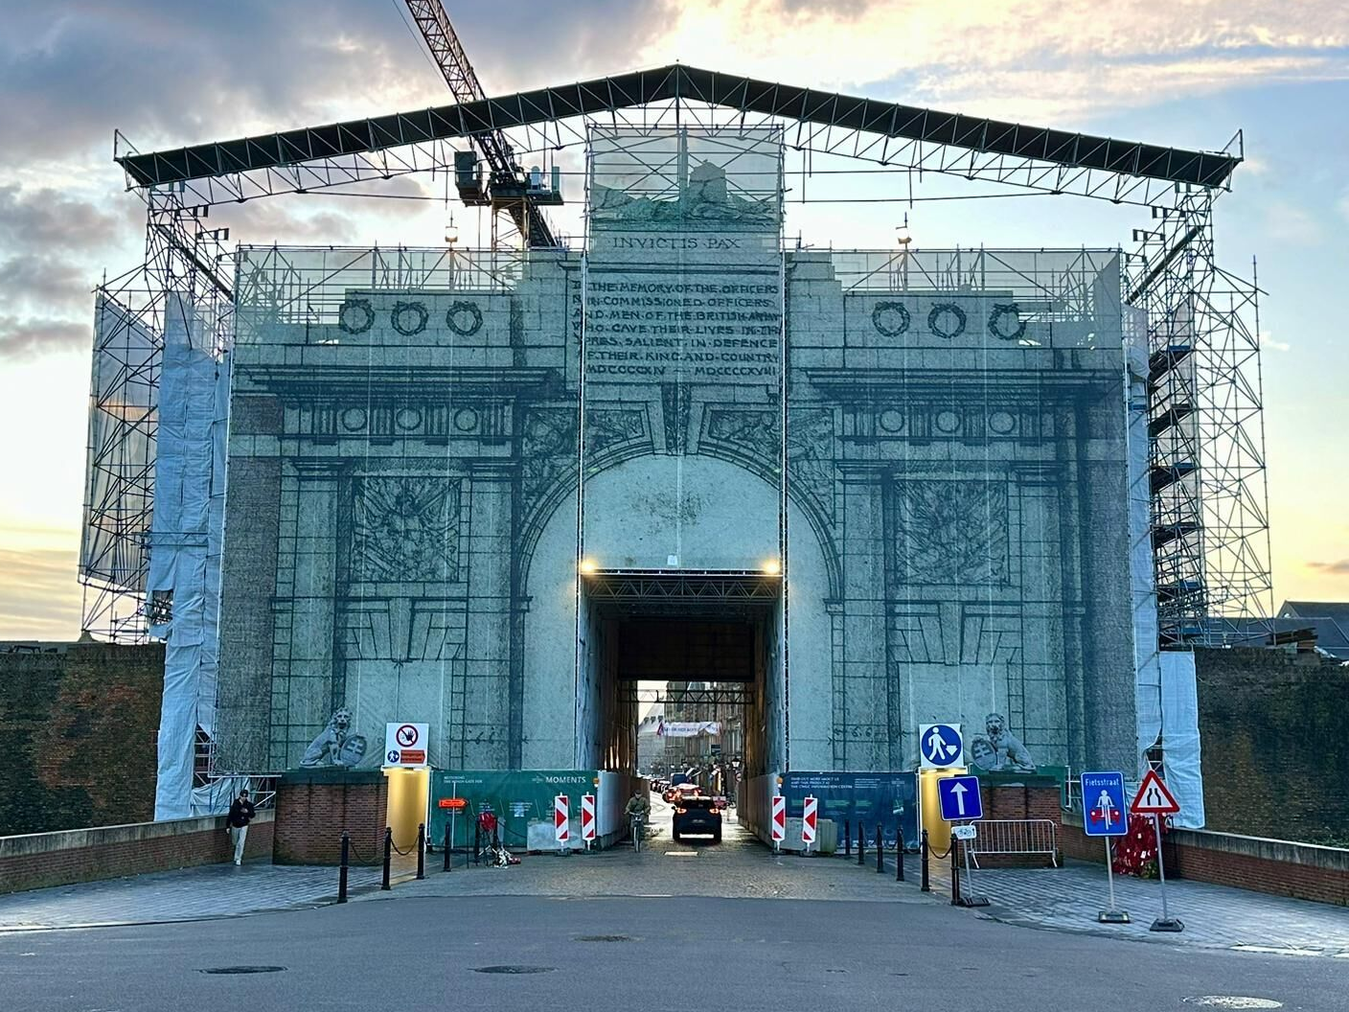
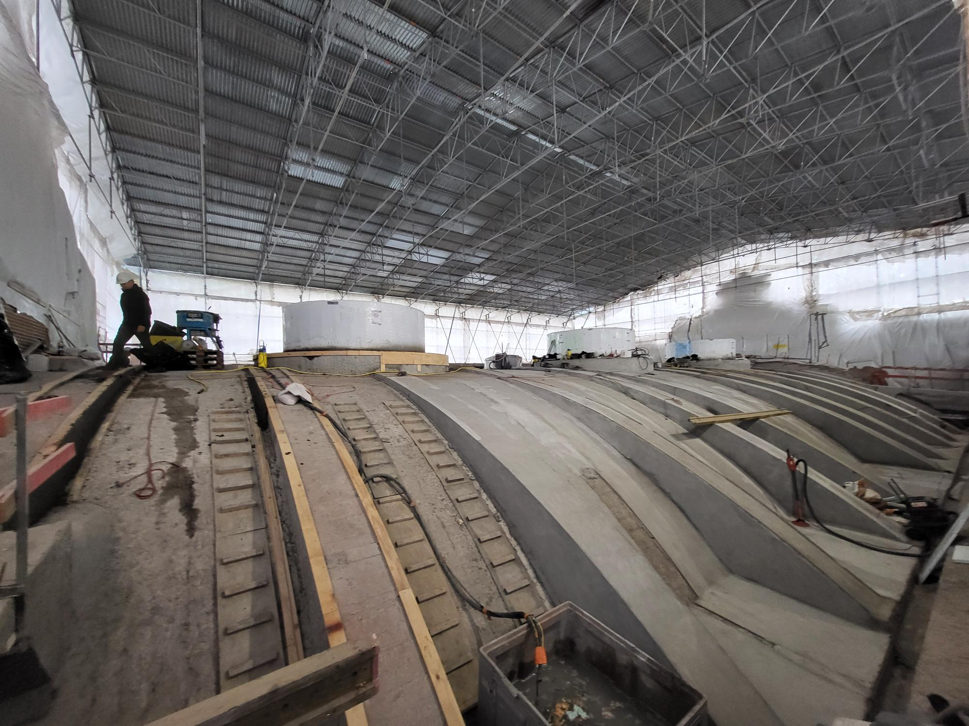
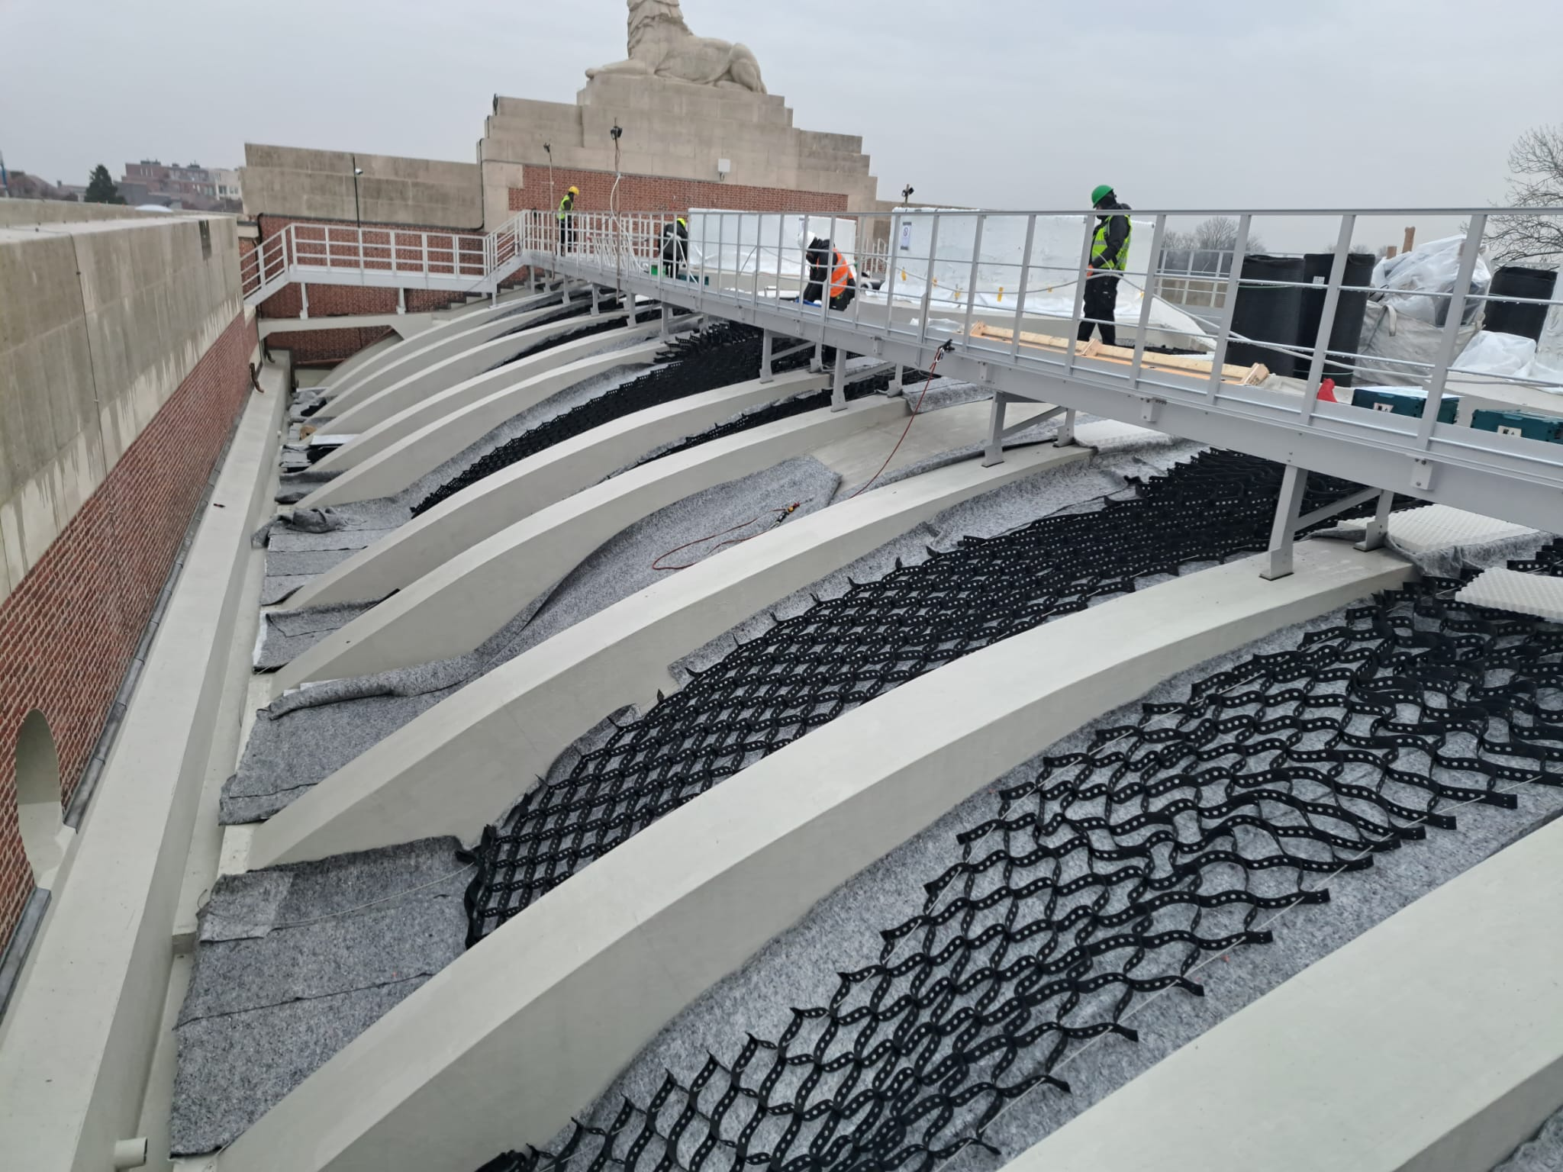
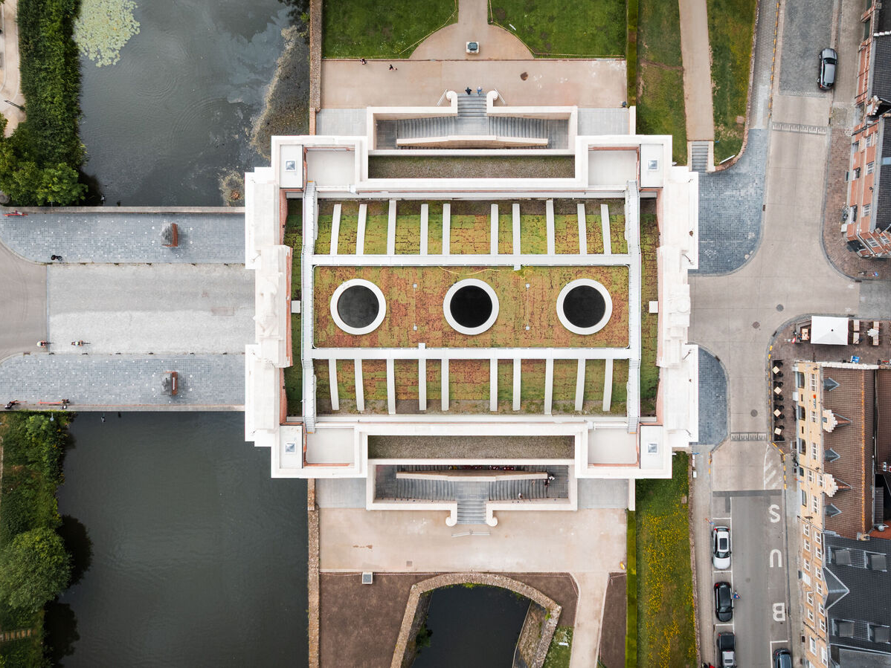
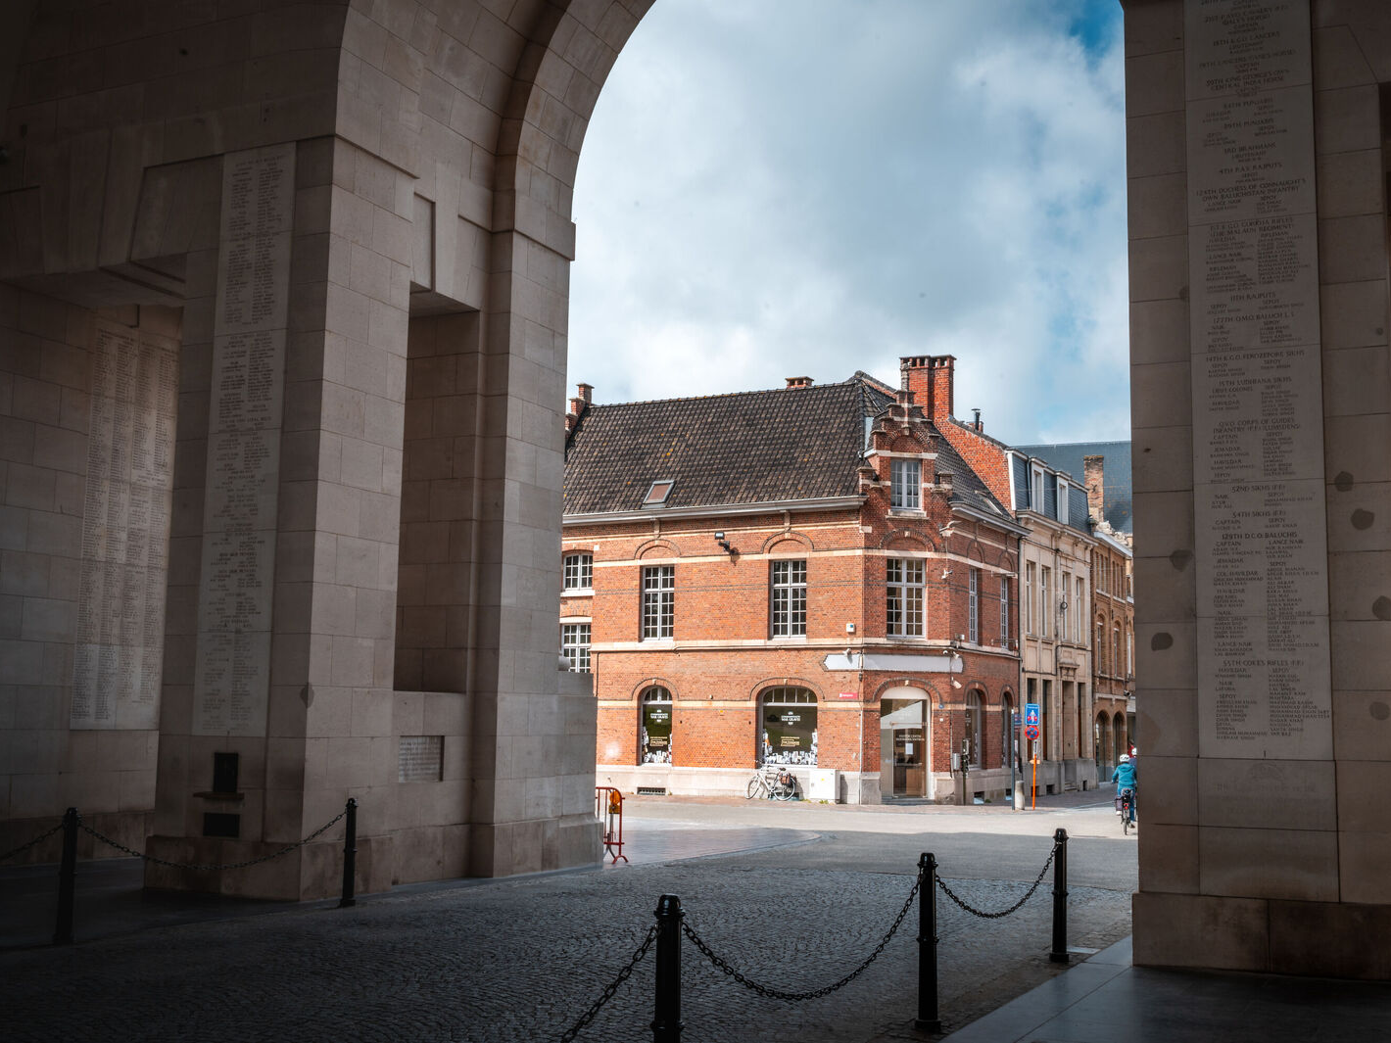
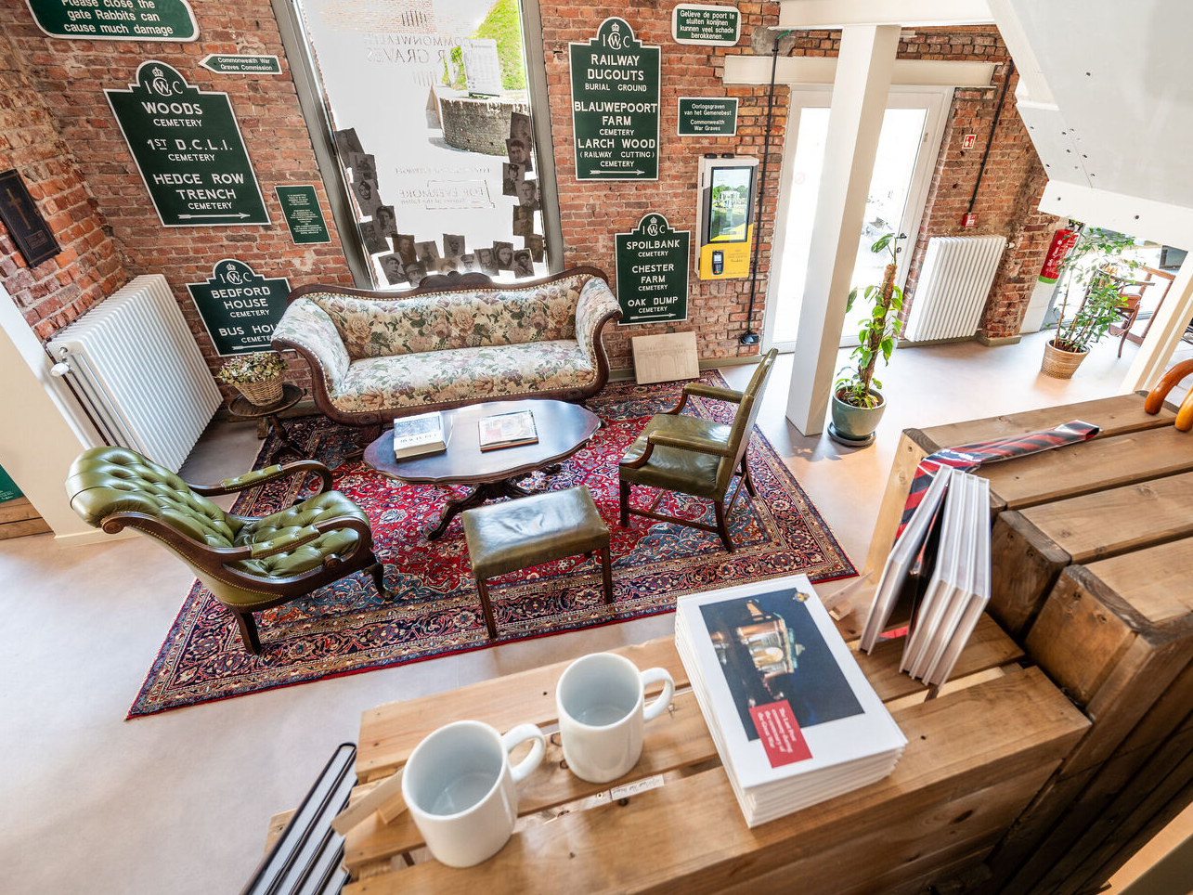
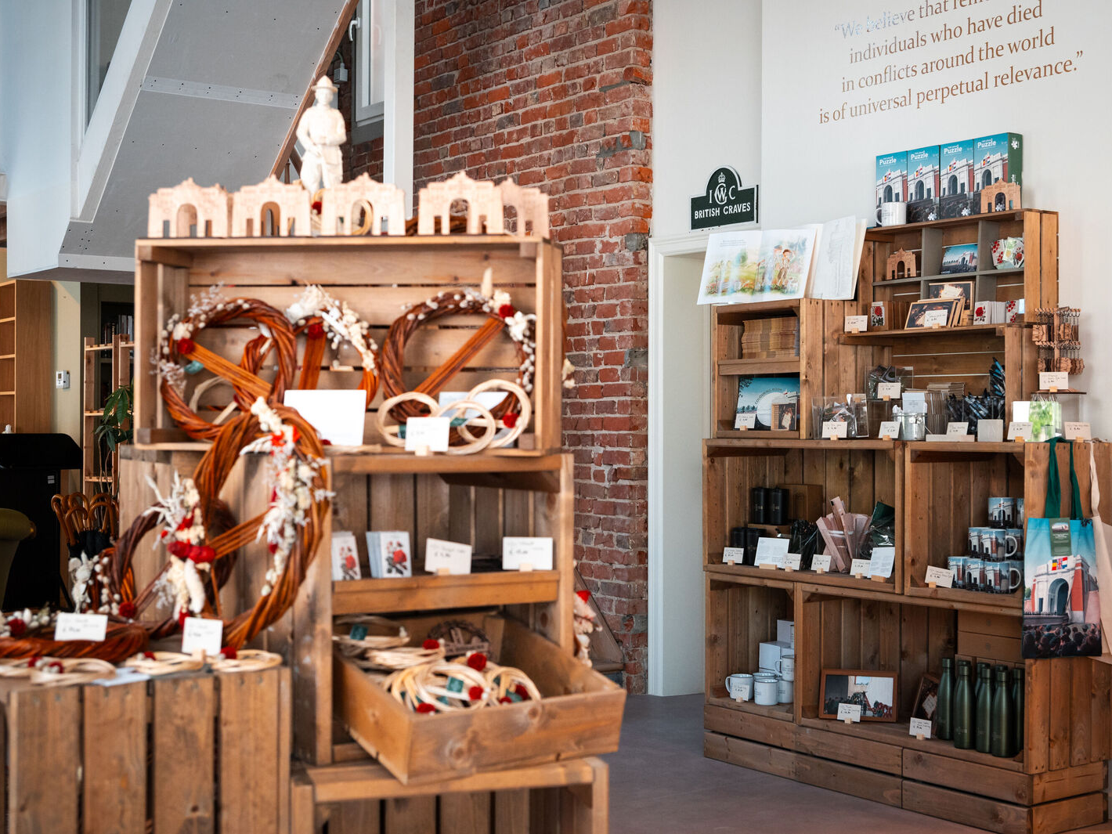
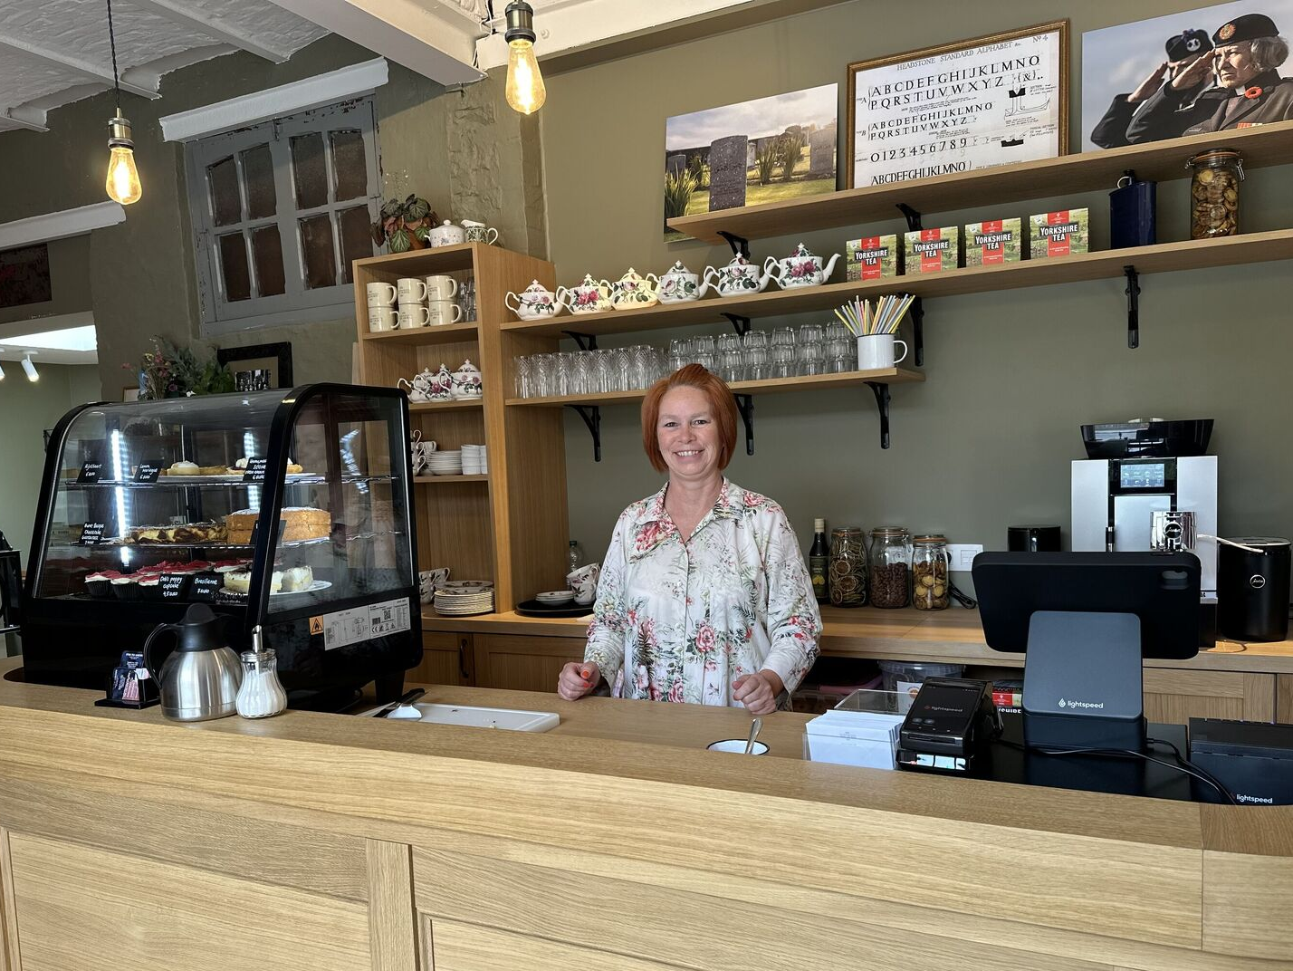
Menin Gate and Visitor Centre in Ypres

Slide 6
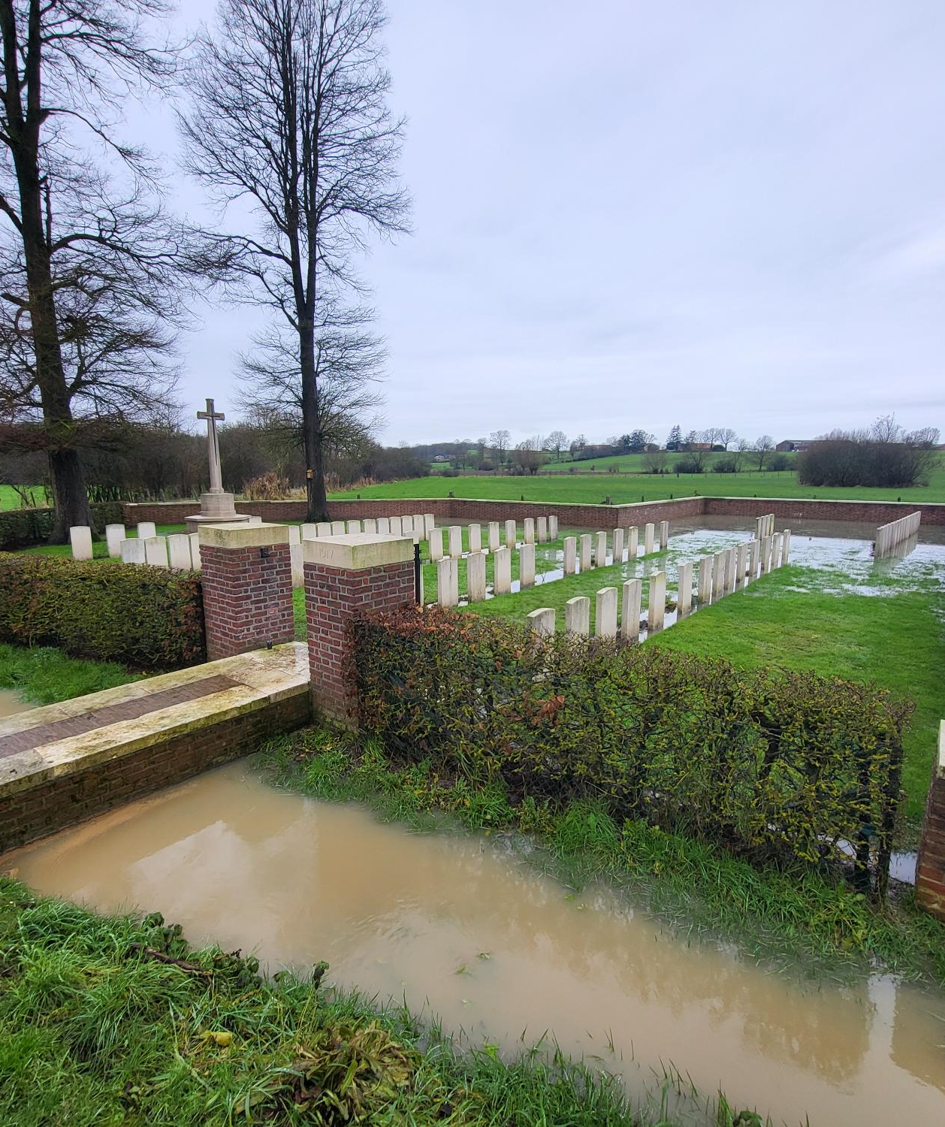
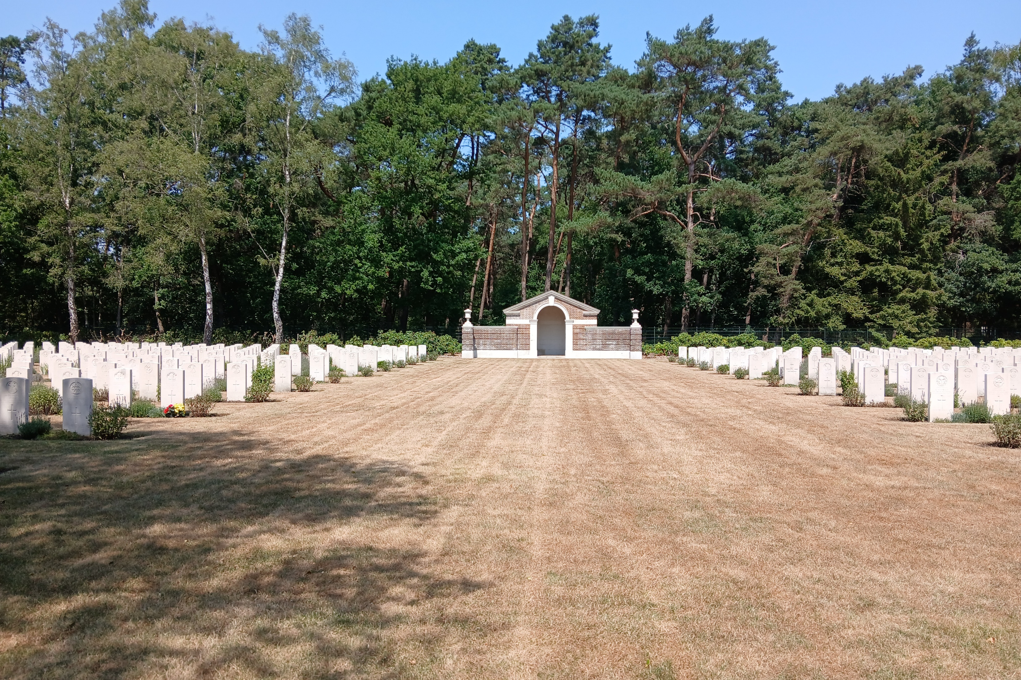
Extreme weather patterns: Benelux countries
Difficult working conditions for staff: cold and very wet – September 23 to February 25
Some cemeteries were hardly accessible because soils were saturated with rainwater
Dozens of sites in same situation in Ieper Salient (Belgium) through combination of weather conditions and soil structure (clay)
Difficult working conditions for staff: hot and very dry from February to August 25.
Sites with sandy soil structure in Belgium and the Netherlands subject to drought
Sustainability: no irrigation policy
Need to adapt work patterns to weather conditions

Slide 7
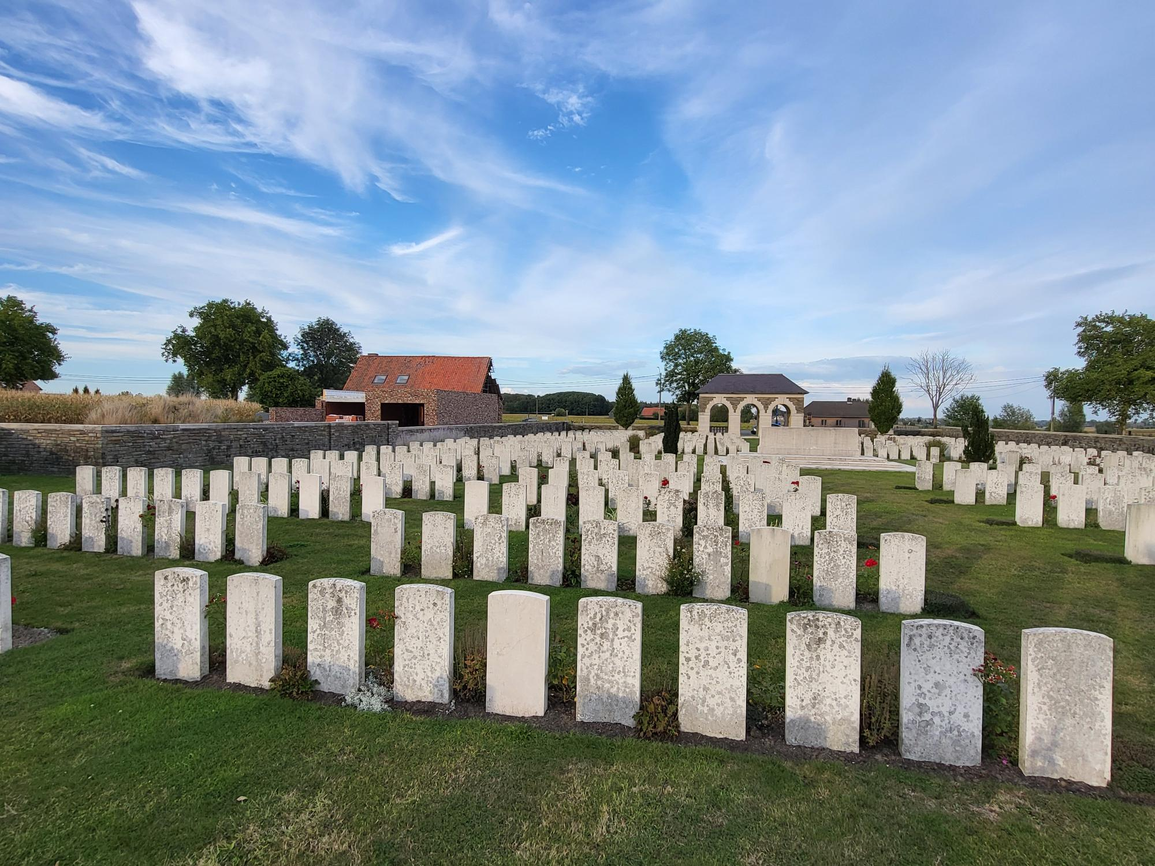
Headstone cleanliness
150,000 headstones in the Ieper Salient
No use of biocides (amonium based) since 2019
Use of enzymes instead
Strict local regulations in Belgium
18 months of rainy weather conditions (September 2023 to February 2025)
Tests ongoing to remove black staining (lichens)
Further research with partners
Similar issues in Northern France only
HS inspection app
5 yearly K2 survey
PQMS

